Slide 1
Political and Military Leadership of the American Revolution
Dr. Nick Noppinger

Slide 2
Myths
I. Great Britain Did Not Know What It Was Getting Into
II. Americans Of All Stripes Took Up Arms Out Of Patriotism
III. Continental Soldiers Were Always Ragged And Hungry
IV. The Militia Was Useless
V. Saratoga Was The War’s Turning Point
VI. General Washington Was A Brilliant Tactician And Strategist
VII. Americans won the war by using guerilla tactics.
VIII. The War Was Between the Colonists and the British
XI. Except for a Few Loyalists, Most Americans Fought for Liberty
X. The Militia was Effective

Slide 3
Points of Discussion
  The Kentucky/Pennsylvania Rifle and the exaggeration of American marksmanship.
  The myth of British tactical rigidity.
  The Revolution was really a Civil War.
  The British couldn’t win.
  The Minutemen were a relatively well trained force. However the history of the militia system was one of extreme readiness followed by benign neglect.
  The brutality of the war was not one sided.
  After France entered the war it became a World War
  Linear Warfare

Slide 4
A Republican Army
American and British political philosophers knew history and had suspicions of permanent standing armies.
Unlike today they viewed professional regular armies as an anathema to freedom rather than protectors of freedom
Our modern view would seem absurd
They knew leaders generally turned the armies on its own more often than using them against external threats.

Slide 5
Historical precedents
Ancient Rome
Marius Vs Sulla, Roman Civil Wars
Numerous usurpations during the Empire
Medieval period
English Civil War
Cromwell turns the army on parliament

Slide 6
A Republican Army
Ancient Greece, under the polis, and Early Republican Rome were the ideal.
An army of citizen soldiers that have a stake in society
Eschewed military professionalism
The constant struggle between the Republican ideals and military pragmatism.
Nationalists vs republicans.

Slide 7
Ages of Warfare
Distant Past-3500BC-Age of Chaotic War
3500BC-1500BC- Primitive Armies
1500BC-800BC-Age of Chariots/Heroes
800BC-450AD-Age of Heavy Infantry- The end of professional warfare, exception Byzantine Empire
450AD-1300AD –The Dominance of Armored Cavalry
1300AD-French Revolution-The return of the infantry, rise of professionalism. The Trace Italienne
French Revolution- now- Modern Warfare- we are currently in its 4^{th-5th} generation- WW2 was 3rd Generation

Slide 8
Avoid oversimplification
Considerable overlap
Other forms of warfare did not disappear
There are exceptions to every rule!!!!
Hard to understand Linear/Trace Italienne System warfare without the background

Slide 9
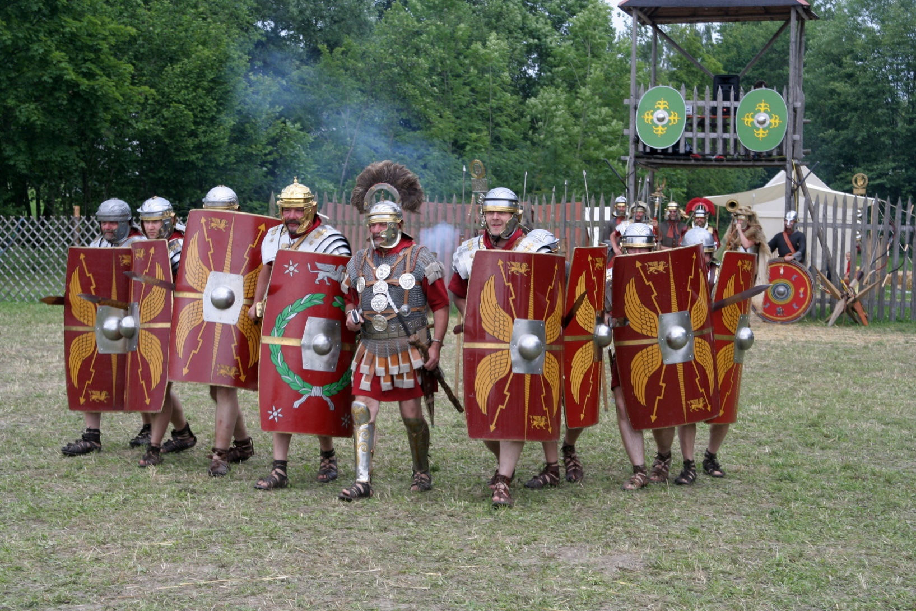
Heavy Infantry

Slide 10
450AD-1300AD –The Dominance of Armored Cavalry
Disappearance of standing armies outside Byzantium
Upper classes augmented by lower class retainers that are professional in skill. Military ranks are not permanent. Armies are ad hoc. Individual skill professional, higher levels a certain amount amateurism.

Slide 11
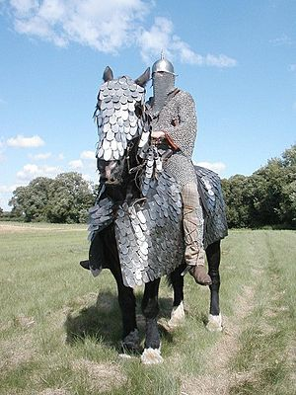
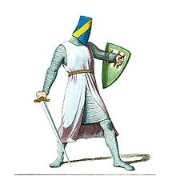
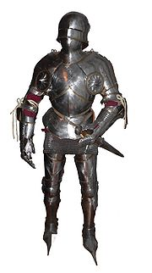

Slide 12
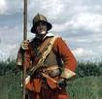
The Military Revolution ?
AKA as the Infantry Revolution or Gunpowder Revolution , from appr 1300AD
The change occurred gradually from appr 1350’s (Crecy 1346 [a convenient starting point]) to the present day.
Swiss Pikemen and German Landsknechts
Discipline and an arms race
Geoffrey Parker, Michael Roberts
Kelly DeVries, Jeremy Black, Chris Duffy
DEMOCRATIZES WARFARE

Slide 13
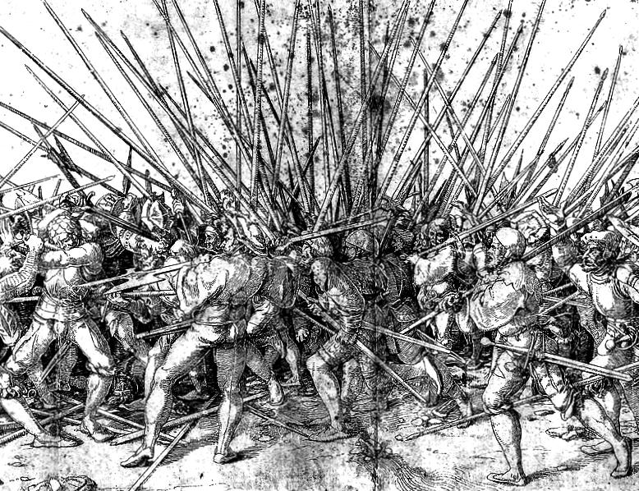
Pike Warfare

Slide 14
The Military Revolution
Caused by the rise of the nation state? Or it caused the nation state? Or incidental?
Gunpowder/pike mix starting at 10 plus in favor of the pike, gradually shifting to one to one and then elimination of pike altogether with adoption of bayonet
Spanish Tercio’s and the return of military professionalism to the West

Slide 15
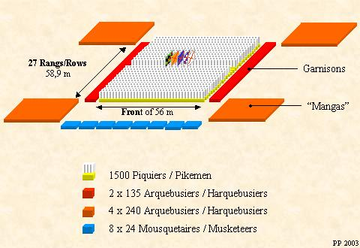
Spanish Tercio 50/50 split

Slide 16
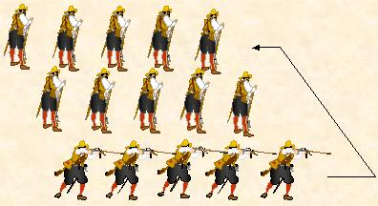
Spanish Tercio (Articulation of the Manga)

Slide 17
Tercio
Will dominate until 1600
It will still be important until the Battle of Rocroi 1643
Copied and improved by others

Slide 18
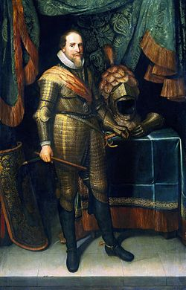
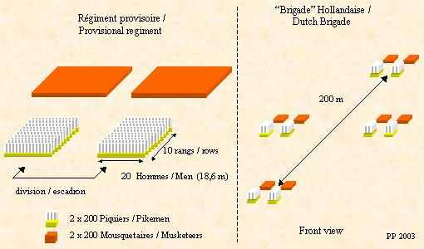
The Dutch Response 50/50 split

Slide 19
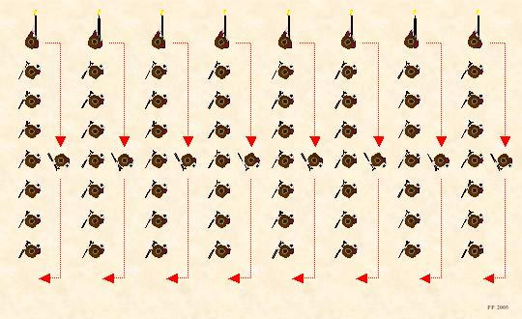
Articulation Dutch Model
Fire by File

Slide 20
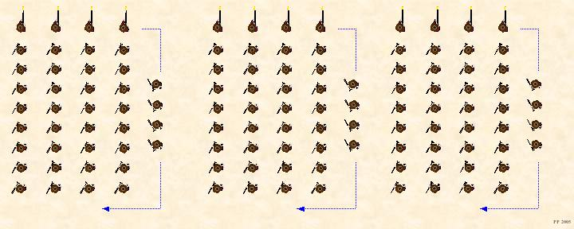
Articulation Dutch Model
Fire by Rank

Slide 21

Articulation Dutch Model
Fire by 3 rank volley

Slide 22
Dutch System of Warfare
Not a coincidence that it was in the most “republican” of European states.
Military technology and culture influence societal aspects and vice and versa.
Religious freedom, and other freedoms that we take for granted today.

Slide 23
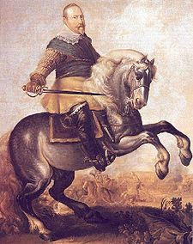
The Swedish Influence Gustavus Adolphus

Slide 24
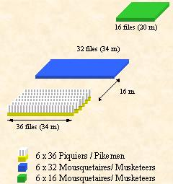
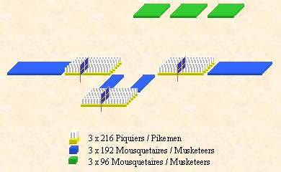
The Swedish System-the Development of Linear Warfare
Tactical deployment of a Swedish Brigade with 3 ½ regiments and numbered 328 Officers and 1512 privates (648 pikemen and 864 musketeers).

Slide 25
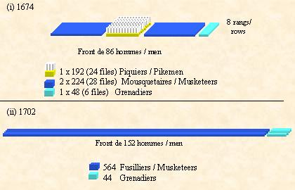
Louis XIV

Slide 26
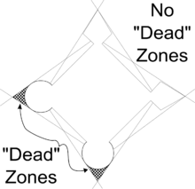
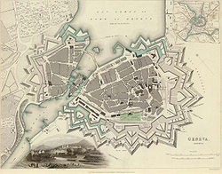
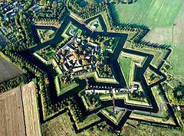
Trace Italienne

Slide 27
Thirty Years War
Westphalian Nation state 1648
The culmination of the new professionalism
The proliferation of military studies.
Standing armies
Aristocratic officers
Scum of the earth dregs as lower ranking soldiers, excess population
The rise of the magazine system
Limits on war
Wars usually over peripheral territories

Slide 28
The Military Revolution Paradox
Gunpowder and pike democratized warfare
Yet Continental Europe though having militias, actively discouraged the arming and war training of the masses.
However the genie was out of the bottle.
Handling a musket and fighting in linear tactics requires training to do well, but it does not require the incessant training of old knightly warfare.
England retains a better organized militia system, out of fear of a large standing army. Longbow, etc.

Slide 29
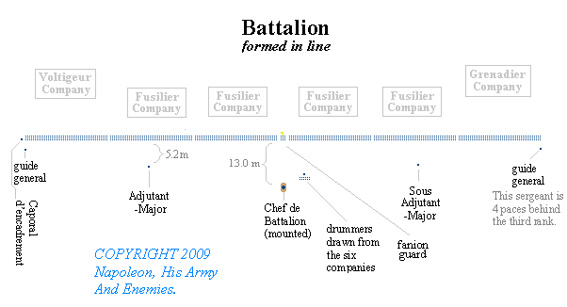
Linear Tactics
Bayonet, Plug, socket, ring-late 17th Century
2 or 3 ranks deep Pikemen disappear
European Dominance

Slide 30
Linear warfare
Was the best method of command and control over the types of troops and the weapons available to the 18th Commanders.

Slide 31
Le Petite Guerre
We did not beat the British by fighting Indian style.
We beat them by creating a European style army.
We did, and so did the British and Loyalists use le petite guerre.
Europe had a long history of irregular warfare.
The Indians were respected and feared as raiders, but were NOT feared as soldiers.
The British Army was a pioneer in light infantry tactics and rifle units.
The British Army will adapt to the North American environment.

Slide 32
North America
Colonial War against Indians
Petite Guerre-Little Wars
Raids, hostages, scalping, burning villages, massacres of women & children, crop destruction, ambushes
Indian vs Indian battles relatively bloodless. Indians thought European Warfare was barbaric.
Indians reluctance to fight the Europeans way
Small units of Rangers or light infantry
Ranger type tactics and units from earliest Colonial period

Slide 33
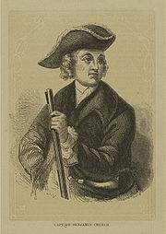
Ranging or Rangers
The Father of American ranging Col Benjamin Church 1675
Light infantry tactics
Ambushing, etc
Colonies begin paying for scalps

Slide 34
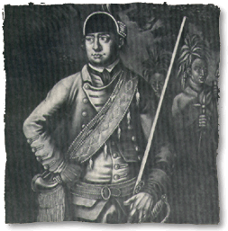
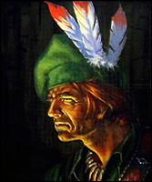
Robert’s Rangers
Rules of ranging
Most famous Ranger

Slide 35
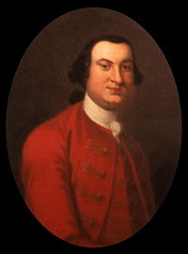
Henri Bouquet
Lt. Col of the 60th Rifles Royal American Regiment
5th Btn formed as a light infantry ranger style unit 1756
5th Btn conducted long range recon/ambush style warfare.
Arguably more successful, certainly more disciplined than Rogers Rangers

Slide 36
Militia System
All able bodied men age 17-60
American system based upon the English Elizabethan system of 1572.
Provide own uniform and equipment (including musket or rifle)
Every household must own a firearm
Muster at least once a month, service limited to 90 days in their own colony
As frontier moved further into the interior, the militia system was subject to neglect

Slide 37
The Pennsylvania Rifle
Not the Kentucky Rifle
Unreliable- too many calibers- overly sensitive to black powder residue.
The story goes of numbers of Americans armed with rifles, hiding behind trees picking off the stupid red coats.
Nothing could be further from the truth
Rifles were used, but Washington in a general order limited, by disbanding rifle units, to no more than 1000 or 1 man in 3-4. Washington preferred smoothbore musket armed troops

Slide 38
The British Army
Fact- The British Army has experienced light infantry and ranger type units (William Howe) Queen’s Ranger’s, etc
Fact-The British enjoyed a better relationship with the Indians with several officers going native.
Fact-The British had rifle units including the first operational breech loading rifle.
Fact- European Armies had a long history of rifle units and ranger type tactics (British used them in Ireland at least as early as 1640’s)

Slide 39
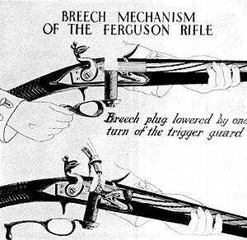
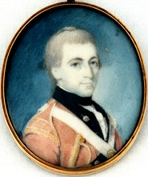

Slide 40
French and Indian War
Indians were highly unreliable
Prone to leaving when the campaign got tough
The French and Indian War was mostly won by conventional forces using conventional European tactics with slight modifications to North American environments.
Light infantry, like Robert Rogers, are important, but tend to be overrated in American histories of the war.

Slide 41
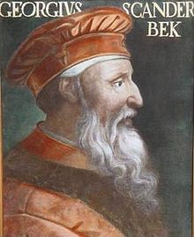
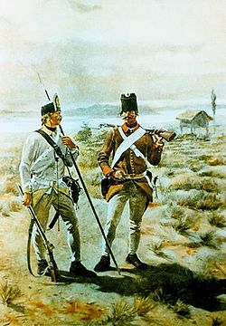
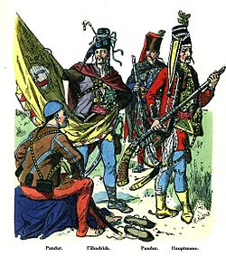
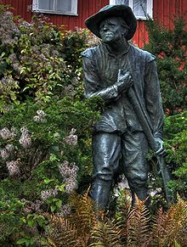
Grenzer’s, Jagërs, Geuzen, Snapphane, and Pandur’s

Slide 42
Geo-politics Great Britain
Intimidate the colonies
Had revoked a Colonial charter before-Massachusetts Bay Colony
The problem with looking at history backwards
We see the British as incompetent, corrupt

Slide 43
The Cause
Colonies were fighting for their rights as Englishmen under the auspices of Enlightenment and Christian principles.
Founding ideas were firmly based in English philosophical and legal principles, as well with influence from others.

Slide 44
British policy-17th century – mid 18th century
SALUTARY NEGLECT
  Britain didn’t pay close attention to the colonies.
  Colonies largely governed themselves.

Slide 45
Early Conflicts
King William’s War (1689-1697)
Queen Anne’s War (1702-1713)
King George’s War (1744-1748)
Peace settlements not always to the benefit of the Colonies
Albany Plan of Union (1754)
Early attempt at Union of the Colonies
  Proposed by Benjamin Franklin
  Confederation, focused on defense
  Rejected by Parliament and colonial legislatures

Slide 46
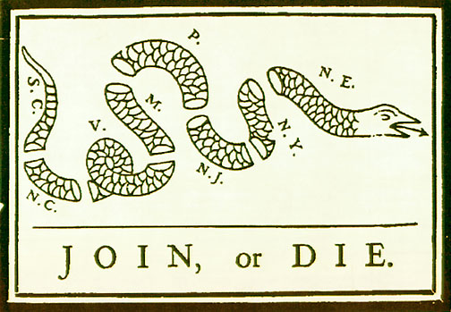
“The Colonial Response: Events Leading to the American Revolution”

Slide 47
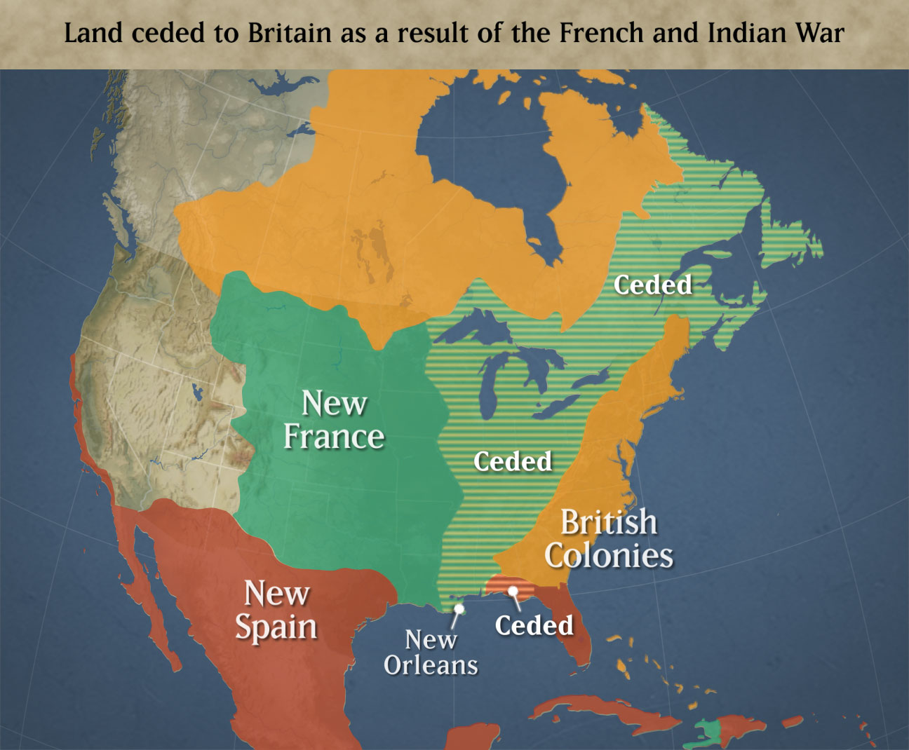
French & Indian War (Seven Years War)

Slide 48
MERCANTILISM
Economic relationship between a mother country and her colonies that enables the country to control the trade of the colonies
Colonies sent raw materials to England
England would manufacture and sell back to colonies

Slide 49
MERCANTILISM
Navigation Acts 1650-1673
  Any good traded by the colonies had to be carried on an English or Colonial Ship
  All goods exported by colonies first had to pass through England and be taxed
  Specific goods could only be sent to England

Slide 50
MERCANTILISM
IMPACT
Positive
  New England shipbuilding prospered
  Chesapeake tobacco farmers had monopoly on British trade
  Protection from England
Negative
  Limited manufacturing
  Low price for crops
  High prices for manufactured British goods
Enforcement
  Navigation officials in charge, but known for corruption
  Led to smuggling

Slide 51
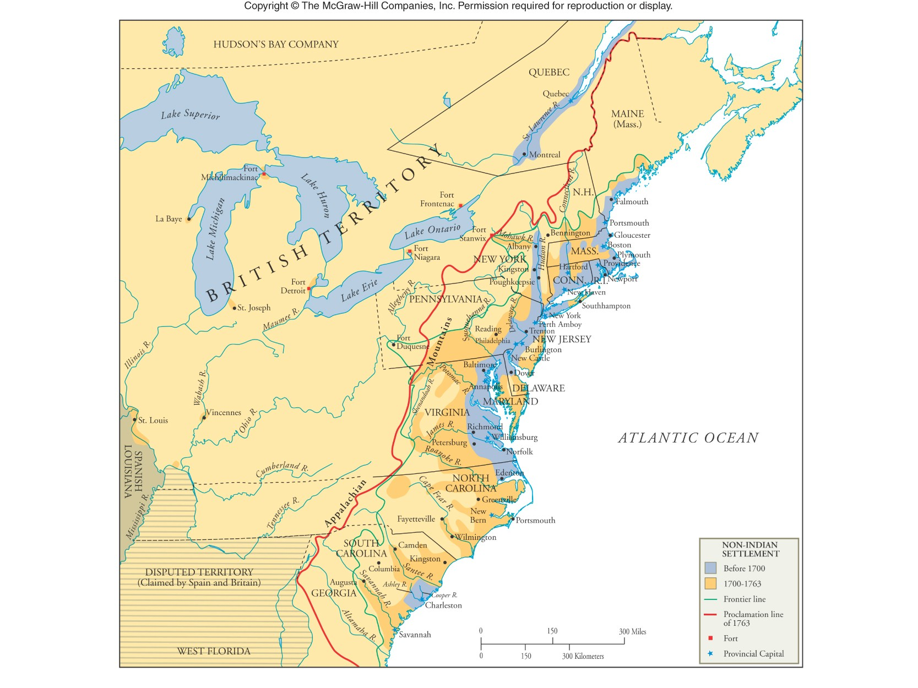

Slide 52
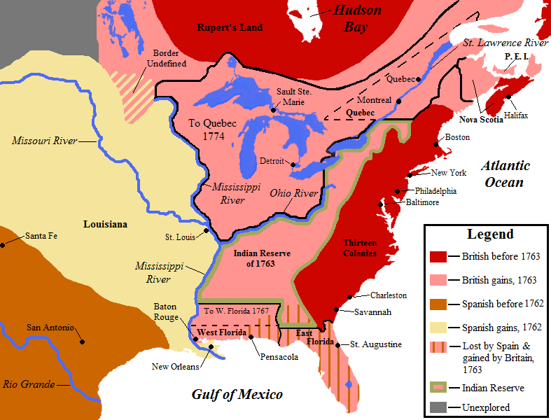

Slide 53
Paying for the War
4000 to 7000 British troops stationed in North America
The end of Salutary Neglect
Navigation Acts
Sugar Act 1764
Stamp Act 1765, Quartering Act 1765
1767 Townshend Acts; the Revenue Act of 1767, the Indemnity Act, the Commissioners of Customs Act, the Vice Admiralty Court Act, and the New York Restraining Act.
Tea Act 1773
Quebec Act 1774

Slide 54
Prelude to the Revolution
British view, the Colonies benefited, and are British citizens they should help pay for the war. Maintain Parliaments right to tax. Do not entertain the idea of American representation.
American view already taxed by Colonies for defense. Army only maintained trample rights.

Slide 55
TAXATION
Britain accumulated huge debt due to French & Indian War
British subjects begin to complain
New Prime Minister-George Grenville
Four Part Plan
  Strict enforcement of Navigation Acts
  Sugar Act (1764)
  Quartering Act (1765)
  Stamp Act (1765)

Slide 56
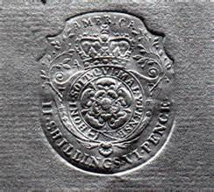
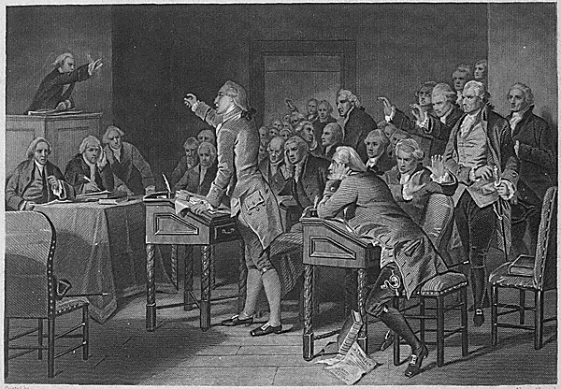

Slide 57
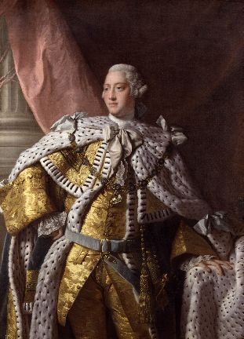
King George III

Slide 58
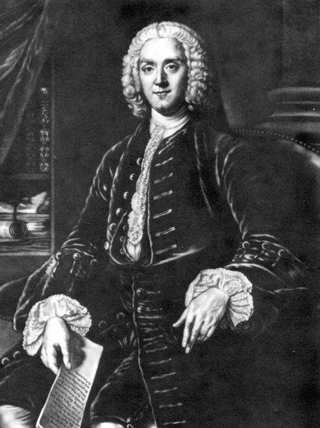
George Grenville
Prime Minister’s Plan to Pay French & Indian War Debt
Sugar Act (1764)
Currency Act (1764)
Quartering Act (1765)
Stamp Act (1765)

Slide 59
STAMP ACT 1765
Revenue for new military force
Required a stamp to be placed on all legal document, newspapers, pamphlets, licenses, playing cards, & dice to show that tax had been paid
First cries of “No taxation without Representation!”
Boycotts and harassment of tax collectors
Organized the Sons of Liberty-led by Samuel Adams

Slide 60
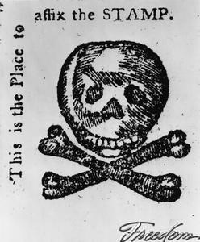
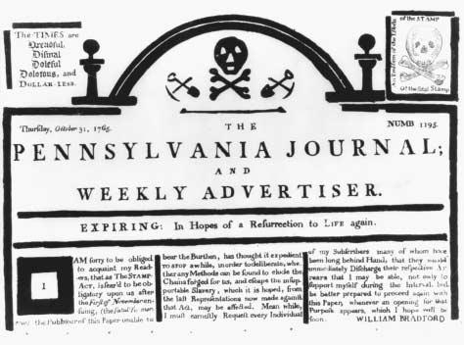
Stamp Act Crisis, 1765

Slide 61
STAMP ACT Congress
Stamp Act Congress-October 1765
  9 colonies
  Americans could not be taxed without consent
  Called for repeal of Stamp Act
  Showed the colonies could work together
  3rd act of colonial unity

Slide 62
STAMP ACT
Most effective protest-boycott (nonimportation)
Made British merchants demand repeal
King George III dismissed Grenville and replaced him with Charles Rockingham
March 1766-Parliament repealed Stamp act, but…
Passed Declaratory Act
  Parliament had right to tax and make laws for the colonies

Slide 63
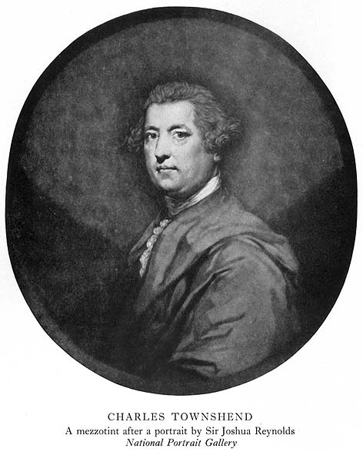
Townshend Acts
(1767)
Taxes on Imported Goods:
Paint, Paper, & Tea
Suspends New York General Assembly

Slide 64
TOWNSHEND ACTS
1766-Rockingham replaced by Charles Townshend
Bragged he could tax the colonies without them knowing
Passed the Townshend Duties
Governors and Judges paid by crown instead of colonies
British Rationale
  Internal (indirect) tax
Colonial Reaction
  Colonist slow to react
  John Dickerson writes pamphlet on how the tax worked

Slide 65
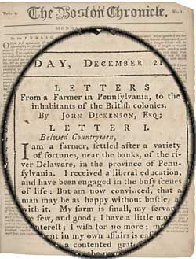
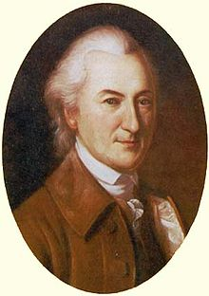
John Dickinson
Letters from a Farmer in Pennsylvania
"the cause of one is the cause of all"

Slide 66
MASS CIRCULAR LETTER
Feb. 1768-Massachusetts Legislature writes letter to other colonies urging them to take a stand
British authorities ordered letter withdrawn and forbade colonists from reading letter
King sent four regiments of troops to Boston
Began nonimportation again
March 1770-Repeal of Townshend Duties, except tax on tea

Slide 67
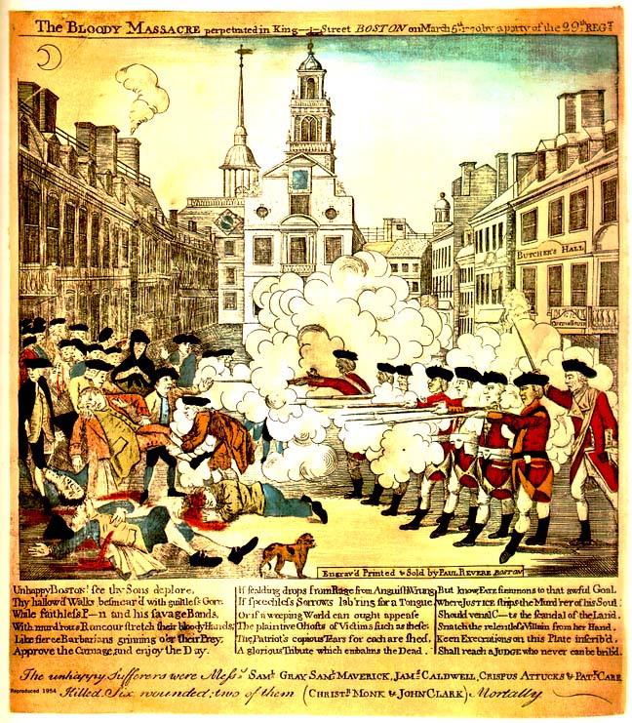
Boston Massacre, March 5, 1770

Slide 68
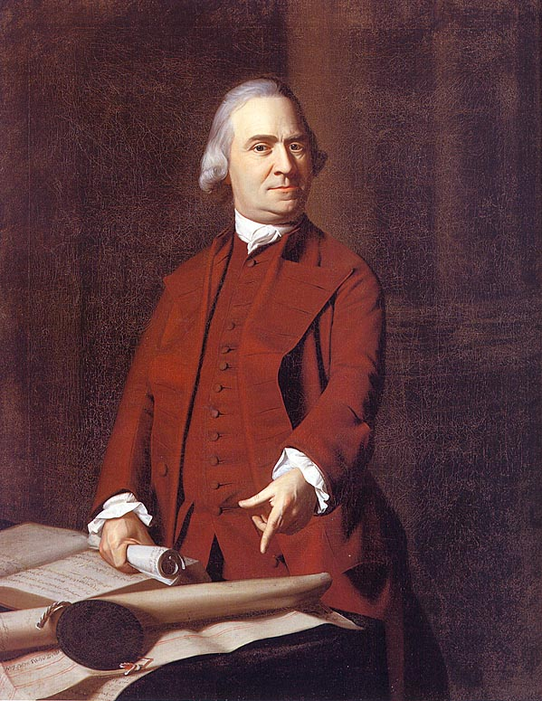
Samuel Adams & the Sons of Liberty

Slide 69
GASPEE INCIDENT
1772-British merchant ship docked off Rhode Island
Sailors come ashore and stole animals, cut down tree, caused problems
8 boats rowed out to ship, wounded captain, removed the crew, and burned the ship
Colonial Rationale
  Revenge
British Reaction
  Parliament sent a commission to investigate, but the colonists “knew nothing” about the incident

Slide 70
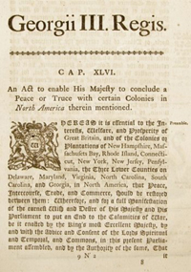
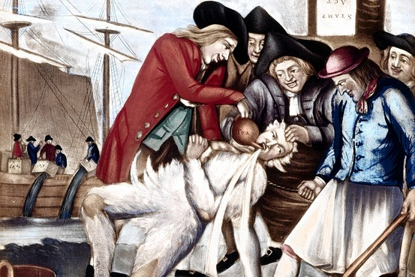

Slide 71
TEA ACT
Colonists still boycotting British tea
Parliament passes Tea Act (1773)
Gave the British East Indian Company permission to go straight to colonies instead of stopping in England
British Rationale
  Made the price of tea cheaper, but still included the tax
  British puts pressure on royal governors to force colonists to buy
Colonial Reaction
  Colonists still refuse to buy
  Boston Tea Party

Slide 72
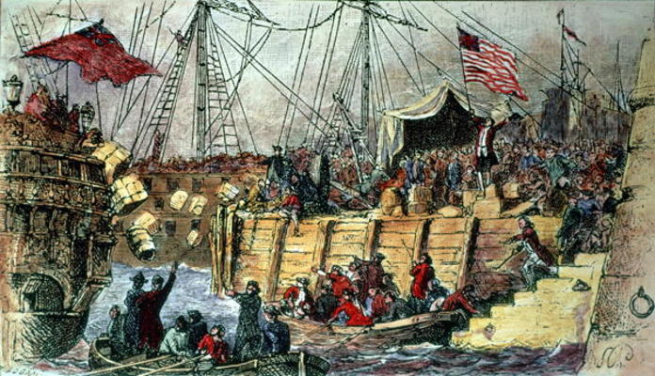
December 16, 1773

Slide 73
The Intolerable Acts (1765-1774) aka Coercive Acts
Quartering Act (1765)
  Colonies must supply and house British troops
Boston Port Bill (1774)
  Closes Boston Harbor until tea is paid for
Administration of Justice Act (1774)
  British officials could not be charged w/ a crime
Massachusetts Government Act (1774)
  Massachusetts charter is revoked
Quebec Act (1774)
  Canada given more territory, taken away from VA, CT & MA

Slide 74
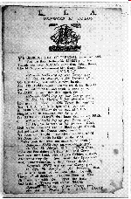
Committees of Correspondence
Formed to allow the colonies to communicate with each other
Spread revolutionary actions
  Often quicker than other methods of communication
  Writings would be read aloud or published in other colonies
Broadsides, like the one above, were often used to spread information.

Slide 75
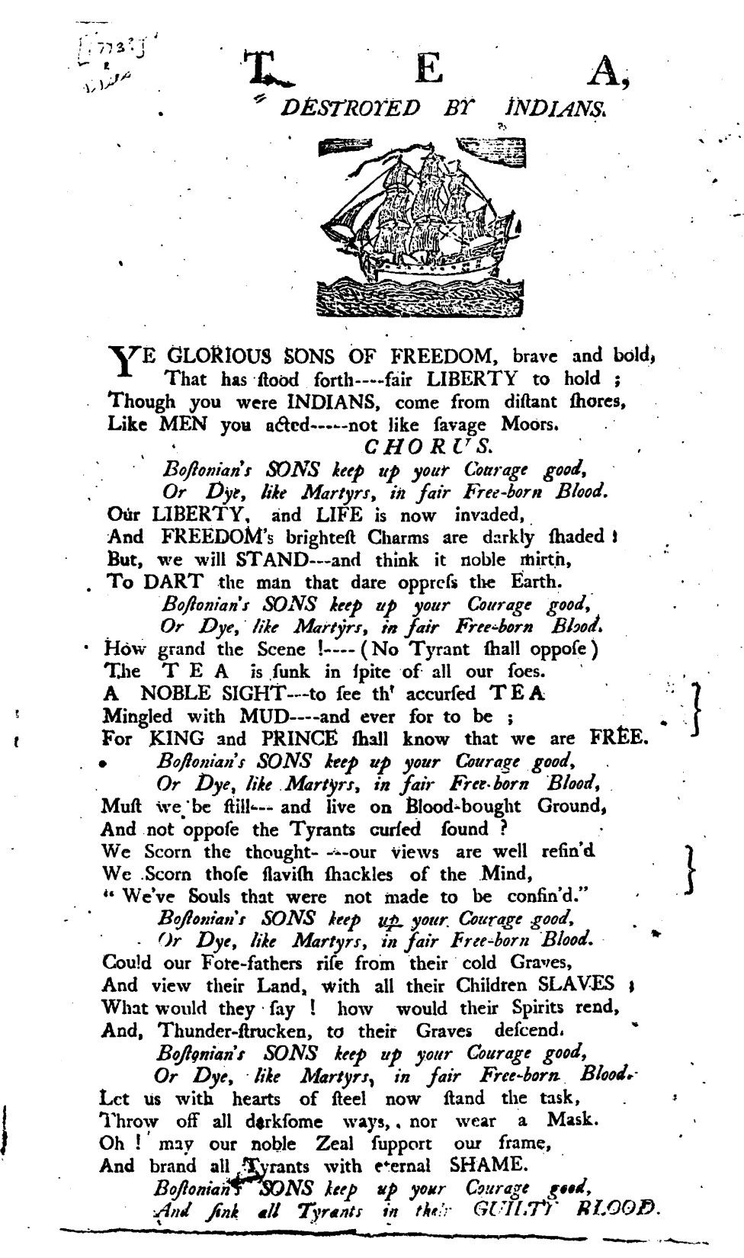


Slide 76
FIRST CONTINENTAL CONGRESS
September 1774-Philadelphia
12 colonies-minus Georgia
Purpose-determine how colonies should react to the threat of losing their rights and liberties
No desire for independence

Slide 77
FIRST CONTINENTAL CONGRESS
Four part plan
  Suffolk Resolves
    Called for repeal of Intolerable Acts
    Encouraged colonist to make military preparations
  Colonial Rationale
    Petition to King to restore colonial rights
  British Reaction
    Ignored, instead sent 25,000 troops

Slide 78
FIRST CONTINENTAL CONGRESS
Colonial Reactions
  “The Association”
    In charge of organizing boycott and “Committees of Correspondence” in each colony
  Called for a 2nd meeting in May of 1775 if demand were not met

Slide 79
Geo-politics Great Britain
Underestimated the American opposition
Believed the American dissenters could be overawed by a show of military force
The Massacre of St George’s Field- John Wilkes (1768)
Were not cruel men, they were men who simply miscalculated
Last attempt at a political compromise Feb 1775. Lord North proposes the colonies provide fixed contributions.

Slide 80



British leaders
Frederick North, Lord North
John Montagu, 4th Earl of Sandwich
George Germain, 1st Viscount Sackville

Slide 81
Geo-politics of Great Britain
Navy ill-prepared, many of the Seven Year War builds were made of green timber (Wartime contingencies)
Falkland’s Crisis with Spain 1770
Not enough yard capacity
Sandwich improves timber stocks and yard capacity
Also wishes to concentrate fleet in home waters in case of war with France and Spain
Army ill prepared, units considerably under strength because of peacetime budgets
Colonial support in England-Rockingham Whigs- Charles James Fox

Slide 82

Thomas Gage-CinC America
Conflicting messages from Britain
Looks favorably on Americans in general, though annoyed of late
Undermined by his some of his own officers
Not suited for task

Slide 83
Militia System
All able bodied men age 17-60
American system based upon the English Elizabethan system of 1572.
Provide own uniform and equipment (including musket or rifle)
Every household must own a firearm
Muster at least once a month, service limited to 90 days in their own colony
As frontier moved further into the interior, the militia system was subject to neglect

Slide 84
Minutemen and volunteers
Volunteers were men of militia that served beyond 90 day period or for service outside the colony.
Subject to quota or draft
Minutemen established 1774, but based upon Snow-shoe men of earlier times
Men were to be young (20’s) subject to mobilization at 30 minutes notice
Trained weekly

Slide 85
American Revolution Militia
The militia at Lexington and Concord were ILLEGAL.
The Redcoats were there to confiscate their powder.

Slide 86


Slide 87


Slide 88


Slide 89



“The Shot Heard Around the World” April 19, 1775
The Battle of Lexington

Slide 90

Battles of Lexington and Concord, April 19, 1775

Slide 91
The British Army
Traces its roots to English Civil War amalgamation of New Model Army and units following Royalists
Redcoats
A collection regiments
Financially 2 separate armies
English Establishment
Irish Establishment
Solid well trained infantry
Scum of the Earth

Slide 92
British Army types of regiments
Household Infantry, 1775
Infantry Regiments of the Line on the English Establishment, 1775
Infantry Regiments of the Line on the Irish Establishment, 1775
Cavalry Regiments on the English Establishment, 1775
Cavalry Regiments on the Irish Establishment, 1775
Staff of Engineers in Canada, 1776-1778
Staff of Engineers at New York, 1774

Slide 93
British Army
Artillery and engineers were part of Board of Ordnance
Enlistment was for life
Discipline was harsh- flogging a common punishment
Purchase system- not as bad as thought
Regiment of 2 btn’s (Usual) which did not serve together
Regiment of 10 companies
Flank companies

Slide 94



Slide 95



Slide 96
The Hessians
Where not all Hessians per se
Hessen-Kassel (17,000 officers and soldiers)
or Hessen-Hanau (2,600 officer and men).
Brunswick sent 5,723 men,
Waldeck sent 1,225 men,
Brandenburg-Anspach sent 1,040 men,
Anhalt-Zerbst sent 1,119 men, this country’s uniforms were white

Slide 97

German Allies in British service

Slide 98
British Provinicials
American units
Militia favorable to Britain

Slide 99


Royal Artillery/Cavalry/Provincials

Slide 100




Slide 101



Slide 102



Slide 103



Slide 104
American views of the British Army
Lobsterbacks
Americans like the British upper and middle class look down upon the British military
British soldier drawn from the lowest elements of society

Slide 105
Important Dates
March 5, 1770- Boston Massacre
December 16, 1773- Boston tea Party
Throughout 1774- Dunmore’s War
September 1, 1774- Powder Alarm

Slide 106



The Continental Army
Won the war by turning our militia into a professional army based upon the British model. (8 later 9 cos per rgt)
Regulars supplemented by militia
Successive establishments 1775, 76, 77, 80

Slide 107
Continental Army thru the war
1775- largely a New England/ New York Army 48 rgt’s strong. Several states south of New York form own fulltime armies, separate from Continental Army.
1776- still largely Northern/New England in makeup 36 rgt’s of a single btn a piece 640 strong
1777- 88 btn resolve +16, 9 co rgts, truly American Army, as most state troops absorbed.
1780- new quota

Slide 108

Militia

Slide 109



Slide 110




Slide 111



Slide 112



Slide 113



Slide 114


Slide 115



Slide 116



Slide 117


Slide 118


Slide 119
French Army
Divided into 2
Army
Navy which ministered French Colonial possessions

Slide 120



French

Slide 121



Slide 122
Operations and Tactics
2 Dimensional environement

Slide 123

Napoleonic Strategy
Strategy of the Central Position- Used if considerably inferior in numbers

Slide 124

Napoleonic Strategy
Single or double envelopment

Slide 125

Napoleonic Strategy
Penetration

Slide 126


Napoleonic Strategy
Battalion Caree

Slide 129
The Hessians
Where not all Hessians per se
Hessen-Kassel (17,000 officers and soldiers)
or Hessen-Hanau (2,600 officer and men).
Brunswick sent 5,723 men,
Waldeck sent 1,225 men,
Brandenburg-Anspach sent 1,040 men,
Anhalt-Zerbst sent 1,119 men, this country’s uniforms were white

Slide 130
German Allies in British service

Slide 131
British Provinicials
American units
Militia favorable to Britain

Slide 132
Royal Artillery/Cavalry/Provincials

Slide 137
American views of the British Army
Lobsterbacks
Americans like the British upper and middle class look down upon the British military
British soldier drawn from the lowest elements of society

Slide 138
Important Dates
March 5, 1770- Boston Massacre
December 16, 1773- Boston tea Party
Throughout 1774- Dunmore’s War
September 1, 1774- Powder Alarm

Slide 139
The Continental Army
Won the war by turning our militia into a professional army based upon the British model. (8 later 9 cos per rgt)
Regulars supplemented by militia
Successive establishments 1775, 76, 77, 80

Slide 140
Continental Army thru the war
1775- largely a New England/ New York Army 48 rgt’s strong. Several states south of New York form own fulltime armies, separate from Continental Army.
1776- still largely Northern/New England in makeup 36 rgt’s of a single btn a piece 640 strong
1777- 88 btn resolve +16, 9 co rgts, truly American Army, as most state troops absorbed.
1780- new quota

Slide 141
Militia

Slide 152
French Army
Divided into 2
Army
Navy which ministered French Colonial possessions

Slide 153
French

Slide 156


Slide 157
Revolutionary War linear tactics
2 rank Open order opposed to close order
Limited cavalry
Gradually quicken step 75 to 120 paces per minute or ordinary to quicktime before run
Finish with bayonet

Slide 158


Column to line (Bland to Frederick)

Slide 159


Slide 160


Slide 161


Slide 162

Second Continental Congress April 1775
Olive Branch Petition
Create Continental Army
Appointed General George Washington to Command the Army

Slide 163


Slide 164


Slide 165


Slide 166


Bunker (Breed’s) Hill June 17, 1775

Slide 167


Slide 168



Slide 169
British Mistakes
Charlestown Neck
Underestimated their opponents
Militia of previous wars

Slide 170
Invasion of Canada June75 to July 76
America hopes to bring Canada in as 14th Colony
Quebec Act-English King wishes to establish Popery
Longstanding animosity between Americans and Quebecois
Strong anti-Catholicism in the Americas
Upper class and most Quebec clergy support the Quebec Act
Expected British reinforcements
American troops from 2 Departments

Slide 171






Commanders

Slide 172
Reasons for the failure
Tolerant policies for Catholics under British leadership
Beyond the logistical capabilities of the Americans
Expiring enlistments and Congress’ inability to sustain army
Lack of a proper siege train
Lack of specie by Continental Congress
David Wooster’s policies regarding Catholics and arrest of other Canadians
Burgoyne's Army

Slide 173
British Loyalist Policy to 1778
View them as something to be protected
Little effort to mobilize as military manpower
They still believe that they can awe the Rebels
Overestimate number of Loyalists particularly in the South

Slide 174
Last chances for peace
2nd Continental Congress- rejects North’s last plan
Olive Branch Petition May 10, 1775-King George refuses to accept
King George issues Proclamation of Rebellion Aug 23, 1775-effectively answering the Petition

Slide 175
Prohibitory Act of 1775
Received by Colonies Feb 1776
the colonies were staging a rebellion against the authority of king and Parliament
they had raised an army and engaged his majesty's soldiers
they had illegally taken over the powers of government
they had stopped trade with the mother country.
Given those circumstances, Parliament felt compelled to prohibit all British trade with the American colonies. Further, all American ships and cargoes were to be treated as if they belonged to an enemy power and were subject to seizure; if adjudged a lawful prize by an admiralty court , the ships and cargoes were to be sold and the proceeds distributed among the capturing ship’s officers and crew.

Slide 176

The Declaration of Independence

Slide 177

Historical Context
Thomas Jefferson
About The Author
Born on April 13, 1743 in Virginia to a wealthy family.
He was very well educated. Attended The College of William & Mary.
Served in the Virginia House of Burgesses.
Eloquent correspondent, but not good public speaker
Known as the "silent member" of the Congress
Was unanimously chosen by the Committee of Five to prepare a draft of the Declaration alone.

Slide 178
Major Events of The Time
Common Sense is published
North Carolina produces the Halifax Resolves making it the first British colony to officially authorize its delegates to vote for independence.
Richard Henry Lee of Virginia proposes a resolution calling for a Declaration of Independence.
Virginia Declaration of Rights by George Mason is adopted by the Virginia Convention of Delegates.
The Delaware General Assembly votes to suspend government under the British Crown

Slide 179



Second Continental Congress 1775-1776
Convened May 19, 1775
George Washington appointed Commander in Chief of the Continental Forces
Appointed 5 men to write a declaration stating the colonies intent and reasons for independence
June 1775 56 delegates met and debated, each colony had one vote
Deliberated for one year
January 1776 Common Sense by Thomas Paine explained why there should be independence to the public

Slide 180

Resolution of Differences
Second Continental Congress drafted the Declaration of Independence. Approved for signature July 2
July 4 1776 Declaration written by Thomas Jefferson was signed, John Hancock signed first with the largest signature
Severed ties with Great Britain

Slide 181
Three Basic Principles of the Declaration of Independence
Natural Rights: life, liberty, and the pursuit of happiness
Popular Sovereignty: People are the source of political authority
Order: Importance of stability, overthrowing a government is only the last resort

Slide 182
List of Grievances that were Improper Actions by the King
Dismissing colonial legislatures and denying the colonists their right for self-government
Tax the colonists without their consent
Maintaining an army in the colonies without the consent of the legislature and elevating the military above civilian authority
Forcing colonists to house British soldiers in their house

Slide 183
List of Grievances that were Improper Actions by the King
Making judges dependent on the King for their salaries and their tenure in office
Refusing colonists the right to a fair trial in front of a jury of their peers
Cutting off the trade of the colonies
Abolishing the Charters, forms of government, and important laws of the colonies
Refusing to address colonial grievances
Renouncing the King’s authority to govern the colonies by waging war on them
Encouraging domestic violence and Indian attacks on the colonies

Slide 184



New Hampshire Delegation
Josiah Bartlett
Matthew Thornton
William Whipple

Slide 185





Massachusetts Delegation
John Adams
Samuel Adams: Had a $35,000 price on his head during the American Revolution
Elbridge Gerry
John Hancock: Elected Governor of Massachusetts 10 times and had a $50,000 price on his head during the American Revolution
Robert Treat Paine

Slide 186


Rhode Island Delegation
William Ellery
Stephen Hopkins

Slide 187




Connecticut Delegation
Samuel Huntington: Elected Governor of Connecticut 10 times
Roger Sherman
William Williams
Oliver Wolcott

Slide 188




New York Delegation
William Floyd
Francis Lewis
Philip Livingston
Henry Misner (left before signing)
Lewis Morris

Slide 189





New Jersey Delegation
Abraham Clark
John Hart
Francis Hopkinson
Richard Stockton
John Witherspoon

Slide 190





Pennsylvania Delegation
George Clymer
John Dickinson (did not sign)
Benjamin Franklin
Robert Morris
John Morton

Slide 191





Pennsylvania Delegation (cont.)
George Ross
Benjamin Rush
James Smith
George Taylor
James Wilson

Slide 192



Delaware Delegation
Thomas McKean
George Read
Cesar Rodney

Slide 193




Maryland Delegation
Charles Carroll: Last signer to die at 95 in 1832
Samuel Chase
William Paca
Thomas Stone

Slide 194




Virginia Delegation
Carter Braxton
Benjamin Harrison
Thomas Jefferson
Francis Lightfoot Lee

Slide 195



Virginia Delegation (cont.)
Richard Henry Lee
Thomas Nelson, Jr.
George Wythe

Slide 196



North Carolina Delegation
Joseph Hewes
William Hooper
John Penn

Slide 197




South Carolina Delegation
Thomas Heyward
Thomas Lynch
Arthur Middleton
Edward Rutledge

Slide 198



Georgia Delegation
Button Gwinnett: Died in a duel in 1777 at 42 most valued signature due to only 14 examples that exist.
Lyman Hall
George Walton

Slide 199
Information on the Signers
The following signers lost their lands, homes and possessions due to signing and being in the American Revolution.
Carter Braxton
Abraham Clark: 2 of his sons died in the Revolution, both were prisoners aboard British prison ship, “Jersey” in NY Harbor, 11,000 American captives died on this ship.
George Clymer
William Ellery

Slide 200
Information on the Signers (cont.)
The following signers lost their lands, homes and possessions due to signing and being in the American Revolution.
William Floyd
Lyman Hall
John Hart: Lost his wife, 13 children and home
Thomas Heyward
William Hooper

Slide 201
Information on the Signers (cont.)
The following signers lost their lands, homes and possessions due to signing and being in the American Revolution.
Francis Lewis: His wife was taken prisoner by the British and died two years after release. His property near Harlem, NY was completely destroyed
Arthur Middleton: Was a British prisoner along with Edward Rutledge and Thomas Heyward and sent to St. Augustine, FL.

Slide 202
Information on the Signers (cont.)
The following signers lost their lands, homes and possessions due to signing and being in the American Revolution.
Thomas Nelson: Fired a cannon at his mansion because it was being used by the British and died destitute and bankrupt. He raised $2 million for the Revolution and was never repaid.
Richard Stockton: Beaten and put in jail and starved, ending up an invalid. Lost estate and his family had to live off of charity.

Slide 203
Information on the Signers (cont.)
Philip Livingston: All his possessions in NY were confiscated
Louis Morris: All his timber, crops and livestock were taken and barred from his home and family for 7 years
Dr. John Witherspoon: President of College of New Jersey, later Princeton. Princeton was occupied and library burned.

Slide 204
Information on the Signers (cont.)
Robert Morris: Merchant in Philadelphia, raised arms and provisions for Washington’s army. He lost 150 ships at sea.
Dr. Benjamin Rush
John Morton: Had views of a Tory prior to signing.
Thomas Lynch, Jr.: Developed health problems while a company commander in the army. He was told to seek a cure in the West Indies and he and his wife were drowned at sea.

Slide 205
Information on the Signers (cont.)
Of the 56, nine died of wounds or hardships during the war
5 were captured and imprisoned, all brutally treated
12 saw their homes burned
17 lost everything they owned

Slide 206




New York-New Jersey Campaign

Slide 207

1776:
British Options
Notes:
COA 1: invade the colonies in the south.
COA 2: invade the Mid-Atlantic Colonies through either the Delaware or Chesapeake Bays
COA 3: invade New York.

Slide 208

xxxx
The Invasion of New York
22 August 1776 –
25 January 1777
xxxx
Notes:
Late June – July: General Howe assembles 32,000 troops on Staten Island
American Distribution:
3 Divisions in Southern Manhattan
1 Division at Northern Tip of Manhattan (Fort Washington)
(Arrows) Washington recognizes that Brooklyn Heights dominate his main forces on Manhattan therefore:
1 Division (under Putnam) placed on Long Island to deny the British access to these Heights

Slide 209

Notes:
Putnam’s Disposition of Forces. Takes advantage of protective terrain formed by Heights of Guian and fortifies the gaps with his troops:
To the West, at Gowanus Road – Lord Sterling with 1,600 troops
In the center at Flatbush and Bedford Passes – Sullivan with 1,500 troops
Putnam leaves the Jamaica Pass to the West unguarded.
22 August – Howe lands 15,000 troops near Gravesend Bay
British conduct a demonstration at Flatbush Gap
26 August – MG Grant attacks Lord Sterling along the Gowanus Pass with 5,000 troops – he does not press his attack – his intent is to keep the American Right flank fixed.
Howe maneuvers the British Main Body(10,000) around the American left flank, through the unguarded Jamaica Gap. Sullivan is forced to withdraw from his fortifications and try to stop the British envelopment.
Greatly outnumbered, Sullivan’s forces break and withdraw back to fortifications at Brooklyn Heights.
Howe completes the trap with Sterling’s forces who capitulate.
Washington personally takes over the Americans at Brooklyn Heights and reinforces the Americans to 9,500 (still ½ of the British Forces).
Howe constructs siege lines (normal for this period to attack enemy fortifications this way)
August 29 – Washington identifies the futility of his position and evacuates the night of 29 August. For the Long Island Campaign:
American Losses: 1,012
British Losses: 392
Howe offers Washington a peace proposal from London. Washington refuses.

Slide 210
The Invasion of New York
22 August 1776 –
25 January 1777
Notes:
15 September – Howe Lands troops at Kips Bay to cut off Putnam’s Southern troops
Putnam abandons NYC and occupies Harlem Heights
16 September – Pursuing British troops repulsed at Harlem Heights
18 October – Howe attempts to outmaneuver Washington and lands troops at Pell’s Point
Washington had already decided to abandon Manhattan and fell back to White Plains. He left 2,800 (Col McGraw) at Fort Washington and 3,000 (General Greene) at Fort Lee on the West side of the Hudson. The intent was to attempt to disrupt British attempts to use the Hudson.
28 October – Howe defeats Washington at White Plains
Washington force to withdraw – Positions 6,000 troops (General Lee) at Castle Hill to prevent further British movement north. Washington takes the remainder of the Army to Peekskill.
10 November – Washington crosses the Hudson and moves south. Howe decides not to pursue and instead moves south and captures Fort Washington (loss of 2,800 American Troops)
20 November – Greene joins Washington’s force just as General Cornwallis (sent by Howe) moves to take Fort Lee. At this point, Washington is down to 3,500 effectives (he lost 2,000 to expiring enlistments).
Washington retreats to the safety of the West side of the Delaware River. Cornwallis pursues him all the way, with 10,000 troops. The two forces face each other on 8 December at Trenton, Washington protected by a still unfrozen Delaware River.
Howe is satisfied with the campaign and moves his troops into winter quarters on 14 December. The British establish garrisons from Trenton all the way back to NY. Howe Returns to NYC and Cornwallis prepares to return to England on leave.

Slide 211
The Invasion of New York
22 August 1776 –
25 January 1777
Notes:
25 Dec – Washington crosses the Delaware with 2,400 men. He attacks the Hessian Garrison at Trenton with the following result:
4 Americans Killed
Hessians: 22 Killed/918 Captured/500 escape
Cornwallis gathers 8,000 troops to attack Washington (he leaves 1,200 troops at Princeton and another 1,200 to his immediate rear) and enters Trenton on 1 January. He faces dug in Americans to the South East of the City.
Washington slips away that night and moves to the North East. He defeats the British Rear Guard at Princeton. The final casualty figures for Princeton action:
Americans: 23 Killed
British: 28 Killed/58 wounded/323 captured
With exhausted troops, Washington finally moves into winter quarters at Morristown
With Washington in a threatening position to cut off the New Jersey outposts – Howe is forced to withdraw his garrisons from New Jersey and return to NY.

Slide 212


Slide 213


Slide 214
New Jersey Campaign
Washington recovers much of Western NJ
Morale temporarily restored
Washington is learning

Slide 215
New York Campaign
Washington performed poorly as a tactician
War was almost lost
Howe failed to crush the rebellion
Howe did not wish to wage war against the Americans
By standards of the day Washington should have asked for terms
Was told Washington’s army was disintegrating
Washington, by the end of the campaign, is showing signs of excellent leadership
The American Crisis-Thomas Paine
The Howe’s offer amnesty-Staten Island Peace Conference The Commission was empowered by the Crown to offer the rebel Americans pardons (with some exceptions), to allow judges to serve on condition of good behavior, and to promise to discuss colonial grievances (except the Quebec Act) in exchange for a cease-fire, the dissolution of the Continental Congress, the re-convening of the legitimate colonial assemblies, the acceptance of Lord North's Conciliatory Proposal and compensation for the Loyalists adversely affected by the war

Slide 216


Slide 217


Slide 218
Howe’s plan for 1777 to Germain
Howe then sketched a campaign for the following year in a letter to Lord Germain: 10,000 men at Newport, 10,000 for an expedition to Albany (to meet an army descending from Quebec), 8,000 to cross New Jersey and threaten Philadelphia, and 5,000 to defend New York. If additional foreign forces were available, operations could also be considered against the southern states.

Slide 219

Valcour Island 11 Oct, 1776

Slide 220
1777 Campaign
Germain rejects Howe’s calls for 30,000 additional reinforcements. The British send 4500.
Howe decides, because that any reinforcements would arrive too late. He changes plans 3 times. His final plan is to largely abandon New Jersey. Leave 5000 in New York, use 10,000 to take Providence, while taking the main army (10-15,000) men to capture Philadelphia.
Burgoyne would be on his own
Germain expects Howe to be able to take Philly, and then help Burgoyne, however, he does not forcefully order Howe to do so.
Burgoyne-Carlton feud.

Slide 221




Leaders 1777

Slide 222


Slide 223


Slide 224

Jane McCrea July 27,1777

Slide 225
Gates to Burgoyne
That the savages of America should in their warfare mangle and scalp the unhappy prisoners who fall into their hands is neither new nor extraordinary; but that the famous Lieutenant General Burgoyne, in whom the fine gentleman is united with the soldier and the scholar, should hire the savages of America to scalp europeans and the descendants of europeans, nay more, that he should pay a price for each scalp so barbarously taken, is more than will be believed in England. [...] Miss McCrae, a young lady lovely to the sight, of virtuous character and amiable disposition, engaged to be married to an officer of your army, was [...] carried into the woods, and there scalped and mangled in the most shocking manner [...]

Slide 226

British Plans
June-October 1777
x
xxx
xxxx

Slide 227










Comparison of Forces
Major General
Horatio Gates
Major General
John Burgoyne
Troops
Troops
6,500 Continentals
4,000 English Regulars
1,500 Militia
3,000 German Mercenaries
650 Canadians
500 Indians
500 Soldiers
Pennsylvania Rifle
900 Indians
Colonel Barry St. Leger
52 Cannon
Major General
Benedict Arnold

Slide 228
Burgoyne’s Expedition
June-October 1777
1777
x
30
25
20
15
10
5
30
25
20
15
10
5
30
25
20
15
10
5
30
25
20
15
10
5
30
25
20
15
10
5
xxx
Oct
Sept
Aug
x
x
x
x
xxx
July
xxxx
June

Slide 229
1777 Considered
Germain-Howe and Burgoyne
Washington-tactically still making grievous mistakes
France agrees to enter the war
Spain still offer clandestine help

Slide 230






Conway Cabal
"Heaven has been determined to save your Country; or a weak General and bad Councellors would have ruind [sic] it."[

Slide 231
Carlisle Commission
To consent to a cessation of hostilities, both by sea and land. To restore free intercourse, to revive mutual affection, and restore the common benefits of naturalization through the several parts of this empire. To extend every freedom to trade that our respective interests can require. To agree that no military force shall be kept up in the different states of North America, without the consent of the general congress, or particular assemblies. To concur in measures calculated to discharge the debts of America, and raise the value and credit of the paper circulation. To perpetuate our union, by a reciprocal deputation of an agent or agents from the different states, who shall have the privilege of a seat and voice in the parliament of Great Britain; or, if sent from Britain, to have in that case a seat and voice in the assemblies of the different states to which they may be deputed respectively, in order to attend to the several interests of those by whom they are deputed. In short, to establish the power of the respective legislatures in each particular state, to settle its revenue, its civil and military establishment, and to exercise a perfect freedom of legislation and internal government, so that the British states throughout North America, acting with us in peace and war, under our common sovereign, may have the irrevocable enjoyment of every privilege that is short of a total separation of interest, or consistent with that union of force, on which the safety of our common religion and liberty depends
It will also look into Parliamentary representation

Slide 232



Northern Theater 1778

Slide 233



Spying
Culper Ring
Ciphers
Benjamin Tallmadge
Abraham Woodhull-Samuel Culper Sr
Robert Townsend-Samuel Culper Jr
Major John Andre

Slide 234
British-Loyalist Policy
After 1778- with no significant reinforcements to be expected, in fact some troops are to be dispatched to protect the West Indies, Loyalist recruitment begins in earnest
Loyalists are expected to make a substantial part of the army
Militia
Provincial- of the American Line
Recruitment into British units
New England is perhaps lost
Keep the South- South is full of Loyalists

Slide 235



Some Loyalist Units
Queen’s Rangers
British Legion
James Wemyss

Slide 236




Southern Theater

Slide 237


Slide 238
Clinton’s Proclamation
Many Patriot leaders had gone home, a few took loyalty oaths
Clinton issues statement negating Southern neutrality
British have a hard time controlling Loyalist militias

Slide 239


Slide 240
Clinton-Arbuthnot Peace Declaration 1780
GREAT BRITAIN having manifested the sincerity of her affectionate and conciliatory intentions, in removing forever your pretended grounds of discontent, by repealing, among other statutes, those relating to the duty on tea, and the alterations in the government of Massachusets Bay, and by exempting forever not only the continental, but the insular colonies, from parliamentary taxations, it is with much pleasure we make known to you, that we have received a commission, under the great seal of Great Britain, which has for its objects the removal of distrusts by the remission of offences—the restoration of the benefits of an extensive commerce—the enabling the constitutional officers of government to reassume their functions, (that you may again enjoy your former local legislatures)—and the confirmation of your rights, liberties, and privileges...we do hereby further declare to the inhabitants of Pennsylvania, the Three Lower Counties on Delaware, New Jersey, that part of New York still in revolt, Connecticut, and Rhode Island, separately as provinces, or to any association of men therein, who shall, on or before the first day of July next ensuing, declare their abhorrence of the rebellion, separate from its councils, and afterwards demean themselves as dutiful and peaceable subjects of his Majesty’s government, that we shall be ready to grant them pardon for all past treasons, and the full benefits of the King’s clemency as before recited. We do also make the same offers of pardon and benefits to the inhabitants of the other more southern and eastern colonies in rebellion, or to any association of men therein, who shall, on or before the first day of August next ensuing, declare and act in the manner aforementioned, and afterwards persevere in the like dutiful and loyal behaviour

Slide 241


Notes:
-April 1780 – Clinton lays siege to American Forces under General Benjamin Lincoln in Charleston. The city falls 12 May with the loss of 5,000 troops.
The British establish a series of outposts to control South Carolina
Congress (w/o consulting Washington) appointed Gates (‘Hero’ of Saratoga) to take command of the Southern Troops. His campaign results in the Battle of Camden (16 Aug) The American Army is destroyed (Greatest American Defeat of the war on the heels of their greatest loss in troops – Charleston)
7 October 1780 – Kings Mountain. Cornwallis initially plans a 3 prong advance into NC. However, his left wing under Major Patrick Ferguson is destroyed by a hastily assembled force of various Militia. Cornwallis is forced to consolidate his forces vicinity of Winnsboro.
Washington appoints Nathanael Greene as the new Southern Cdr. With very few troops, he divides his forces. He controls the main force at Cheraw Hill and sends the remainder to Cowpens under the Cmd of Daniel Morgan.
With this risky deployment, the British cannot attack one force w/o allowing the other to get into the British rear. Cornwallis therefore decides to split his forces into three elements. One force to move vic. Camden to hold Greene, one force under LTC Tarleton to attack Morgan and Cornwallis commanded the main force which moved into North Carolina between the two forces. His plan was to defeat Morgan at Cowpens with Tarleton, and destroy the retreating Americans with his main force. He would then turn on Greene.

Slide 242
Washington
Morgan
Hill
N
Coulter’s Ferry Road
Militia
Reforming
The Swale
VaM
17
VaST
Howard
Triplett
Hammond
North Head
NCST
VaLt
1Md
2Md
Del
3Md
Legion
7
Suck Creek
McDowell
Legion
Light
71
McDowell
Roebuck
Thomas
Hayes
Brandon
South Head
Legion
Hammond
71(-)
Maple
Swamp
1
Green River Road
Hayes
Rise
West Ravine
McDowell
Hammond
Rising
Ground
Legion
7
17
242
The Rivulet
Legion
Light
1
71
120 meters
Notes:
-Morgan’s plan – 3 lines of defense. The first line (Militia) were sharpshooters who will fire and force the British to deploy. They will fall back to the second line (Militia). This line will also fire two shots at the approaching British. They were to then retire behind the main American line (that was anchored in the center by the Continental troops). The small American Cavalry under Washington was to be the reserve.
The British deploy with artillery in the center, with infantry on each side. The flanks were covered by mounted units. There were also 200 Legion Dragoons in the British rear, but these would never enter the battle.
Skirmishers conduct a fighting withdrawal as the British advance and fall back to the flanks of the second line.
The British pursue and are met with two volleys from the second line. Estimated 60% of the officers are hit.
The Militia fall back behind the American third line and begin to reform.
The British pursue an attack the 3rd line. The Legion Dragoons and a company from 1-71st attack McDowell’s Militia on the flank, while the 17th Light Dragoons attempted to pursue the American Militia in the rear of the third line.
Washington counters this move and the 17th Light Dragoons withdraw.
McDowell’s militia breaks and falls back. The Legion Dragoons then attack the American Right Flank and the North Carolina Militia break and fall back.
The VA Continentals have been given the order to refuse the right, but confuse the order and begin to fall back. The rest of the American line follows suit, in good order.

Slide 243
VaLt
VaST
Morgan
Hill
VaM
N
Coulter’s Ferry Road
Howard
Militia
Reforming
1
71
1Md
2Md
Del
3Md
Washington
7
The Swale
Triplett
Hammond
North Head
Legion
Legion
Light
7
Legion
Light
Suck Creek
71
South Head
71(-)
Maple
Swamp
1
Green River Road
Hayes
Rise
West Ravine
Rising
Ground
243
The Rivulet
120 meters
Notes:
On orders from LTC John Howard, the American line turns and fires into the pursuing British Troops. The British were stunned by this action (they were under the misunderstanding that the Americans had broken and were in retreat).
The Results:
Washington’s Cavalry Stops the Legion Cav and Envelops the British left.
The 1-71st withdraw and finally surrender. The artillery is also captured.
The 7th foot and the right side of the British line withdraw from the field.
****NOTE: Events of Washington’s Dragoons and the Militia’s Actions at the end of the battle are based on the most recent study of the battle (A Devil of a Whipping, Lawrence Babits)

Slide 244
1781
Notes:
Although Morgan has defeated Tarleton, the Americans are still not strong enough to defeat the main British force. They therefore fall back into North Carolina and rejoin at Guilford Courthouse. After some further maneuver and gathering of more forces, Greene establishes a triple defense line similar to Cowpens which Cornwallis attacks on March 15 1781.
While Greene was driven from the field, Cornwallis suffered 30% casualties. Since he also had burned his supplies to try to catch Morgan, he withdrew to Wilmington to get re-supplied by sea. Greene initially followed, but then diverted south back into South Carolina. The British Commander in South Carolina, General Rawdon, had 8,000 troops, but they were dispersed throughout the countryside(25,000 square miles to control). The largest (900) was in the vicinity of Camden, and Greene attacked that force at Hobkirk’s Hill on April 25. Although Rawdon defeated Greene, Greene’s Army was still in tact.
Knowing he would not have been able to withstand another attack from Greene, and knowing his outposts were vulnerable, Rawdon called for a general withdrawal back to Charleston while Cornwallis headed into Virginia.
British units then either withdrew from their outposts, or were besieged and fell to American patriots.
The final British outpost at Ninety-Six required Greene to conduct a siege with his force. However, Rawdon rescued the outpost with a relief force.
Greene again attacked the British main force located at Eutaw springs in September 8, and once again, lost. But the British were once again forced to withdraw to Charleston and Savannah. Greene was to never win a battle, but, with his forces in tact, drove the British from the Carolina’s.

Slide 245

R
W
CL
L
CW
The Road to Yorktown
May 1779-
September 1781
Notes:
1779-1781 – Cornwallis is convinced VA is the key to the south and convinces Clinton to send an expedition to VA. British forces (to include a force under the American traitor, Arnold) wreck havoc in VA.
March 1781 - Washington sends a small force under Lafayette to attempt to check the destruction (and possibly capture Arnold).
May 1781 – Cornwallis arrives in VA from his campaign in the Carolinas
Summer of 1781 – French Army under Rochambeau arrives in Newport, RI (4,000). The French also promise the use of their fleet to conduct and all out effort in 1781. July 1781- Rochambeau moves to mass forces with Washing in NY. Both Washington and Clinton envision a large battle in New York/ Pennsylvania area. However, DeGrasse, the Admiral of the main French Fleet, informs Washington he will move only as far north as the Chesapeake Bay, and will leave prior to October (Hurricane Season)
Aug-Sept 81 – Washington leaves a small force to cover NYC, conducts deception operations and moves his combined American/French Army to VA to trap Cornwallis.
British Admiral Hood, departing the Caribbean, and looking for Degrasse’s Fleet, arrives at Chesapeake bay first, found an empty bay, and moved on to New York.
Since he had stopped in Havana, Degrasse’s fleet was 5 days behind Hood, and by luck, arrived in the empty Chesapeake Bay on 30 August. Degrasse delivers 3,000 troops.
Admiral Graves, with Hood’s fleet, moved back to the Chesapeake Bay and attacked the French Fleet in the inconclusive Battle of Virginia Capes. (Sept 5)
A French Squadron slips into Chesapeake Bay during a lull in the naval battle to deliver siege cannon.
The combined French fleet numbered 35 vs. the 19 English Ships, who thus depart back to NY. Cornwallis is trapped by land and by sea.

Slide 246


Slide 247
Britain on the World Stage
21 Jun 1779 Spain declares War
Dec 1780 Dutch and UK go to war
League of Armed Neutrality-Russia, Sweden, Denmark

Slide 248



1781-Yorktown

Slide 249
Treaty of Paris 1783
Would France betray America?
Spain hostile to America
Status quo
Acknowledging the United States (viz. the Colonies) to be free, sovereign and independent states, and that the British Crown and all heirs and successors relinquish claims to the Government, property, and territorial rights of the same, and every part thereof;
Establishing the boundaries between the United States and British North America;
Granting fishing rights to United States fishermen in the Grand Banks, off the coast of Newfoundland and in the Gulf of Saint Lawrence;
Recognizing the lawful contracted debts to be paid to creditors on either side;
The Congress of the Confederation will "earnestly recommend" to state legislatures to recognize the rightful owners of all confiscated lands "provide for the restitution of all estates, rights, and properties, which have been confiscated belonging to real British subjects Loyalists";
United States will prevent future confiscations of the property of Loyalists;
Prisoners of war on both sides are to be released and all property left by the British army in the United States unmolested (including slaves);
Great Britain and the United States were each to be given perpetual access to the Mississippi River;
Territories captured by Americans subsequent to treaty will be returned without compensation;
Ratification of the treaty was to occur within six months from the signing by the contracting parties.

