Slide 1
Mexican-American War 1846-1848
Dr Nicholas “Nick” Noppinger

Slide 2
Problem with history and historians
Far too often the way historians portray a past event says more about the social customs and politics of the time they live rather than the event.
Too many historians view history as a weapon in which to bludgeon their political opponents today rather than an accurate interpretation of past events.
Go along to get along. Herd mentality.

Slide 3
Historiography
Was their opposition to the war- certainly, but it is severely overstated.
Lincoln, Grant, Longfellow etc.
There was opposition to ALL wars, including the Civil War and the lead up to World War 2.
The vast majority of Americans and that includes anti-slavery Northern Whigs were supporters of MANIFEST DESTINY and that includes Lincoln.
There were anti-slavery proponents that were iffy on annexing Texas, but wholeheartedly supported war with Britain over Oregon or acquiring California.
War guilt must also placed on the Banana Republic like Mexican government and populace.

Slide 4
Historiography
Was the US expansionistic?
YES, but so was most of the main European powers.
The Mexican government was also engaging in their own brutal warfare against Indian tribes within their areas.
This did not stop Spanish, later Mexican, and American forces from border incursions into each others territory.
The UK, France, Russia, had designs on North American territory.
Even Spain made noise about regaining their Empire.

Slide 5
Historiography
Mexican-American War one of the most criticized wars in US history
Viewed as a blatant act of aggression on the part of the US.
RACISM, RACISM, RACISM!!!!!!

Slide 6
Historiography
John S.D. Eisenhower called it a “dirty war,” and praised the Mexican for resisting the Yankee Gringo.
Otis A. Singletary, the former Dean of the University of Kentucky, stated, “Still another reason for our apparent indifference to the Mexican War lies rooted in the guilt that we as a nation have come to fell about it. The undeniable fact it was an offensive war so completely stripped it of moral pretension that no politician of that era succeeded in elevating it to the lofty level of a ‘crusade’”

Slide 7
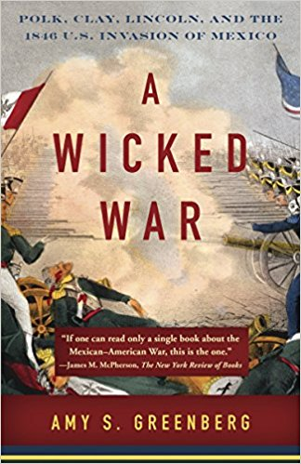
Historiography
Loathes Polk, whom she considers a national villain, and racist.
Resorts to using quotes that contradict known contemporary correspondence.

Slide 8
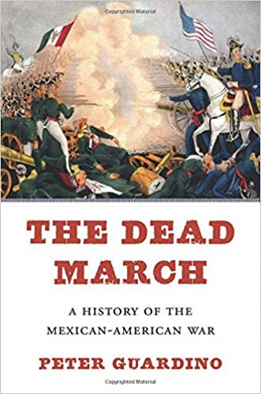
Historiography
By focusing on the experiences of ordinary Mexicans and Americans, The Dead March offers a clearer historical picture than we have ever had of the brief, bloody war that redrew the map of North America.
Peter Guardino invites skepticism about the received view that the United States emerged victorious in the Mexican-American War (1846–1848) because its democratic system was more stable and its citizens more loyal. In fact, heading into the war, American forces dramatically underestimated the strength of Mexicans’ patriotism and failed to see how bitterly Mexicans resented America’s claims to national and racial superiority. Having regarded the United States as a sister republic, Mexicans were shocked by the scope of America’s expansionist ambitions, and their fierce resistance surprised U.S. political and military leaders, who had expected a quick victory with few casualties. As the fighting intensified over the course of two years, it claimed the lives of thousands of Americans and at least twice as many Mexicans, including many civilians.
As stark as they were, the misconceptions that the Mexican-American War laid bare on both sides did not determine the final victor. What differentiated the two countries in battle was not some notion of American unity and loyalty to democracy but the United States’ huge advantages in economic power and wealth―advantages its poorer Latin American neighbor could not hope to overcome.

Slide 9
Historiography
“The history of a war of expansion and empire that reverberates today in talk of border walls and deportation. Viewed through a retrospective lens, the American invasion of Mexico in 1846, an act of single-sided aggression, has eerie parallels with later incursions in Vietnam and Iraq. For one thing, all were adventures that enjoyed public support at first but that lost backing as time wore on. It was also precipitated, writes Guardino in this vigorous, readable account, by an American president who ‘had to hide crucial information and engage in intense partisan maneuvering to start the war.’…In a narrative that blends set-piece accounts of battle, profiles of individual combatants, and wide-ranging explorations of larger issues, Guardino examines the inevitability of American victory, which proved Pyrrhic. Some of our received wisdom about the conflict, he argues, does not hold up…The Mexican-American War is too little studied today. Guardino’s swift-moving, broad-ranging history is a welcome remedy.”―Kirkus Reviews

Slide 10
Historiography
In his memoirs, published 20 years after the end of the Civil War, Ulysses S. Grant judged the Mexican War “as one of the most unjust ever waged by a stronger against a weaker nation,” more so because Americans had attacked Mexico solely from a “desire to acquire additional territory.” But this was not the worst of it, as far as Grant was concerned, for the unjust war had produced terrible consequences for Americans, too. “The Southern rebellion,” he wrote, “was largely the outgrowth of the Mexican War.”

Slide 11
Grant during the Mexican War
In an 1846 letter Grant confided to his wife: “I would volunteer to come to Mexico as a private if I could come no other way.”
Grant’s change of heart had more to with his conversion from antebellum southern leaning Democrat to post bellum Northern Whig.

Slide 12
Reality
The successful Texas Revolution in the 1830’s ensured strong American interest in that territory, and, if Mexican threats were to be taken seriously, annexation meant war sooner or later.
Did Singletary, et al, forget that one of the primary reasons for the American Revolution was to be able to expand beyond the Appalachian Proclamation Line of 1763? Did they forget our invasion of Canada during both the Revolution and the War of 1812? In the 1800’s, we took, by force of arms, territory from the Indians, Spain, and Mexico.

Slide 13
Realism
All nations engage in actions based upon rational self interest.
THAT IS THE PURPOSE of a Nation State.
Polk, Andrew Jackson or any American president could NOT have stopped expansion since the AMERICAN PEOPLE DEMANDED IT.
Spanish-American War contrast.

Slide 14
History
If you want to find racism in 19th Century US it is not hard to find along with many other vices.
However, every society has its issues and if that is the sole or primary focus historians are missing the point.

Slide 15
The nature of war
War tends to be chaotic and unpredictable, and can never be distilled into a few proscriptions (Jomini, John Boyd, and the use of Sun Tzu).
The flow of a war is never a mathematical certainty. (Friction of war)
It is a calculated risk, as human behavior can never be fully anticipated.
Carl von Clausewitz-”everything is very simple, but the simplest thing is very difficult.”
There are also many paths to victory.
War is simply a means of 1 group or nation attempting to pose its political will upon another

Slide 16

CONTINUITIES
CHANGES
Societal Factors
Political
Economic
Social
Technological
Science
Nature of War
SOCIETY
Interrelationships
WILL
*
Reflection of Society
Human
Dimension
Military Institutions

Slide 17
National Policy/National Objectives
Grand Strategy/ National Security Strategy
Military Strategy
Operations
Tactics

Slide 18
National Policy
The basic and supreme war aim of the nation.
Everything else subordinate and considered tools to achieving the all encompassing national policy.
Political in nature.
US DOD -A broad course of action or statements of guidance adopted by the government at the national level in pursuit of national objectives.

Slide 19
Grand Strategy/National Security Strategy
The mobilization of a nations, political, military, social, cultural, religious, and economic forces to achieve the national policy.
Political, military, economic, and social in nature.
US DOD- A document approved by the President of the United States for developing, applying, and coordinating the instruments of national power to achieve objectives that contribute to national security. Also called NSS. See also National Military Strategy; strategy; theater strategy.

Slide 20
Military strategy
The more detailed planning and employment of military forces in an attempt to carry out the grand strategy and national policy.
Military in nature- the importance of other aspects still present, but diminishing.
Time and space dependent.
US DOD- A prudent idea or set of ideas for employing the instruments of national power in a synchronized and integrated fashion to achieve theater, national, and/or multinational objectives.

Slide 21
Operational Art
The planning and employment for a particular campaign.
Time and space dependent
Armored warfare theory
US DOD- The cognitive approach by commanders and staffs--supported by their skill, knowledge, experience, creativity, and judgment--to develop strategies, campaigns, and operations to organize and employ military forces by integrating ends, ways, and means.

Slide 22
Tactics
The employment of troops in a specific battle., from the highest command echelon to the lowest.
Time and space dependent.
US DOD- The employment and ordered arrangement of forces in relation to each other.

Slide 23
Objective
Direct every military operation toward a clearly defined, decisive, and attainable objective.
The ultimate military purpose of war is the destruction
of the enemy’s armed forces and will to fight.
The ultimate objectives of operations other than war
might be more difficult to define; nonetheless, they
too must be clear from the beginning. The linkage,
therefore, between objectives at all levels of war is
crucial; each operation must contribute to the ultimate
strategic aim.
The attainment of intermediate objectives must directly,
quickly, and economically contribute to the operation.
Using the analytical framework of mission,
enemy, troops, terrain, and time available (METT-T),
commanders designate physical objectives such as an
enemy force, decisive or dominating terrain, a juncture
of lines of communication (LOCs), or other vital
areas essential to accomplishing the mission. These
become the basis for all subordinate plans. Actions
that do not contribute to achieving the objective must
be avoided.

Slide 24
Offensive
Seize, retain, and exploit the initiative.
Offensive action is the most effective and decisive
way to attain a clearly defined common objective.
Offensive operations are the means by which a
military force seizes and holds the initiative while
maintaining freedom of action and achieving decisive
results. This is fundamentally true across all levels of
war.
Commanders adopt the defensive only as a temporary
expedient and must seek every opportunity to
seize the initiative. An offensive spirit must therefore
be inherent in the conduct of all defensive operations.
The side that retains the initiative through offensive
action forces the enemy to react rather than act.

Slide 25
Mass
Mass the effects of overwhelming combat power at the decisive place and time.
Synchronizing all the elements of combat power
where they
will have decisive effect on an enemy force
in a short period of time is to achieve mass. To mass
is to hit the enemy with a closed fist, not poke at him
with fingers of an open hand. Mass must also be sustained
so the effects have staying power. Thus, mass
seeks to smash the enemy, not sting him. This results
from the proper combination of combat power with
the proper application of other principles of war.
Massing effects, rather than concentrating forces, can
enable numerically inferior forces to achieve decisive
results, while limiting exposure to enemy fire.

Slide 26
Economy of Force
Employ all combat power available in the most effective way possible; allocate minimum essential combat power to secondary efforts.
Economy of force is the judicious employment and
distribution of forces. No part of the force should ever
be left without purpose. When the time comes for
action, all parts must act. The allocation of available
combat power to such tasks as limited attacks, defense,
delays, deception, or even retrograde operations is
measured in order to achieve mass elsewhere at the
decisive point and time on the battlefield.

Slide 27
Maneuver
Place the enemy in a position of disadvantage through the flexible application of combat power.
Maneuver is the movement of forces in relation to
the enemy to gain positional advantage. Effective maneuver
keeps the enemy off balance and protects the
force. It is used to exploit successes, to preserve freedom
of action, and to reduce vulnerability. It continually
poses new problems for the enemy by rendering
his actions ineffective, eventually leading to defeat.
At all levels of war, successful application of maneuver
requires agility of thought, plans, operations,
and organizations. It requires designating and then
shifting points of main effort and the considered application
of the principles of mass and economy of
force. At the operational level, maneuver is the means
by which the commander determines where and when
to fight by setting the terms of battle, declining battle,
or acting to take advantage of tactical actions. Maneuver
is dynamic warfare that rejects predictable
patterns of operations.

Slide 28
Unity of Command
For every objective, seek unity of command and unity of effort
At all levels of war, employment of military forces
in a manner that masses combat power toward a common
objective requires unity of command and unity
of effort. Unity of command means that all the forces
are under one responsible commander. It requires a
single commander with the requisite authority to direct
all forces in pursuit of a unified purpose.
Unity of effort, on the other hand, requires coordination
and cooperation among all forces even though
they may not necessarily be part of the same command
structure toward a commonly recognized objective.
Collateral and main force operations might go on
simultaneously, united by intent and purpose, if not
command. The means to achieve unity of purpose is a
nested concept whereby each succeeding echelon’s
concept is nested in the other. In combined and interagency
operations, unity of command may not be possible,
but the requirement for unity of effort becomes
paramount. Unity of effort coordination through cooperation
and common interests is an essential complement
to unity of command.

Slide 29
Security
Never permit the enemy to acquire unexpected advantage.
Security enhances freedom of action by reducing
vulnerability to hostile acts, influence, or surprise. Security
results from the measures taken by a commander
to protect his forces. Knowledge and understanding
of enemy strategy, tactics, doctrine, and staff planning
improve the detailed planning of adequate security
measures. Risk is inherent in war; however, commanders
must not be overly cautious. To be successful,
commanders must take necessary, calculated risks to
preserve the force and defeat the enemy. Protecting
the force increases friendly combat power.

Slide 30
Surprise
Strike the enemy at a time or place or in a manner for which he is unprepared.
Surprise can decisively shift the balance of combat
power. By seeking surprise, forces can achieve
success well out of proportion to the effort expended.
Rapid advances in surveillance technology and mass
communication make it increasingly difficult to mask
or cloak large-scale marshaling or movement of personnel
and equipment. The enemy need not be taken
completely by surprise but only become aware too late
to react effectively. Factors contributing to surprise
include speed, effective intelligence, deception, application
of unexpected combat power, operations security
(OPSEC), and variations in tactics and methods
of operation. Surprise can be in tempo, size of force,
direction or location of main effort, and timing. Deception
can aid the probability of achieving surprise.

Slide 31
Simplicity
Prepare clear, uncomplicated plans and concise orders to ensure thorough understanding.
Everything in war is very simple, but the simple
thing is difficult. To the uninitiated, military operations
are not difficult. Simplicity contributes to successful
operations. Simple plans and clear, concise
orders minimize misunderstanding and confusion.
Other factors being equal, the simplest plan is preferable.
Simplicity is especially valuable when soldiers
and leaders are tired. Simplicity in plans allows better
understanding and troop leading at all echelons and
permits branches and sequels to be more easily understood
and executed.

Slide 32
American Exceptionalism
“for wee must Consider that wee shall be as a Citty upon a Hill, the eies of all people are uppon us[sic];” John Winthrop-City Upon a Hill 1630. Later taken up by JFK and Reagan.
Heightened sense of American Nationalism and American Exceptionalism
The United States was an example to a world suffering from oligarchy.

Slide 33
The global context
A point often forgotten
Adds to the idea of American Exceptionalism
Failures of the 48’s- Wave of “classically liberal” Revolutions in Europe
The birth of political “isms”
The “temporary” failure of the ideas of the French Revolution (liberty, equality, and fraternity)… distinct from the American model
Followed by violent reactionary counter-movement.
The ’48’s come to America (Carl Schurz, Franz Sigel)

Slide 34
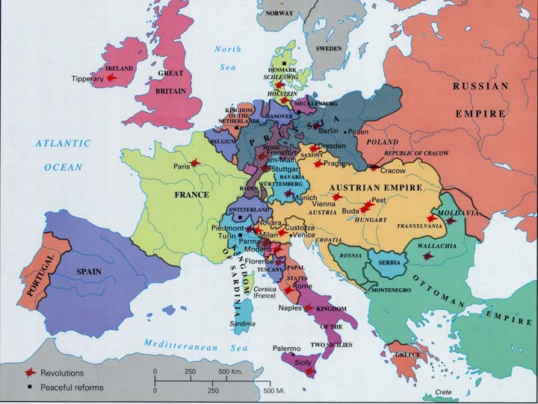
Revolutions in Europe 1848

Slide 35
Agree to disagree 1781-1831
International Slave Trade ends, (officially), 1807.
Support from the Northern and Southern States
Most abolitionists supported gradual emancipation and colonization
Liberia
Colonization of free blacks supported by North and South
Cotton Gin

Slide 36
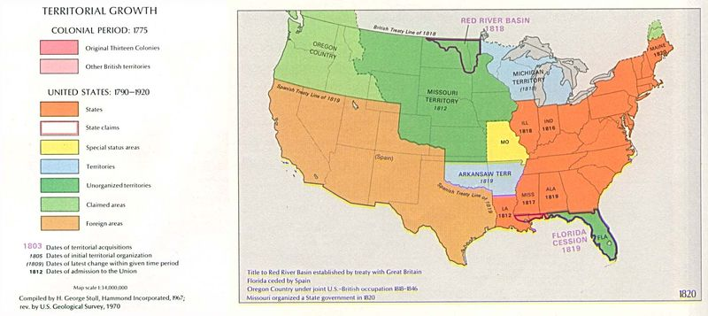

Slide 37
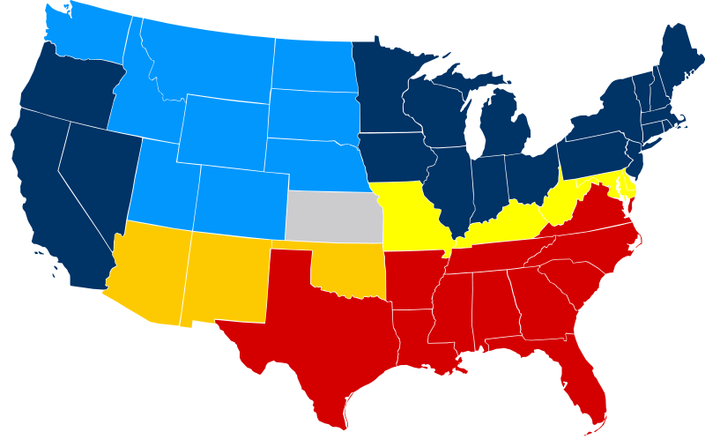

Slide 38
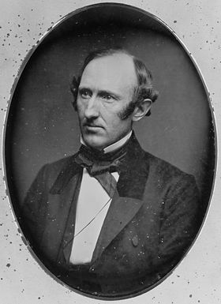
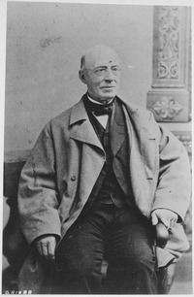
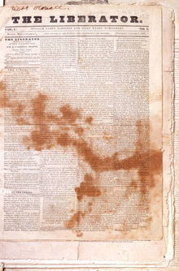
2 events change the amity
The Second Great Awakening divides Slave from Free
Burned Over District
The Rise of the Militant Abolitionist movement
Charles Finney, Lyman Beecher, Wendell Phillips and William Lloyd Garrison joined by free blacks like Frederick Douglass
"No Union With Slaveholders",
The experience of the fifty years ... shows us the slaves trebling in numbers -- slaveholders monopolizing the offices and dictating the policy of the Government -- prostituting the strength and influence of the Nation to the support of slavery here and elsewhere -- trampling on the rights of the free States, and making the courts of the country their tools. To continue this disastrous alliance longer is madness. The trial of fifty years only proves that it is impossible for free and slave States to unite on any terms, without all becoming partners in the guilt and responsible for the sin of slavery. Why prolong the experiment? Let every honest man join in the outcry of the American Anti-Slavery Society.

Slide 39
Nat Turner’s Rebellion
August 21-22, 1831
Suppressed by local militia
57 whites killed
Nat Turner eludes capture until October 30, 1831
55 Blacks executed. Many other blacks were lynched.

Slide 40
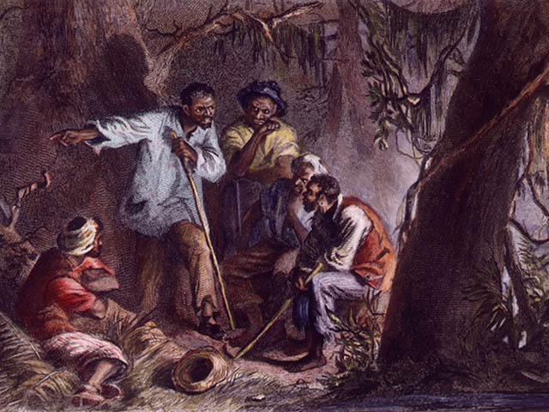
Nat Turner’s Rebellion
August 21-22, 1831

Slide 41
Nat Turner’s Rebellion
August 21-22, 1831
Slave States (including Maryland) tighten manumission laws. The first bans on slave education.
Slave patrols beefed up.
Religious gatherings of slaves were prohibited.
Free blacks prohibited from firearm ownership in many states.
South becomes increasingly paranoid and many in the North give them a reason.

Slide 42
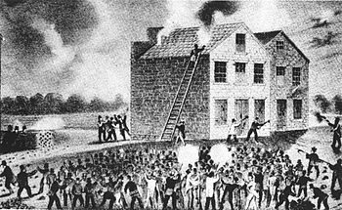
Increased violence
Nov 7, 1837 pro-slavery mob burns barn that held a anti-slavery newspaper Shotgun blast to chest results in death Elijah P. Lovejoy, Elton, IL.

Slide 43
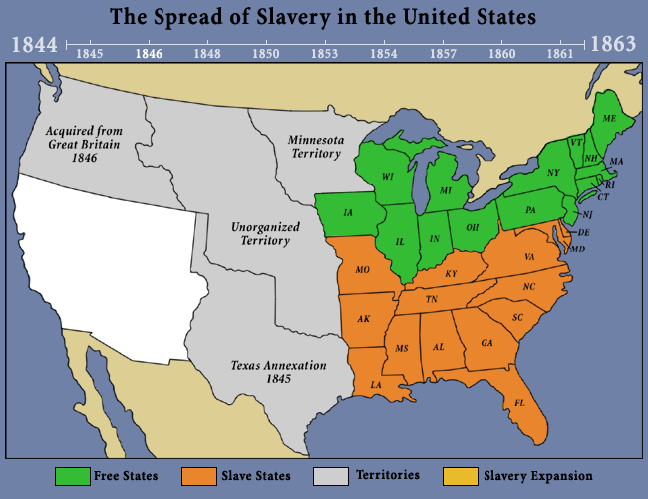

Slide 44
Politics
Politically the Whigs were the inheritors of the Federalists.
They understood what caused the demise of the Federalist Party.
Democrats viewed themselves as the inheritors of the Jeffersonianism.

Slide 45
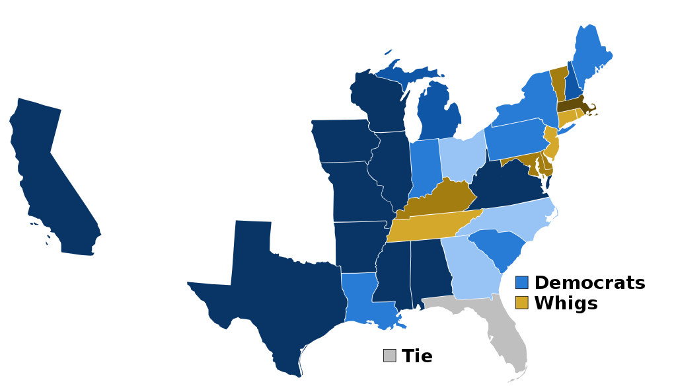
Second Party System 1828-1852

Slide 46
Hostility towards Spain and Mexico
Border incursions along the Mississippi.
Access to the Mississippi
Florida
Secretary of State John Quincy Adams because Florida had become "a derelict open to the occupancy of every enemy, civilized or savage, of the United States, and serving no other earthly purpose than as a post of annoyance to them.“

Slide 47
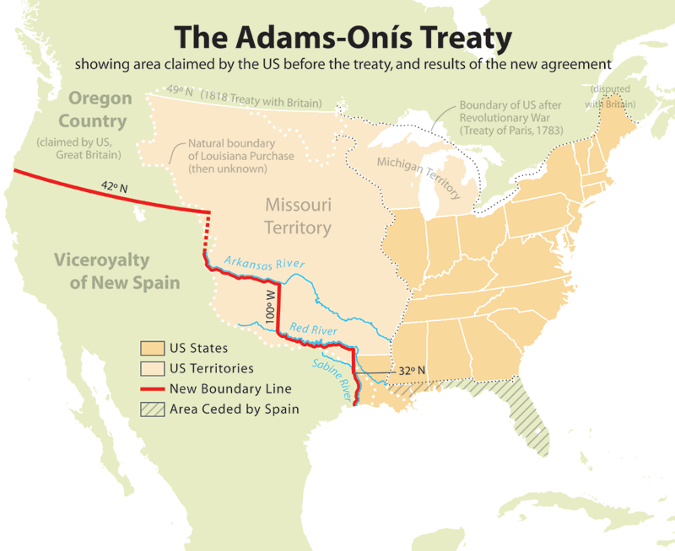

Slide 48
Mexico
Was essentially a semi-feudalistic government that was/is inherently unstable and corrupt.
Engaged in a series of brutal wars in which the whites of Spanish descent crushed the natives and their mixed race sympathizers
Encouraged white-Anglo settlement in the North as a buffer to help with Mexico City control over the region against the Indians as a tax base.
1st Empire 1821-1823
1st Republic 1823-1835
Centralist Republic 1835-1846
2nd Republic 1846 thru the war

Slide 49
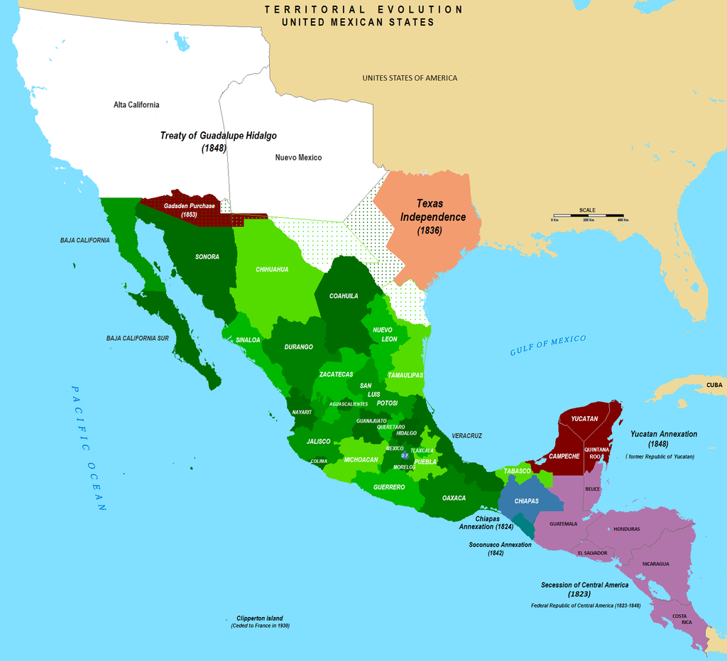

Slide 50
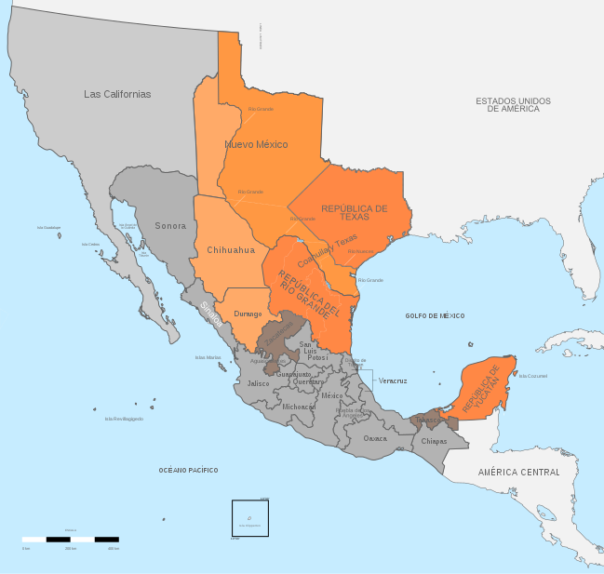
Armed opposition to Mexican government

Slide 51
US and UK
The UK was showing territorial ambition towards California "to establish an English population in the magnificent Territory of Upper California", saying that "no part of the World offering greater natural advantages for the establishment of an English colony ... by all means desirable ... that California, once ceasing to belong to Mexico, should not fall into the hands of any power but England ... daring and adventurous speculators in the United States have already turned their thoughts in this direction."

Slide 52
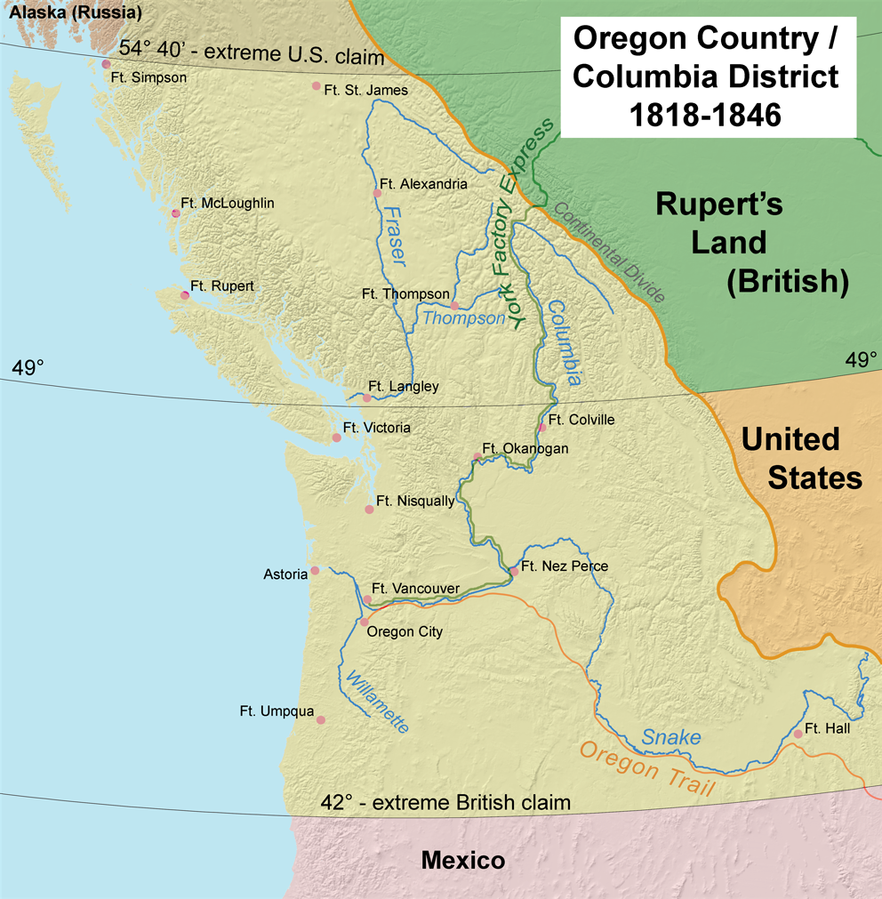

Slide 53
US and UK
Whig editor John L. O'Sullivan argued that the United States should claim all of Oregon "by the right of our manifest destiny to overspread and to possess the whole of the continent which Providence has given us...“
The Whig Party, as well as Democrats, favored aggressive action towards the UK over Oregon territory
54:40 or fight

Slide 54
US and UK
Polk, the “expansionist” favored the 49th parallel.
UK government armed the Mexican Army, including supplying 2 warships used by Mexico against Texas. In spite of claims of neutrality
British policy changed from supporting Mexico to acknowledging Texas independence to keep it away from the US.
Charles Elliott of the UK told the US consul that US annexation of Texas would mean war with Mexico and “may” mean armed conflict with the UK.
UK government disavows Elliott, but they continued with diplomatic maneuvering favorable to the UK.
Slidell mission possibly sabotaged by the UK.
Leading Whigs urged Tyler and Polk to annex California before it fell into UK hands.

Slide 55
US and Mexico
US offered to purchase Texas and other Mexican territory many times rebuffed, insulted and ignored by the Mexican government.
Mexican government to refuse to consider US debts
Pastry War 1838-1839 France vs Mexico
Mexican actions during the Texas War

Slide 56
US and Texas
Polk Administration advances and supports the Rio Grande line to show support for citizens of Texas
Polk figured that he could use to gain concessions on other disputes
Or pay Mexico a fair price, subject to arbitration, for the territory.
Mexico claimed US annexation of Texas was a declaration of war.
Far from being the bully Polk backed down when the Mexicans showed a willingness to negotiate.

Slide 57
Diplomacy
Slidell mission- Us offered to assume Mexican debt to US citizens, plus offer compensation towards land purchased.
Possibility, belief that the UK outed Slidell
Mexican instability 4 changes of government in 1846
Nationalistic Mariano Paredes y Arrillaga reaffirmed Mexican claims to Texas and ignored Slidell.

Slide 58
Mexican War
National Policy- Defeat Mexico and facilitate US land claims.
Grand Strategy (warfare planning at its most basic)- invade Mexico to facilitate National Policy
Military Strategy- Invade California, New Mexico, Northern Mexico, possible landing on Mexican east coast, blockade.

Slide 59
Operational Art
The planning and employment for a particular campaign.
Time and space dependent
US DOD- The cognitive approach by commanders and staffs--supported by their skill, knowledge, experience, creativity, and judgment--to develop strategies, campaigns, and operations to organize and employ military forces by integrating ends, ways, and means.

Slide 60
Tactics
The employment of troops in a specific battle., from the highest command echelon to the lowest.
Time and space dependent.
US DOD- The employment and ordered arrangement of forces in relation to each other.

Slide 61
Objective
Direct every military operation toward a clearly defined, decisive, and attainable objective.
The ultimate military purpose of war is the destruction
of the enemy’s armed forces and will to fight.
The ultimate objectives of operations other than war
might be more difficult to define; nonetheless, they
too must be clear from the beginning. The linkage,
therefore, between objectives at all levels of war is
crucial; each operation must contribute to the ultimate
strategic aim.
The attainment of intermediate objectives must directly,
quickly, and economically contribute to the operation.
Using the analytical framework of mission,
enemy, troops, terrain, and time available (METT-T),
commanders designate physical objectives such as an
enemy force, decisive or dominating terrain, a juncture
of lines of communication (LOCs), or other vital
areas essential to accomplishing the mission. These
become the basis for all subordinate plans. Actions
that do not contribute to achieving the objective must
be avoided.

Slide 62
Offensive
Seize, retain, and exploit the initiative.
Offensive action is the most effective and decisive
way to attain a clearly defined common objective.
Offensive operations are the means by which a
military force seizes and holds the initiative while
maintaining freedom of action and achieving decisive
results. This is fundamentally true across all levels of
war.
Commanders adopt the defensive only as a temporary
expedient and must seek every opportunity to
seize the initiative. An offensive spirit must therefore
be inherent in the conduct of all defensive operations.
The side that retains the initiative through offensive
action forces the enemy to react rather than act.

Slide 63
Mass
Mass the effects of overwhelming combat power at the decisive place and time.
Synchronizing all the elements of combat power
where they
will have decisive effect on an enemy force
in a short period of time is to achieve mass. To mass
is to hit the enemy with a closed fist, not poke at him
with fingers of an open hand. Mass must also be sustained
so the effects have staying power. Thus, mass
seeks to smash the enemy, not sting him. This results
from the proper combination of combat power with
the proper application of other principles of war.
Massing effects, rather than concentrating forces, can
enable numerically inferior forces to achieve decisive
results, while limiting exposure to enemy fire.

Slide 64
Economy of Force
Employ all combat power available in the most effective way possible; allocate minimum essential combat power to secondary efforts.
Economy of force is the judicious employment and
distribution of forces. No part of the force should ever
be left without purpose. When the time comes for
action, all parts must act. The allocation of available
combat power to such tasks as limited attacks, defense,
delays, deception, or even retrograde operations is
measured in order to achieve mass elsewhere at the
decisive point and time on the battlefield.

Slide 65
Maneuver
Place the enemy in a position of disadvantage through the flexible application of combat power.
Maneuver is the movement of forces in relation to
the enemy to gain positional advantage. Effective maneuver
keeps the enemy off balance and protects the
force. It is used to exploit successes, to preserve freedom
of action, and to reduce vulnerability. It continually
poses new problems for the enemy by rendering
his actions ineffective, eventually leading to defeat.
At all levels of war, successful application of maneuver
requires agility of thought, plans, operations,
and organizations. It requires designating and then
shifting points of main effort and the considered application
of the principles of mass and economy of
force. At the operational level, maneuver is the means
by which the commander determines where and when
to fight by setting the terms of battle, declining battle,
or acting to take advantage of tactical actions. Maneuver
is dynamic warfare that rejects predictable
patterns of operations.

Slide 66
Unity of Command
For every objective, seek unity of command and unity of effort
At all levels of war, employment of military forces
in a manner that masses combat power toward a common
objective requires unity of command and unity
of effort. Unity of command means that all the forces
are under one responsible commander. It requires a
single commander with the requisite authority to direct
all forces in pursuit of a unified purpose.
Unity of effort, on the other hand, requires coordination
and cooperation among all forces even though
they may not necessarily be part of the same command
structure toward a commonly recognized objective.
Collateral and main force operations might go on
simultaneously, united by intent and purpose, if not
command. The means to achieve unity of purpose is a
nested concept whereby each succeeding echelon’s
concept is nested in the other. In combined and interagency
operations, unity of command may not be possible,
but the requirement for unity of effort becomes
paramount. Unity of effort coordination through cooperation
and common interests is an essential complement
to unity of command.

Slide 67
Security
Never permit the enemy to acquire unexpected advantage.
Security enhances freedom of action by reducing
vulnerability to hostile acts, influence, or surprise. Security
results from the measures taken by a commander
to protect his forces. Knowledge and understanding
of enemy strategy, tactics, doctrine, and staff planning
improve the detailed planning of adequate security
measures. Risk is inherent in war; however, commanders
must not be overly cautious. To be successful,
commanders must take necessary, calculated risks to
preserve the force and defeat the enemy. Protecting
the force increases friendly combat power.

Slide 68
Surprise
Strike the enemy at a time or place or in a manner for which he is unprepared.
Surprise can decisively shift the balance of combat
power. By seeking surprise, forces can achieve
success well out of proportion to the effort expended.
Rapid advances in surveillance technology and mass
communication make it increasingly difficult to mask
or cloak large-scale marshaling or movement of personnel
and equipment. The enemy need not be taken
completely by surprise but only become aware too late
to react effectively. Factors contributing to surprise
include speed, effective intelligence, deception, application
of unexpected combat power, operations security
(OPSEC), and variations in tactics and methods
of operation. Surprise can be in tempo, size of force,
direction or location of main effort, and timing. Deception
can aid the probability of achieving surprise.

Slide 69
Simplicity
Prepare clear, uncomplicated plans and concise orders to ensure thorough understanding.
Everything in war is very simple, but the simple
thing is difficult. To the uninitiated, military operations
are not difficult. Simplicity contributes to successful
operations. Simple plans and clear, concise
orders minimize misunderstanding and confusion.
Other factors being equal, the simplest plan is preferable.
Simplicity is especially valuable when soldiers
and leaders are tired. Simplicity in plans allows better
understanding and troop leading at all echelons and
permits branches and sequels to be more easily understood
and executed.

Slide 70
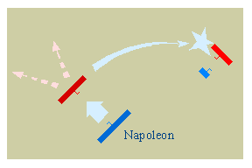
Napoleonic Strategy
Strategy of the Central Position- Used if considerably inferior in numbers

Slide 71
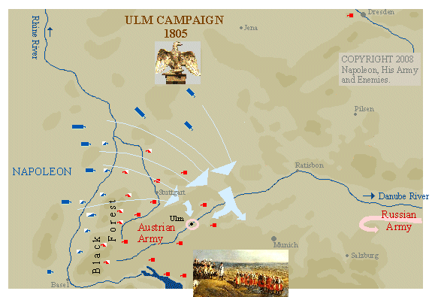
Napoleonic Strategy
Single or double envelopment

Slide 72
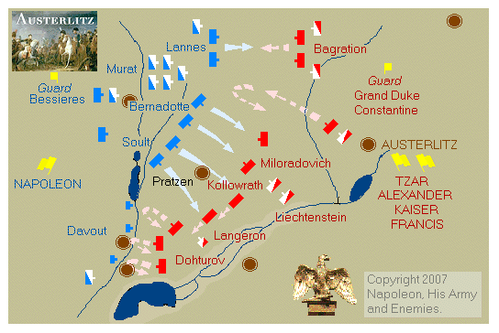
Napoleonic Strategy
Penetration

Slide 73
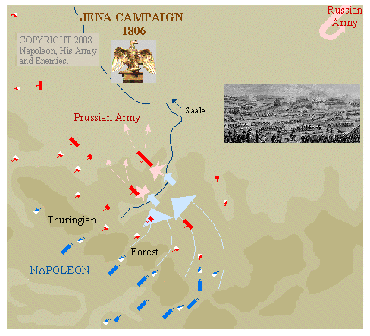
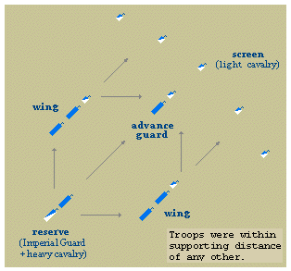
Napoleonic Strategy
Battalion Caree

Slide 74
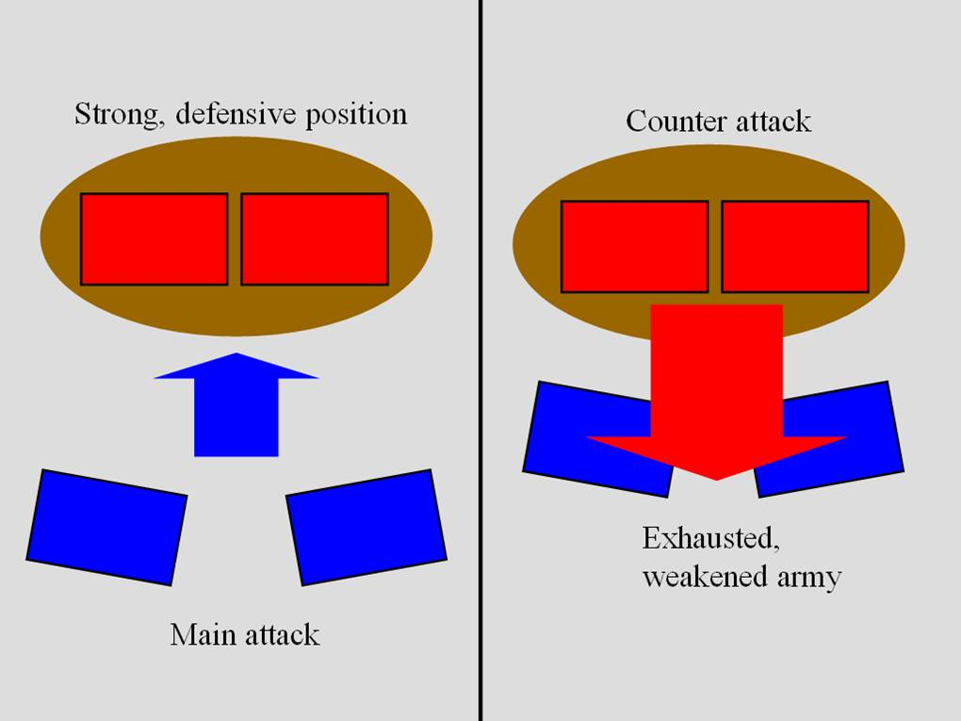
Attack from a strong position

Slide 75
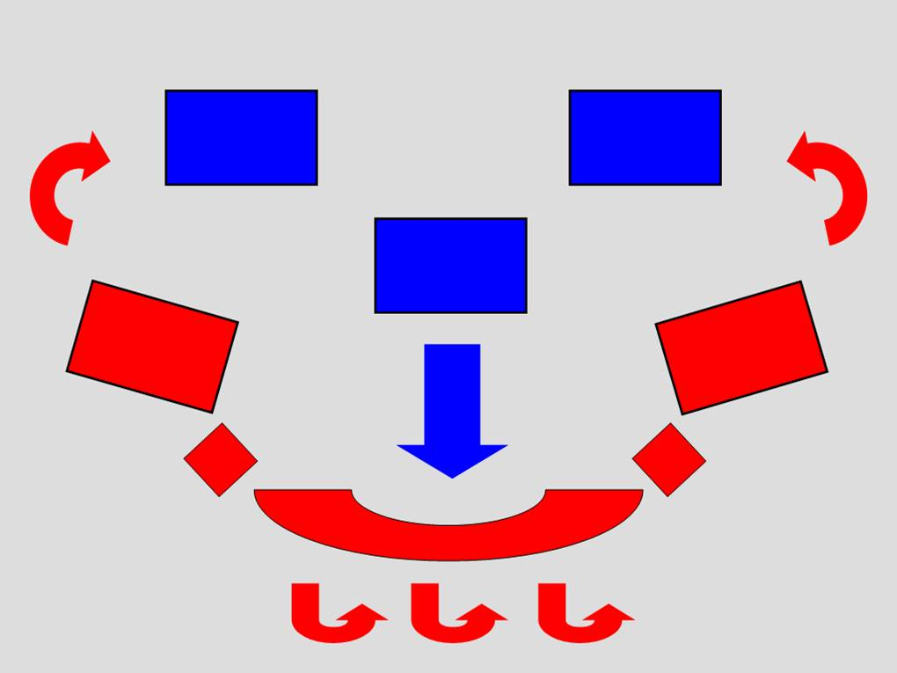
Feigned retreat

Slide 76
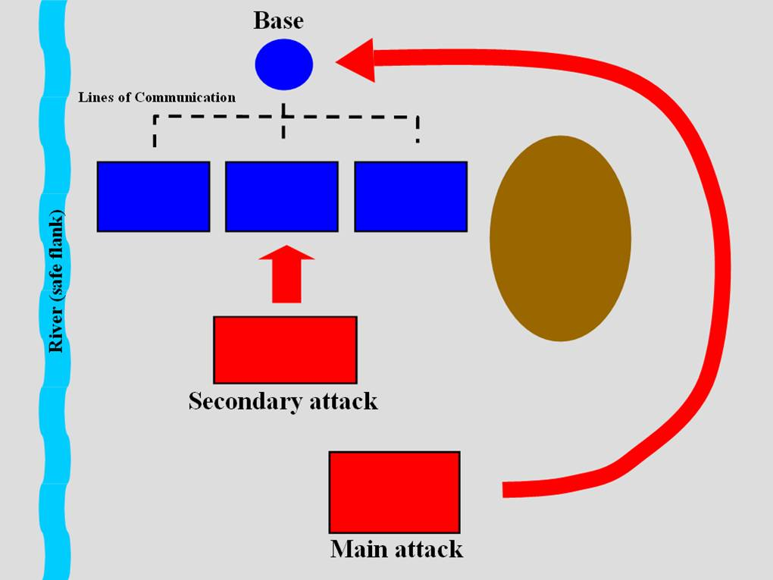
Indirect approach

Slide 77
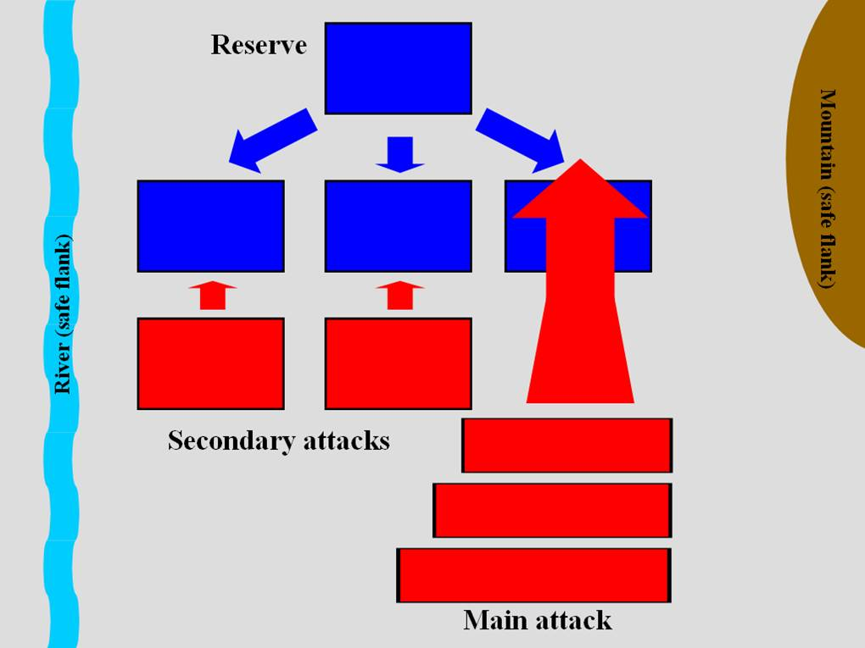
Oblique Order

Slide 78
Le Petite guerre
Raids by Mexican guerillas, bandits.
Pacification efforts
Guarding supply lines

Slide 79
Mexican Army
A poor imitation of a Napoleonic Army, ie 20 years out of date.
Peacock- parade ground phenomenon.
Poor officer corps/with exception to Academy graduates.
Corruption rampant
Very poor NCO’s
Soldiers were ill nourished illiterate peasants.
Bachelors and married men without children 18 to 40 – 6 years.
Desertion rampant
On paper their 20,000 to 7000 manpower advantage seemed imposing.

Slide 80
Mexican Army
No arms producing facility.
In barracks their uniforms were colorful, but under wartime conditions the Mexican quartermasters proved insufficient.
Gunpowder of extremely poor quality and the malnourished Mexican peasant had a hard time firing their outdated Brown Bess’s and Baker rifles.
Mexican cavalry favored the lance and had all of the typical European types of cuirassier, dragoons, hussars, mounted rifles.
Mexican artillery was severely outdated with too many calibers in the field artillery from 24 to 4 pounders.
Ill-trained with the exception of the San Patricios.

Slide 81
Mexican Army
Mexican specialists were too few relative to then modern practice.
Could be brave in attack and defense, but their lack of skill meant they suffered disproportionate casualties.
On parade ground could be magnificently dressed, but colorful dress does not make a soldier.
Mexican Navy was practically non-existent as an effective force.

Slide 82
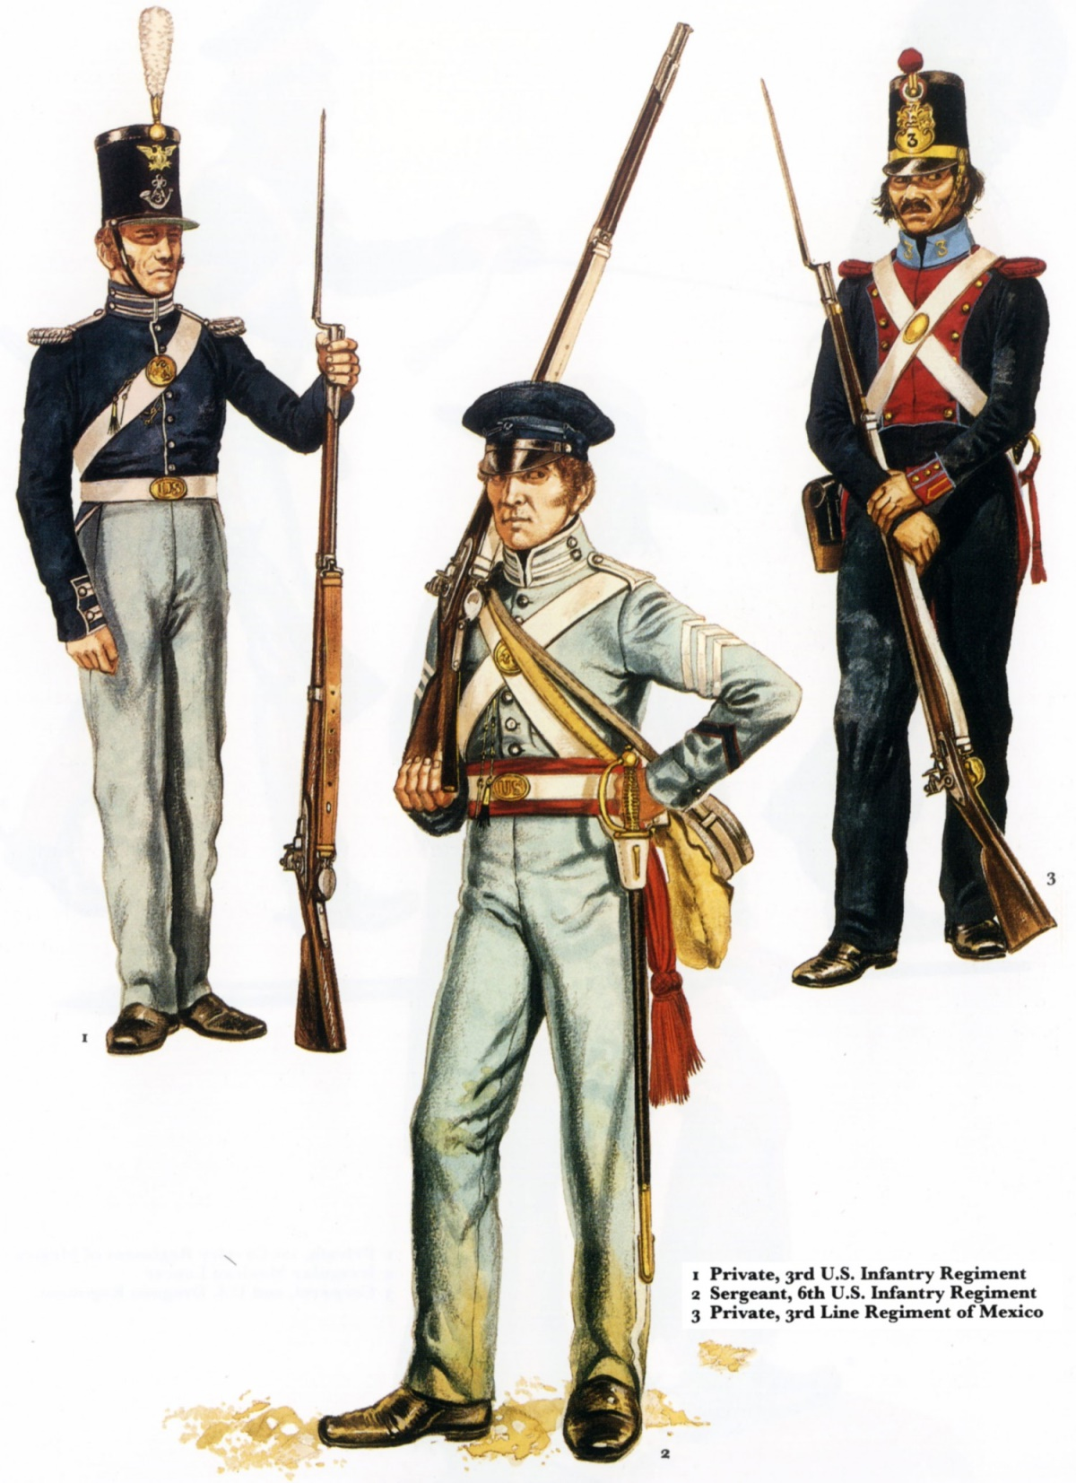

Slide 83
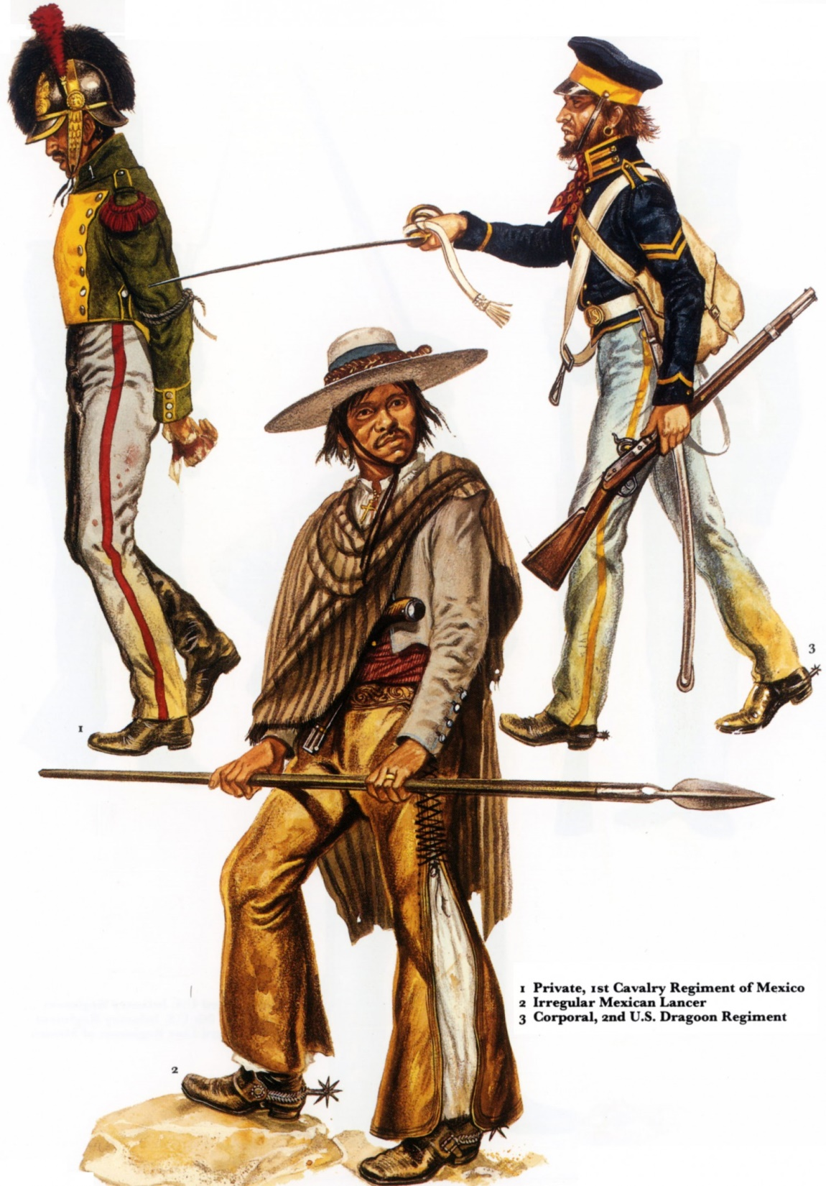

Slide 84
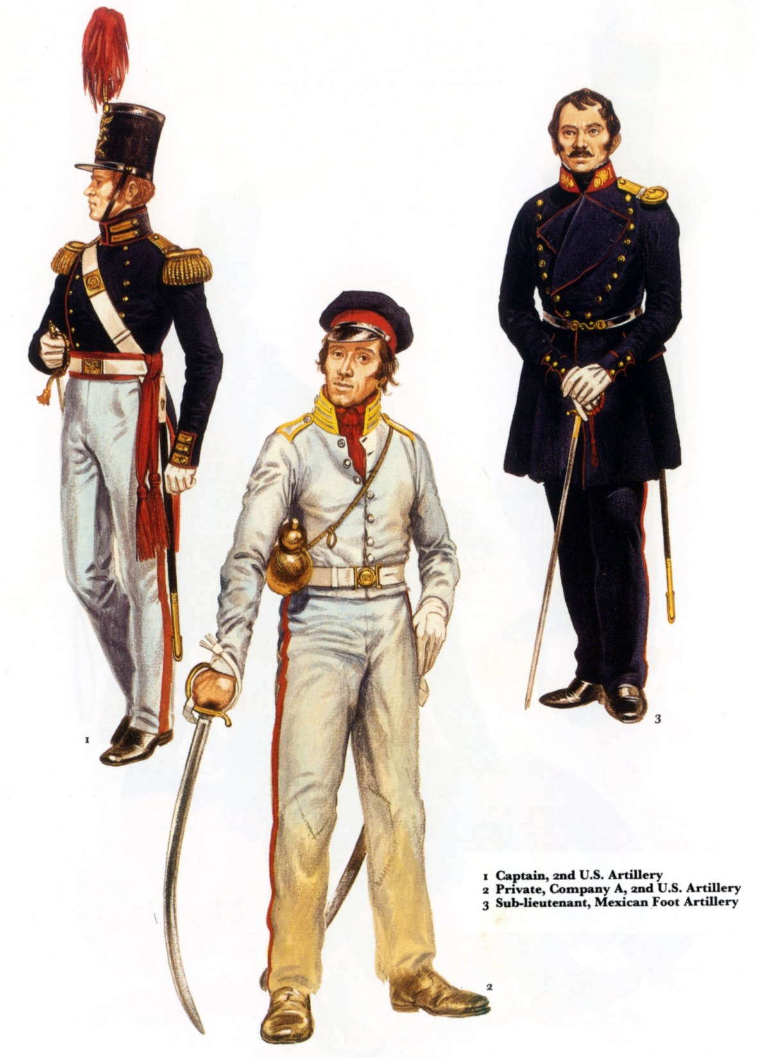

Slide 85
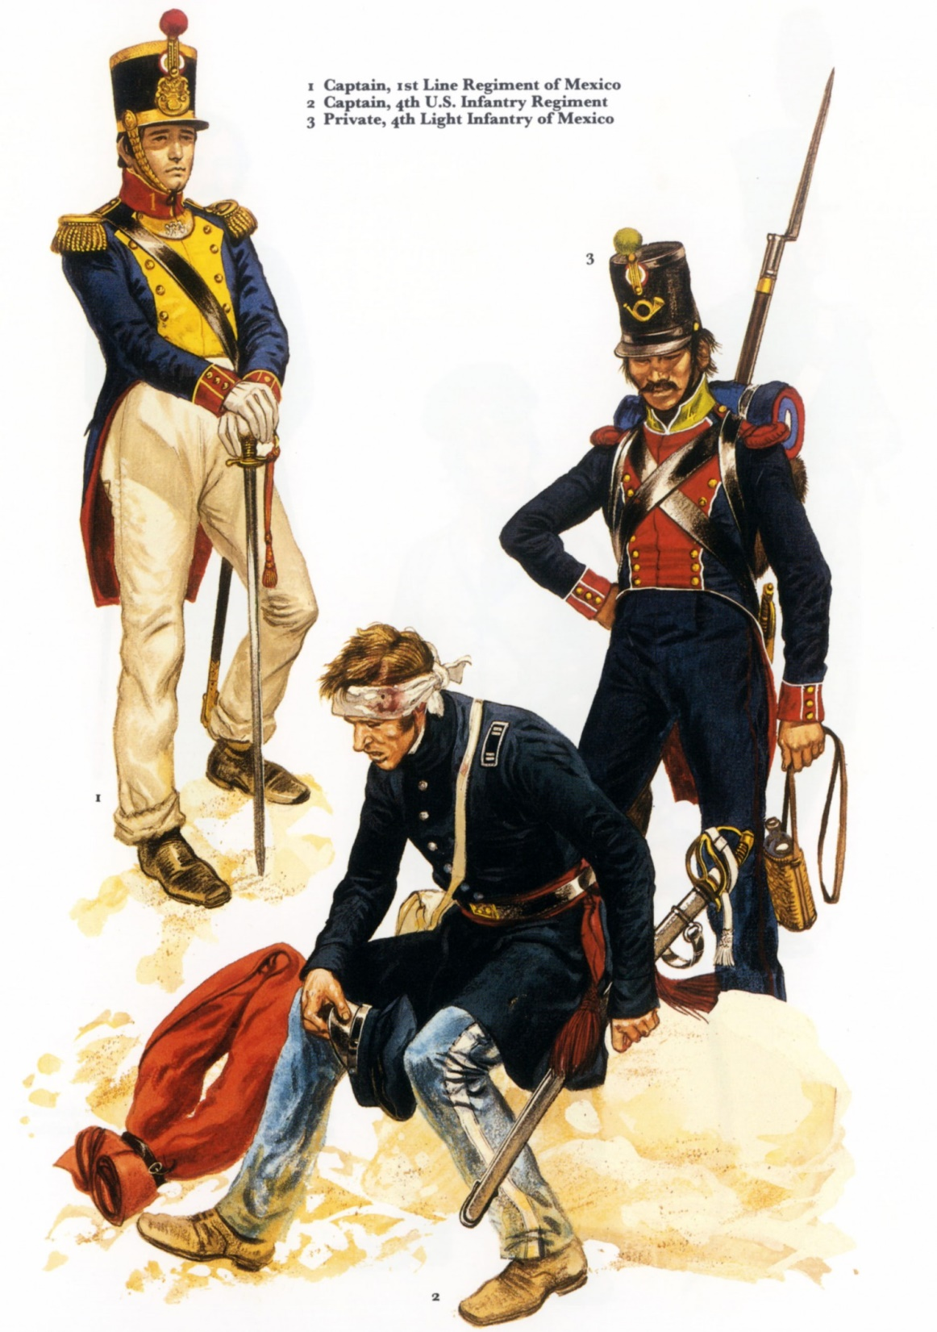

Slide 86
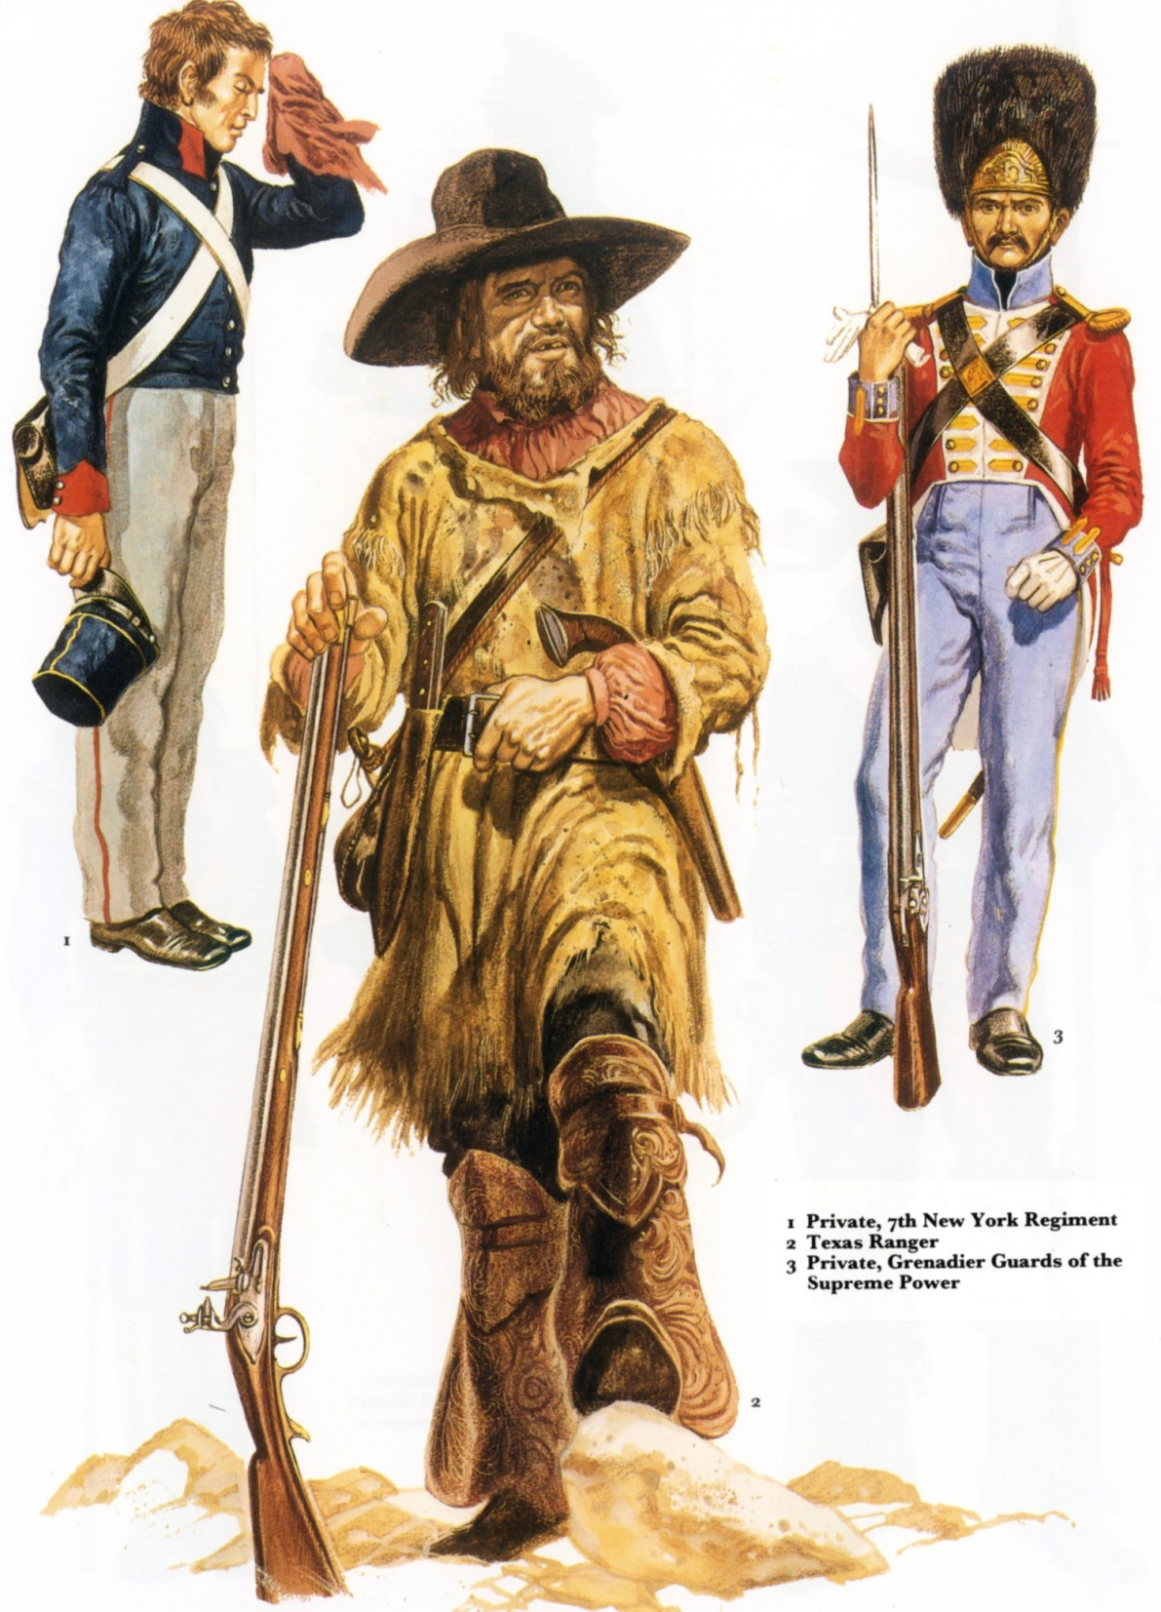

Slide 87
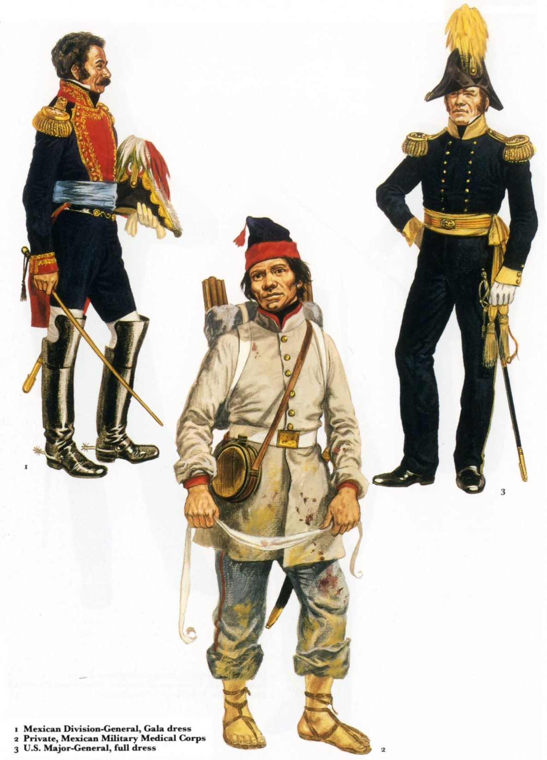

Slide 88
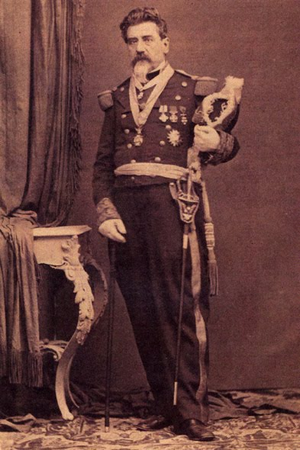
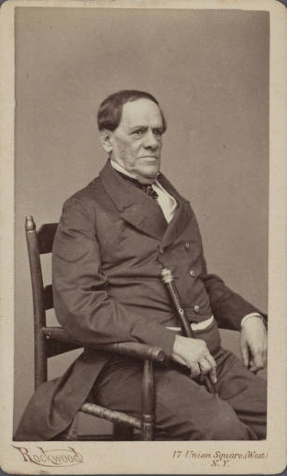
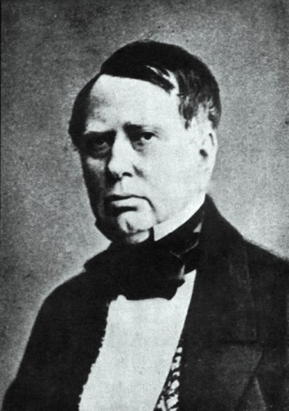
Mexico
Santa Anna- Aristo, Ampudia

Slide 89
Change in tactics
Evolutionary not revolutionary
French/British, and Prussians
All soldiers were trained in light and heavy infantry tactics.
Sped up maneuvering and flexibility in intervals depending upon the tactical situation
chasseurs à pied
Increased focus on skirmishers.

Slide 90
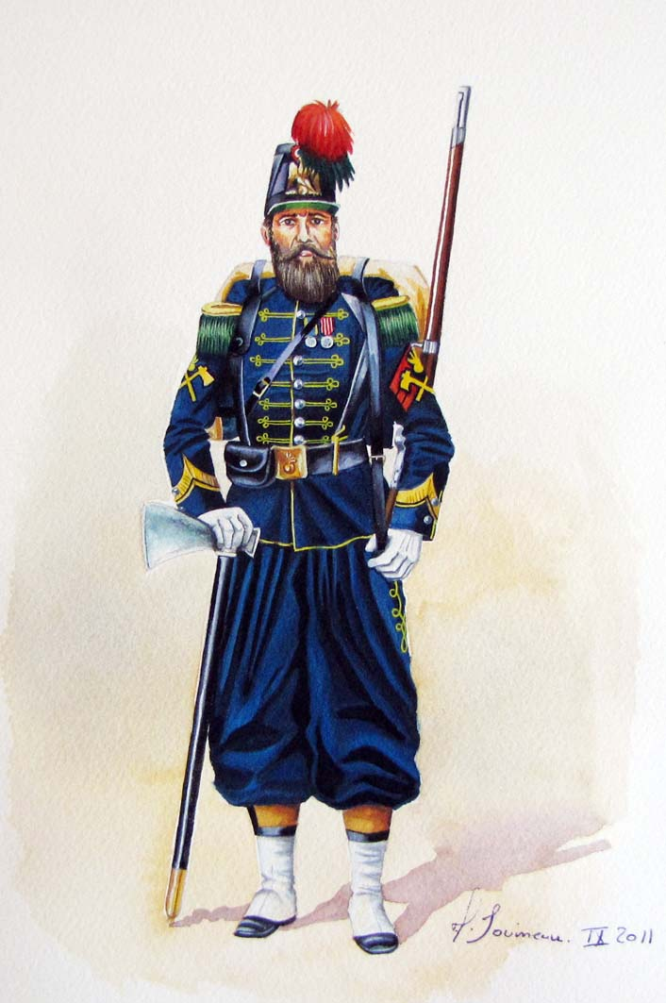
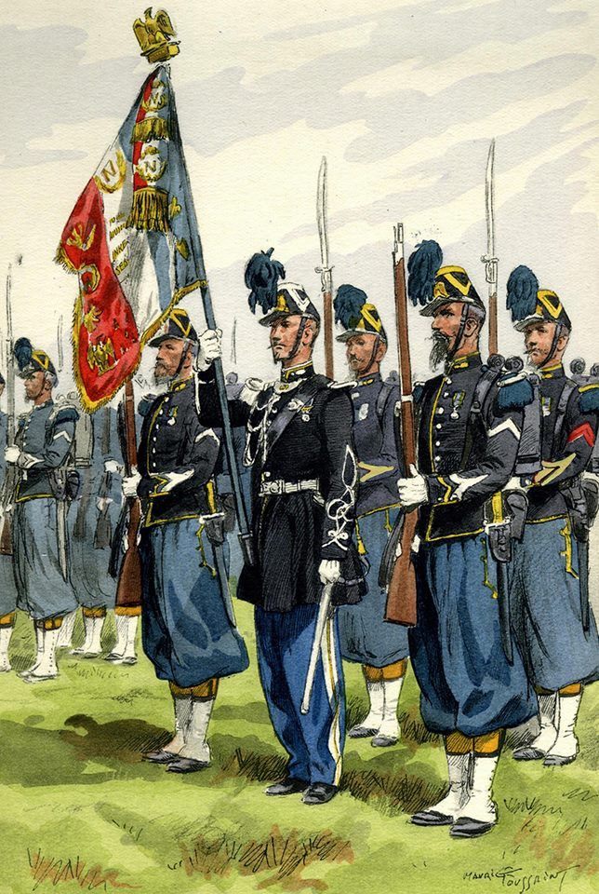

Slide 91
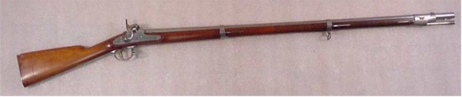
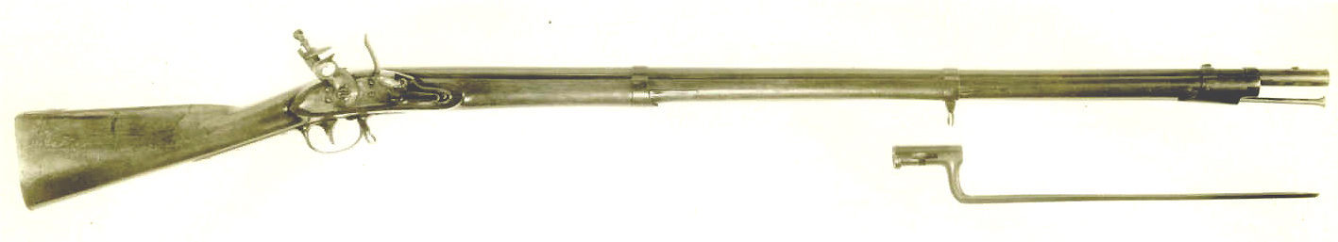
American weapons
1842 Springfield with percussion (2nd Model) (1st model flintlock)
1822 Springfield

Slide 92

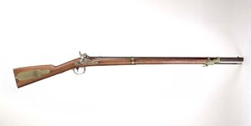
American Weapons
1847 Musketoon
1841 Springfield Rifle “Mississippi”

Slide 93
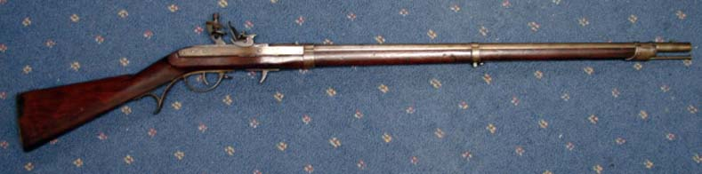
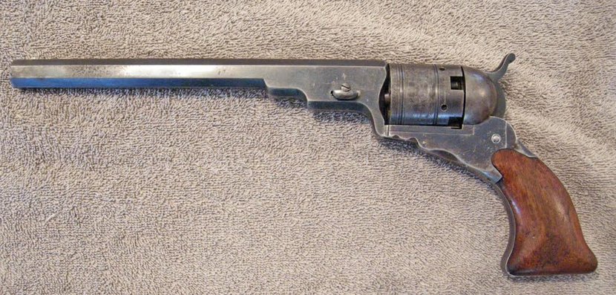
American weapons
1822 Hall Rifle
Colt Walker- Patterson

Slide 94
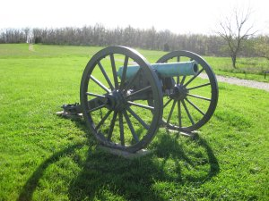
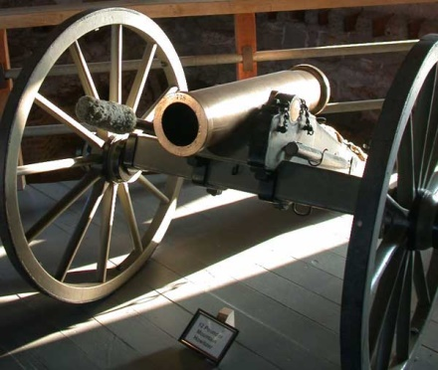
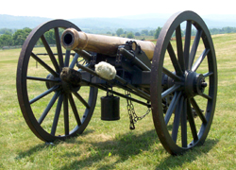
American weapons
1841 Gun 6 pounder
1841 Howitzer 12 pound
1841 Mountain Howitzer 12 pound.

Slide 95
US Army
Regulars
Myth of the Citizen Soldier
Volunteers
Militia
Brevet ranks and seniority
Complaints of officers on newly formed units and volunteers
Scum of the Earth

Slide 96
US Army Order of Battle
Regular U.S. Army regiments serving in Mexico from 1846 to 1848
Regiments of Horse
1st Regiment of Dragoons, Colonel Richard B. Mason
2nd Regiment of Dragoons, Colonel William S. Harney
3rd Regiment of Dragoons, Colonel Edward G. W. Butler,
Regiment of Mounted Riflemen, Colonel Persifor F. Smith
Regiments of artillery
1st Regiment of Artillery, Lt. Colonel Benjamin K. Pierce
2nd Regiment of Artillery, Colonel James Bankhead
3rd Regiment of Artillery, Colonel William Gates
4th Regiment of Artillery, Lt. Colonel Matthew M. Payne

Slide 97
US Army Order of Battle
Regiments of infantry
1st Regiment of Infantry, Colonel William Davenport
2nd Regiment of Infantry, Lt. Colonel Bennet Riley
3rd Regiment of Infantry, Lt. Colonel Ethan A. Hitchcock
4th Regiment of Infantry, Lt. Colonel John Garland
5th Regiment of Infantry, Lt. Colonel James S. Mcintosh
6th Regiment of Infantry, Colonels: Zachary Taylor; Newman S. Clarke
7th Regiment of Infantry, Lt. Colonel Joseph Plympton
8th Regiment of Infantry, Colonel William J. Worth
Regiments of infantry, 1847
These units were raised according to an act of Congress, 11 February 1847 for an enlistment period of one year.^{[Note 2]} 9th Regiment of Infantry, Colonel Truman B. Ransom, (appointed from Vermont)
10th Regiment of Infantry, Colonel Robert E. Temple, (appointed from New York)
11th Regiment of Infantry, Colonel Albert C. Ramsey, (appointed from Pennsylvania)
12th Regiment of Infantry, Colonel Milledge L. Bonham, (appointed from South Carolina)
13th Regiment of Infantry, Colonel Robert M. Echols, (appointed from Georgia)
14th Regiment of Infantry, Colonel William Trousdale, (appointed from Tennessee)
15th Regiment of Infantry, Colonel George W. Morgan, (appointed from Ohio)
16th Regiment of Infantry, Colonel John W. Tibbatts, (appointed from Kentucky)
Regiment of Voltigeurs and Foot Riflemen, Colonel Timothy P. Andrews, (appointed from District of Columbia)

Slide 98
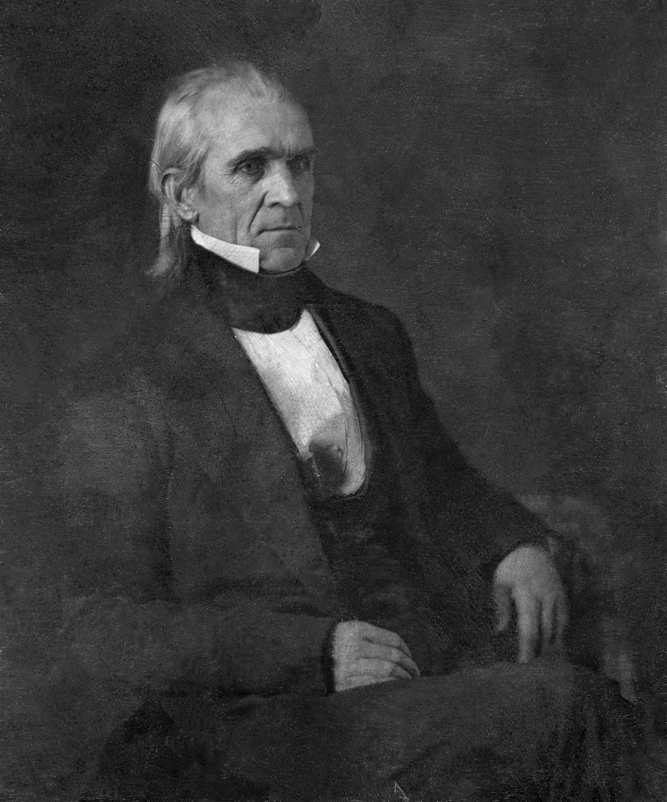
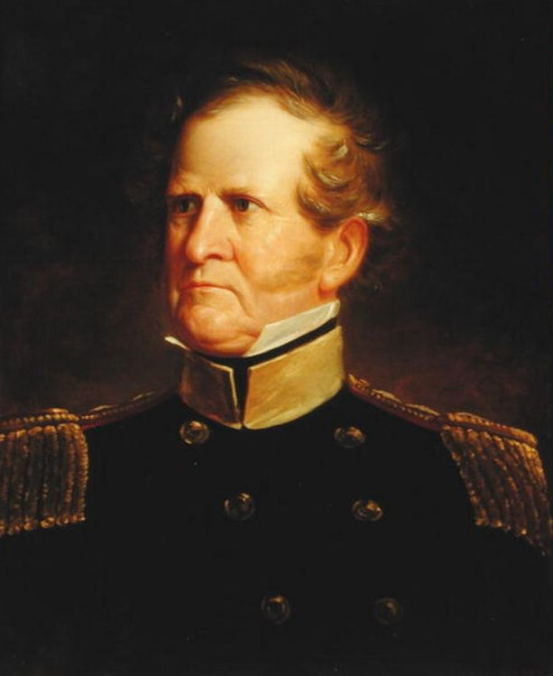
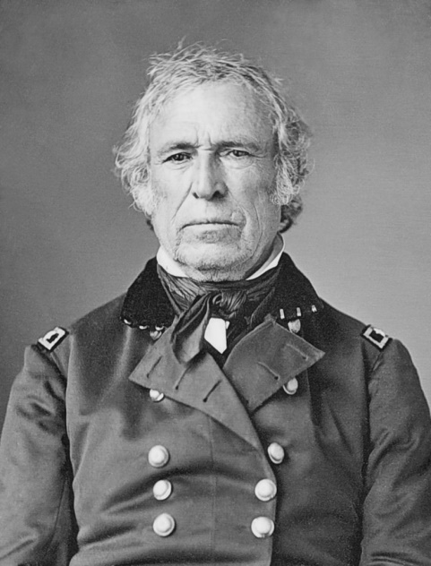
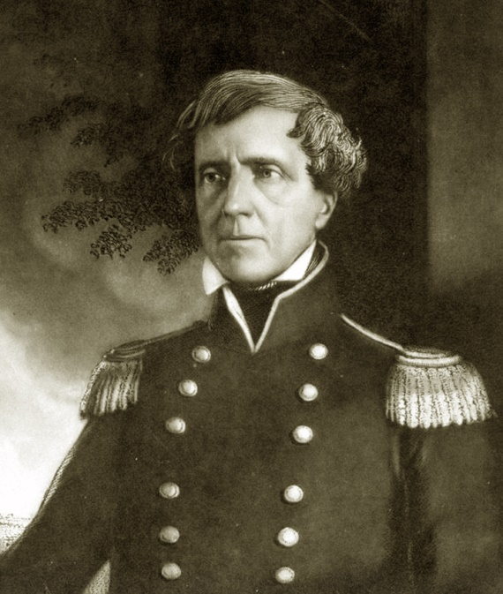
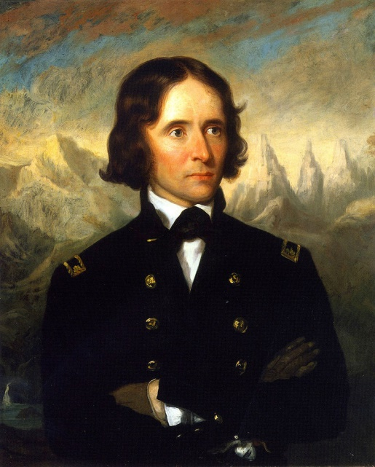
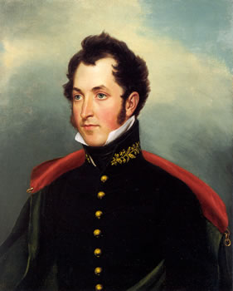
American leaders

Slide 99


Slide 100


Slide 101
Texas Campaign
Feb 1845 Polk, with approval of Tyler, orders Taylor to move to Corpus Christi.
Army of Occupation Jun 1845
Taylor in Corpus Christi with 3500 men half the Army
Mexicans move 6000 men under Ampudia, later to be replaced by Arista, to Matamoros
April 12 1846 Ampudia informs Taylor that they are on Mexican territory and must withdraw
Spring of 1842 Connor and Sloat given permission to blockade the Gulf Coast and California harbors if war breaks out.
Sloat given authority to seize ports.
Apr 14, 1846 Mexican Army tells Taylor that the war has started and they start moving north of he Rio Grande.
Ambush in which 16 Americans killed

Slide 102

Texas Campaign

Slide 103


Slide 104


Slide 105


Slide 106


Slide 107

George Meade
Topographical Engineers with Taylor

Slide 108
US Declaration of War
May 11, 1846 -"Mexico has passed the boundary of the United States, has invaded our territory and shed American blood upon American soil.“
May 13, 1846 Congress declares war 174 to 14 in the House 40 to 2 in the Senate.

Slide 109


Jefferson Davis
Col of the 1st Mississippi Rifles

Slide 110

Troop Strength
30,000
20,000
10,000
Mexico
U.S.
Notes:
Disputed Terrain
Comparison of Army strengths prior to war
American Plan:
Blockade Gulf and California Coasts with Navy
3 Pincers to occupy Northern Mexican Provinces Attempting to force the Mexicans to negotiate a border between the two countries.
Seize Monterrey with the Army of Occupation (Taylor)
Seize Chihuahua with the Center Division (Wool – Originally part of Taylor’s Army)
Seize New Mexico (Santa Fe) and subsiquently seize upper California.

Slide 111

Troop Strength
30,000
20,000
10,000
U.S. Regular
Mexico
U.S.
U.S. Volunteer
Notes:
July – Feb 1846: Taylor moves to Corpus Christi to train his army
Negotiations break down and Taylor is ordered into the disputed territory: March 23 Taylor arrives at Rio Grande to defend against Mexico crossing this river.
4000 man Army under General Arista faces Taylor on the south side of the river, treating Taylor’s Army as an invading force in their territory.
25 April – initial contact between Mexican Cavalry and US Dragoons is followed by the Mexican Army crossing the Rio East of Taylor. Taylor falls back to his supplies at Point Isabel. Taylor then moves fwd to the Rio and clashes with Arista at Palo Alto on May 8 and again at Resaca de la Palma (5 miles south) on May 9. The Mexican army breaks and crosses the river. Taylor cannot pursue due to lack of river crossing equipment.
29 July - San Diego Falls to the Navy
18 - August Kearny takes Santa Fe without a shot
Taylor establishes base at Camargo – Army grows to 15,000, but Militia fiasco and illness drop Taylor’s Army to 3,080 Regulars and 3150 Volunteers
Sept 20-24 – Taylor attacks and Monterrey falls. Taylor allows the Mexicans to withdraw and establishes an Armistice – Polk immediately rescinds it

Slide 112


Slide 113
Polk vs his generals
Jan 1848 Polk unhappy with Taylor’s handling of Monterey authorizes Scott’s amphib assault.
Strips Taylor of all his regular infantry, a large group of his volunteers and 2/3rd’s of his artillery, Taylor’s only regulars are 2 Cav Rgts and 2 artillery batteries
Mar 9 Scott lands at Veracruz
Santa Anna, who was brought in by the US on the promise to end the war, takes command of the Mexican Army.
His scouts capture US orders showing that Taylor had ben weakened and that Scott would land at Veracruz. Santa Anna vows to destroy Taylor and then proceed to meet Scott.

Slide 114


Slide 115
Troop Strength
30,000
20,000
10,000
U.S. Regular
Mexico
U.S.
U.S. Volunteer
Notes:
25 Sept-12 Dec: Kearney moves on San Diego
2 Oct – Wool leaves San Antonio – Arrives at Monclova on 29 Oct
Nov 13 – Taylor occupies Saltillo (important road juncture btwn Northern and Southern Mexico)
Nov 14 – Navy occupies Tampico
Dec 21 – Intelligence reports that Chihuahua is no longer defended, so Wool joins Taylor
Dec 25 - Doniphan (originally with Kearney’s force, who promised to support Wool if extra troops were available) defeats Mexican force at Brazito and occupies El Paso on Dec 27.
Mid Dec-Jan 23: Troops taken from Taylor (4,000 Regulars, 4,000 Volunteers) and moved to Tampico for ship transport to Veracruz.
Santa Anna forms an Army at San Luis Potosi and captures a copy of orders stating the movement of troops from Taylor to Scott. He therefore gambles by taking his troops through a seemingly impassible dessert, and attacking Taylor’s remaining volunteers.
Feb 23 – Taylor defeats Santa Anna at Buena Vista
Feb 28 – Doniphan defeats Mexican Force at Sacramento and Chihuahua falls on Mar 2
Mar 9 - Scott lands at Veracruz which falls on Mar 27
Santa Anna builds another army and establishes defensive positions to try to keep the Americans in the Yellow Fever belt.
April 18 - Scott, using reconnaissance and maneuver defeats Santa Anna at Cerro Gordo
May 15-Aug 7: Scott loses a majority of his volunteers due to enlistment expirations. He moves to Puebla and builds his force back up to 10,000. With no further troops to defend his lines of communication, he breaks free from his supply line and gambles he can live off the land.
Santa Anna builds a third Army (about 30,000 throughout the city) and occupies fortifications facing East
Aug 7-Sept 14: Scott avoids the Mexican fortifications and attacks Mexico City from the South. In a series of battles, he again defeats Santa Anna and the City falls on Sept 14.

Slide 116


American Commanders
Major General
Zachary Taylor
Major General
Winfield Scott
Notes:
See Analysis for Commander comparison.

Slide 117
Notes:
Added for possible hand outs.

Slide 118

San Patricios

Slide 119


Slide 120


Slide 121



Training Ground

Slide 122


Slide 123


Slide 124


Training Ground

