Slide 1
The Guns of August
Nick Noppinger

Slide 2
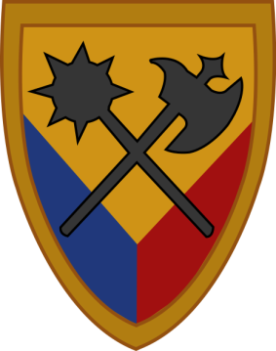
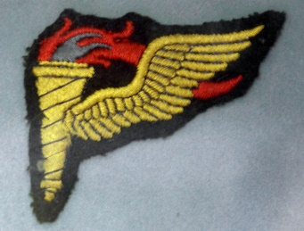
Qualifications
Doctorate in Military History/Civil War Concentration from American University- Dr Steven Woodworth of TCU mentor
Masters in Military History/Science with concentrations in the American Civil War, The World Wars, Napoleon and the Long Peace, Colonial America, Classical
Graduate Certificates-Europe in the Middle Ages, Renaissance and Reformation, War and Diplomacy, Military Science
US Army Veteran of the Cold War, Panama- Just Cause, Gulf War 1- Desert Shield and Desert Storm
Cav Scout, US Army Weapons Immersion Program, NCO Armor leadership course., US Army Airborne School, US Army Pathfinder School, Spur Ride with Delta Troop, 10th Cav 194th Arm Bde, SFQC.
Delta Troop 10th Cav-194th Arm Bde, C. Co, 3rd Bn, 73rd Arm, 82nd Airborne- US Army OPFOR detachment Ft Knox when with 10th Cav.
Trained to be an expert on the Red Army with an emphasis on their armor, mechanized/motorized infantry, Spetznaz and reconnaissance forces.

Slide 3
National Policy
Grand Strategy
Military Strategy
Operations
Tactics

Slide 4
National Policy
The basic and supreme war aim of the nation.
Everything else subordinate and considered tools to achieving the all encompassing national policy.
For the Central Powers- Defeat, in some form, of the Entente- Germany as uncontested dominant power of Europe with Austria-Hungary strengthened.
For the Entente- Defeat, in some form, of the Central Powers redress of territorial issues. separation and independence.
Political in nature.

Slide 5
Grand Strategy
The mobilization of a nations, political, military, social, cultural, religious, and economic forces to achieve the national policy.
Military planning at its most basic- {attack into French territory). Some overlap with military strategy.
Centers of gravity.
Center of gravity could be a geographical point or the enemy’s army(ies). There can also be more than one.
Grand strategy includes such things as emancipation.
While it identifies centers of gravity, it is less military in nature, as it includes all of the factors.

Slide 6
Military strategy
The more detailed planning and employment of military forces in an attempt to carry out the grand strategy and national policy.
“Arrows on maps”
For example-Schlieffen Plan.
Military in nature- the importance of other aspects still present but diminishing.
Concentration in time
Concentration in space

Slide 7
Operations
The planning and employment for a particular campaign.
The management and organization of an army
For example, the decision to invade through Belgium.

Slide 8
Tactics
The employment of troops in a specific battle at all levels from Army to individual soldier.
Sometime divided into Grand tactics and tactics.

Slide 9
Carl von Clausewitz

Slide 10
Von Clausewitz
the dialectical approach to military analysis
the methods of "critical analysis
the economic profit-seeking logic of commercial enterprise is equally applicable to the waging of war and negotiating for peace
the nature of the balance-of-power mechanism
the relationship between political objectives and military objectives in war
the asymmetrical relationship between attack and defense
the nature of "military genius" (involving matters of personality and character, beyond intellect)

Slide 11
Von Clausewitz
the "fascinating trinity" (wunderliche Dreifaltigkeit) of war.
philosophical distinctions between "absolute war," "ideal war," and "real war"
in "real war," the distinctive poles of a) war of limited objectives and b) war to "render the enemy helpless"
"war" belonging fundamentally to the social realm—rather than to the realms of art or science
"strategy" belongs primarily to the realm of art, but is constrained by quantitative analyses of political benefits versus military costs & losses
"tactics" belongs primarily to the realm of science (most obvious in the development of siege warfare)
the importance of "moral forces" (more than simply "morale") as opposed to quantifiable physical elements

Slide 12
Von Clausewitz
the "military virtues" of professional armies (which do not necessarily trump the rather different virtues of other kinds of fighting forces)
conversely, the very real effects of a superiority in numbers and "mass"
the essential unpredictability of war
the "fog" of war
"friction" – the disparity between the ideal performance of units, organization or systems and their actual performance in real world scenarios strategic and operational "centers of gravity"
the "culminating point of the offensive"
the "culminating point of victory"

Slide 13
The culminating point
The culminating point in military strategy is the point at which a military force no longer is able to perform its operations.
On the offensive, the culminating point marks the time when the attacking force can no longer continue its advance, because of supply problems, the opposing force, or the need for rest. The task of the attacker is to complete its objectives before the culminating point is reached. The task of the defender on the other hand, is to bring the attacking force to its culminating point before its objectives are completed.
The concept of a culminating point was formulated by the Prussian military theorist Carl von Clausewitz in his book On War published in 1832

Slide 14
Clausewitzian Trinity
1) primordial violence, hatred, and enmity, which are to be regarded as a blind natural force-the people
2) of the play of chance and probability within which the creative spirit is free to roam-the commander of an army
3) and of its element of subordination, as an instrument of policy, which makes it subject to reason....”-the government
WAR IS CHAOS and the side which best manages that chaos will win
DETERMINISTIC CHAOS

Slide 15
Friedrich Adolf Julius von Bernhardi

Slide 16
Von Bernardi
Deutschland und der Nächste Krieg (Germany and the Next War), 1911
a policy of ruthless aggression and of complete disregard of treaties
War is divine business
war "is a biological necessity,“
"the natural law, upon which all the laws of Nature rest, the law of the struggle for existence."

Slide 17
Lecturer Biases
Anti-socialist/communist.
Anti-Frankfurt School and Third Way- Marcuse and Foucault as naïve morons.
Political realist, but in the Austrian School in economics.
Opposed to political idealism as a matter of practicality.
Oppose the Democratic Peace Theory as naïve in the extreme, with no basis in history.
Anti-egalitarian and “Justice as fairness” (Rawls)- again on practical matters.
Political Realist in the mold of Machiavelli, von Clausewitz, Mackinder, Hobbes, Kennan, Kissinger model.

Slide 18
What is Political Realism?
That states are the central actors in international politics rather than individuals or international organizations,
Caveat 1 -that they serve some purpose, but are largely impotent short of world power agreement.
That the international political system is anarchic as there is no supranational authority that can enforce rules over the states,
Caveat 2-WITHOUT the compliance of the states.
That the actors in the international political system are rational as their actions maximize their own self-interest, and
Caveat 3- Irrational actors are usually short lived if they threaten the world balance.
That all states desire power so that they can ensure their own self-preservation.

Slide 19
What does this mean
I view political realism as the only political philosophy with evidence in history.

Slide 20
The 4 Propositions of Realism
The international system is anarchic. No actor exists above states, capable of regulating their interactions; states must arrive at relations with other states on their own, rather than it being dictated to them by some higher controlling entity. The international system exists in a state of constant antagonism
States, or semi states, are the most important actors.

Slide 21
The 4 Propositions of Realism
All states within the system are unitary, rational actors- States tend to pursue self-interest. Groups strive to attain as many resources as possible.
The primary concern of all states is survival. States build up a military to survive, which may lead to a security dilemma.

Slide 22
Geopolitics
Geopolitics, analysis of the geographic influences on power relationships in international relations, however, in contemporary discourse, geopolitics has been widely employed as a loose synonym for international politics.
Earliest roots in Thucydides, Machiavelli- The Prince and Art of War.
CAN TRANSCEND WHATEVER POLITICAL PARTY CONTROLS A NATION, HOWEVER, A POLITICAL PHILOSOPHY, AS WELL AS RELIGION, AND CULTURAL ISSUES CAN HEAVILY INFLUENCE GEOPOLITICS.

Slide 23
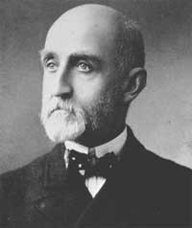
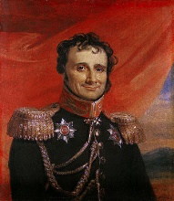
MODERN GEOPOLITICAL THEORY
CHOKEPOINT THEORY
Antoine-Henri Jomini
Alfred Thayer Mahan- The Influence of Sea Power Upon History, 1660–1783 (1890) believed that national greatness was inextricably associated with the sea—and particularly with its commercial use in peace and its control in war…and emphasized that strategic locations (such as chokepoints, canals, and coaling stations), as well as quantifiable levels of fighting power in a fleet, were conducive to control over the sea.

Slide 24
Mahan
He proposed six conditions required for a nation to have sea power:.
Advantageous geographical position;
Serviceable coastlines, abundant natural resources, and favorable climate;
Extent of territory
Population large enough to defend its territory;
Society with an aptitude for the sea and commercial enterprise; and
Government with the influence and inclination to dominate the sea

Slide 25
Influence
United Kingdom- to some extent with exception on some aspects of naval strategy.
Germany to 1918
Japan to 1945
United States

Slide 26
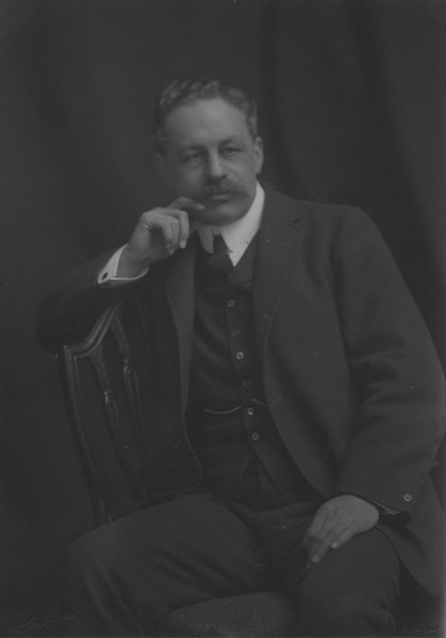
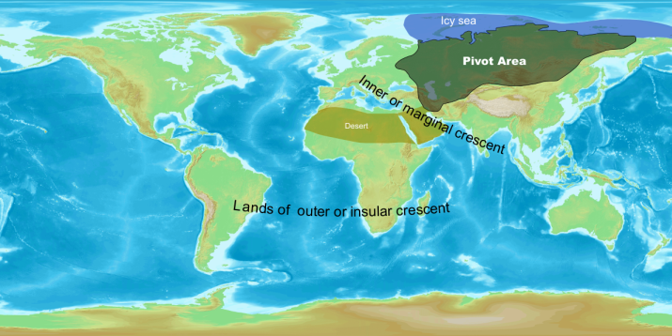
Sir Halford Mackinder
Heartland Theory

Slide 27
Heartland Theory
"Who rules East Europe commands the Heartland;
who rules the Heartland commands the World-Island;
who rules the World-Island commands the world.“
The West European powers had combined, usually successfully, in the Great Game to prevent Russian expansion.
The Russian Empire was huge but socially, politically and technologically backward—i.e., inferior in "virility, equipment and organization".

Slide 28
Heartland Theory
The Heartland was protected from sea power by ice to the north and mountains and deserts to the south.
Previous land invasions from east to west and vice versa were unsuccessful because lack of efficient transportation made it impossible to assure a continual stream of men and supplies.

Slide 29
Heartland Theory
Mackinder warned the leaders of Great Britain that its reliance on seapower and quasi-Mahanian theory might not be enough to contain a Eurasian power that controlled the Heartland.
The nightmare was that if Germany or Russia were allowed to control East Europe then this could lead to the domination of the Eurasian land mass by one of these two powers as a prelude to mastery of the world.
Coincided to past British National Policy.
Very influential on both US and UK foreign policy post World War 2

Slide 30
Geo-political concepts
Autarky is the quality of being self-sufficient. Usually the term is applied to political states or their economic systems. Autarky exists whenever an entity can survive or continue its activities without external assistance or international trade. If a self-sufficient economy also refuses all trade with the outside world then it is called a closed economy

Slide 31
World War 1 Historiography
History of history
No current consensus- in which a majority agree on why the war started
There are large pluralities on different aspects
My position is that it was all of the above
I eschew historical schools of thought such as the Annales or Marxist
I will use a mixture of the Annales and the Great Man Theory
Annales is history over a long period of time and mentalities
The history of mentalities focuses on the wider mindsets of past cultural and social groups. In keeping with the Annales' interest in the longue durée (long-term), it tends to focus on gradual developments rather than short-term events. The term can also be seen as an equivalent to, or a form of, cultural history or historical anthropology.
Famous Annales School of Georges Duby, Marc Bloch, Roger Chartier

Slide 32
German Guilt
Von Bernardi and to a less extent von Clausewitz as warmongers
Fritz Fischer- Fischer Hypothesis-the outbreak of the war rested solely on Imperial Germany.
Griff nach der Weltmacht: die Kriegszielpolitik des Kaiserlichen Deutschland, 1914–18, 1961.
Examined German Imperial Documents alone
that there was continuity in German foreign policy from 1900 to the Second World War, implying that Germany was responsible for both world wars.
Fischer was the first German historian to support the negative version of the Sonderweg ("special path") interpretation of German history, which holds that the way German society developed from the Reformation (or from a later time, such as the establishment of the German Reich of 1871) inexorably culminated in the Third Reich. Prussian/German militarism peculiar to the Germans.
Particularly strong among leftwing German historians and select leftists from other countries with the exception of many Marxists who dislike Fischer for not mentioning class to the extent of their desires.
This is still a VERY influential school.
I like m0st British historians reject at it as an oversimplification that ignores the warlike tendencies of other nations and its laser like focus on German documents to the exclusion of others.
Fischer found what he wanted to find and ignored what he didn’t.

Slide 33
Caveat-Weltpolitik
I do recognize Wilhlem II’s transition to Weltpolitik
Was the imperialist foreign policy adopted by the German Empire during the reign of Emperor Wilhelm II from 1890 onwards. The aim was to transform Germany into a global power through aggressive diplomacy, the acquisition of overseas colonies, and the development of a large navy. Though considered a logical consequence of the German unification by a broad spectrum of Wilhilmine society, it marked a decisive break with the defensive Realpolitik of the Bismarck era.
German bungling

Slide 34
Germany
German Imperial General Staff worried about growing Russian power and suggested that if war was inevitable it was better sooner than later.
Most people forget this was the military does by nature.
War Plan Red scenario
Germany was looking to split the Entente isolating France.

Slide 35
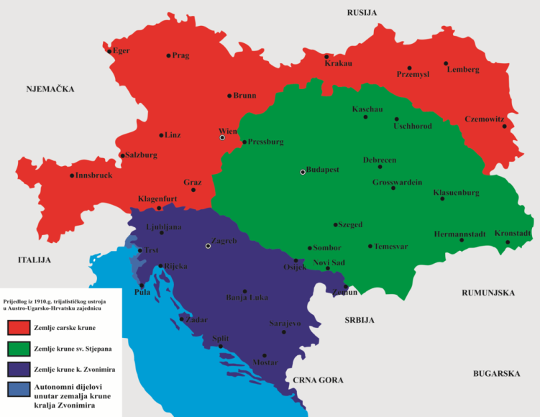
Austria-Hungary
View that AH was on its way out- its multi-ethnic Empire could not exist because of Austrian, Hungarian, and the many Slavic groups nationalism.
Trialism

Slide 36
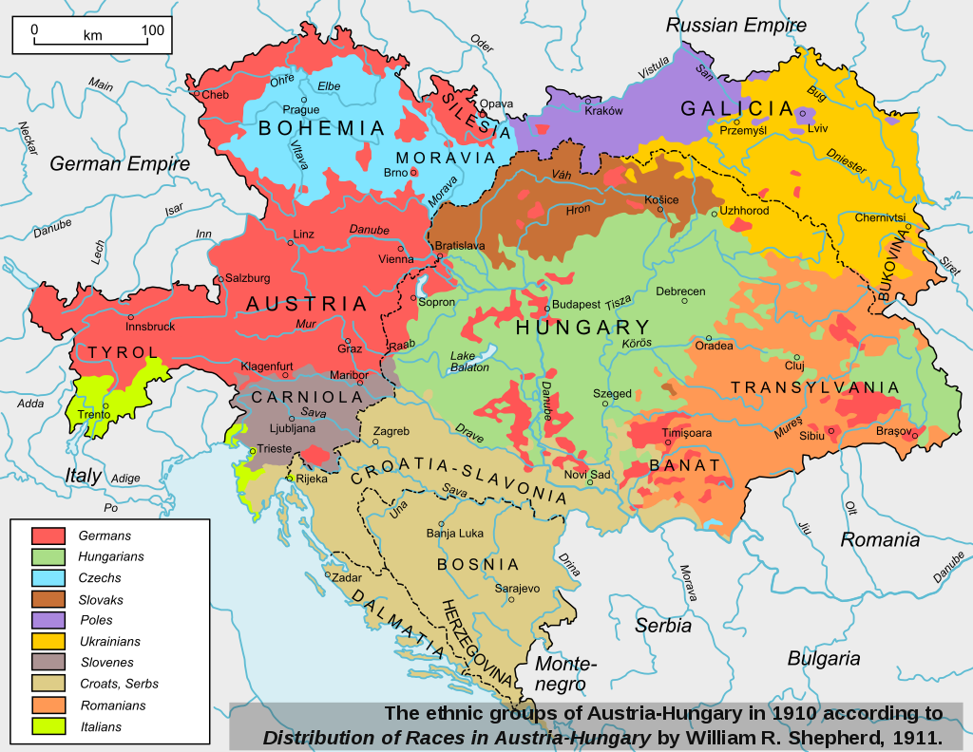

Slide 37
Austria-Hungary
Quality of life was actually going up in AH before the war which lessened nationalistic sentiment.
There were no mainstream attempts by the local powers that be to break it up
They wanted to share in the power.
A contemporary described it ‘desperate but not serious.”
Postwar to discredit the breakup of AH
AH was very aggressive towards Serbia and reckless
Believed that war would only be with Serbia
AH incompetents

Slide 38
Serbia
Greater Serbia
Elements of the Serbian government were behind the assassination of Franz Ferdinand.

Slide 39
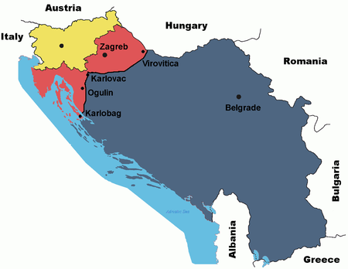

Slide 40
French and Russian Stupidity
The Entente went from a loose defensive alliance to one in which the French pushed for an alliance based upon expansion and spheres of influence.
France recognizes Russia’s “protectorate” over Slavs, particularly South Slavs.
Poincaré visit 20 July and departed on 23 July 1914
The French blank checque to Russia
Agreement to protect Serbia
Russia has been flaming anti-Austrian irredentism since 1912
France aggressively wants return of Alsace-Lorraine and ahs been looking for an alliance with another power to go to war.

Slide 41
British Bungling
Anglo-German Détente 1912-1914 ignored
Britain ignored French bellicosity while highlighting every action in Germany
Even if the alliance was loose there was a view that Britain had to back the Entente or ally with the Central Powers.
Only the former was a realistic policy for if Germany one Britain’s position would be threatened.
Britain already an existing quasi-alliance with France and Russia.
Niall Ferguson and Christopher Clark believe that Britain turned to alliance with France and Russia over Germany as they saw the former as less of a threat to her empire.

Slide 42
Sick Man of Europe-The Ottoman Empire
By 1914 had lost most of its European possessions.
British, Russian, and French ambitions

Slide 43
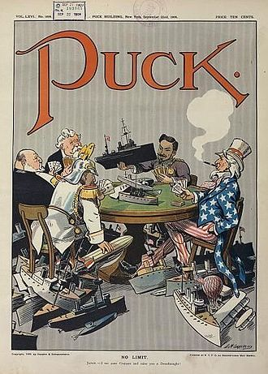
Arms Race
Both sides were training substantially larger reserves pools of manpower.
Naval

Slide 44
Arms Race
Jackie Fisher
1912 Haldane Mission-the Germans attempted to link a "naval holiday" with a British promise to remain neutral if Germany should attack France
The Germans largely abandoned the race in 1913 as too expensive.
However, the cultural aspects is downplayed Clark and Ferguson.

Slide 45
Imperialism
Germany, Italy and Japan the late bloomers
All sides had extensive colonial Empires.
The primary Marxist cause for the war.
"Imperialism," argued Lenin, "is the monopoly stage of capitalism.

Slide 46
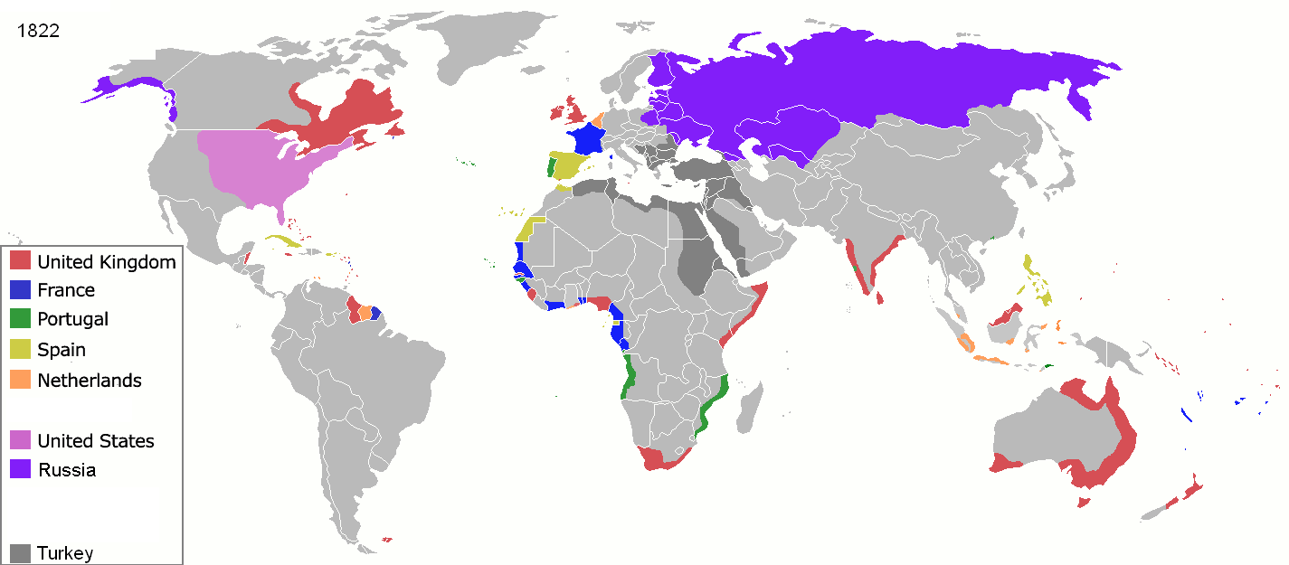

Slide 47
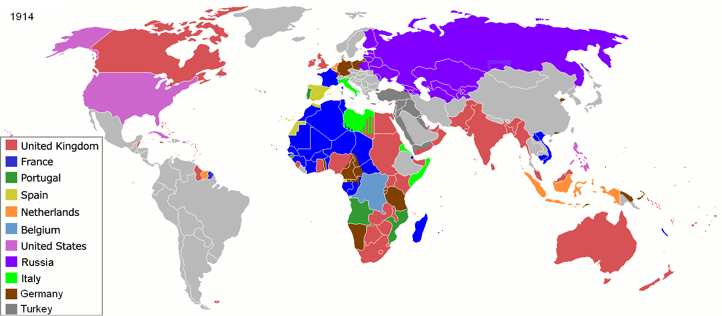

Slide 48
Short War Theory
Still seen in High School and some college textbooks
Largely discredited as theory as there is ample evidence that the governments thought this was going to be a long war even if they said otherwise to their public.
Moltke hoped that a European war, if it broke out, would be resolved swiftly, but he also conceded that it might drag on for years, wreaking immeasurable ruin. Asquith wrote of the approach of ‘Armageddon’ and French and Russian generals spoke of a ‘war of extermination’ and the ‘end of civilization’. Foreign Secretary Grey famously stated just hours before Britain declared war: "The lamps are going out all over Europe, we shall not see them lit again in our life-time”.

Slide 49
Alliances
Both Alliance systems, until relatively late, were much looser than is suggested.
Defensive in nature only.

Slide 50
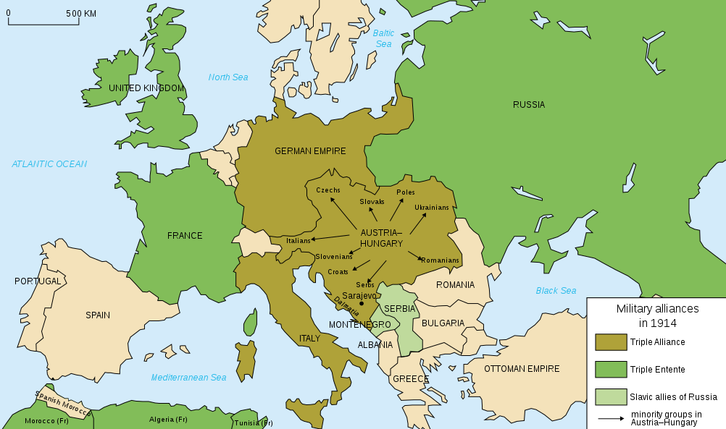

Slide 51
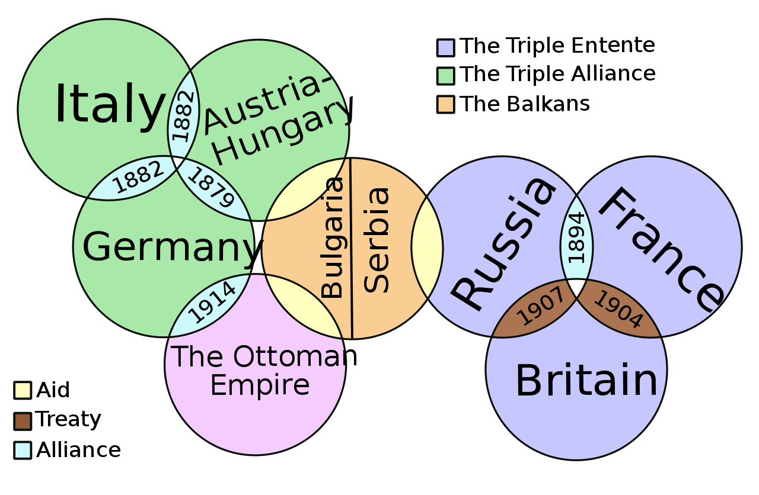

Slide 52
The Long Term (VERY) causes of the War
Can be traced to formation of modern Europe and the changing geo-political factors of Europe.
The wars of religion in France, Britain, and Germany will have a profound impact on later European history.
The Holy Roman Empire and the growing power of Britain and France.
Protestant vs Catholic
France vs any too powerful German state, which is for most of the period since 1648 the Holy Roman Empire or Hapsburg Austria.
France actively working to suppress German nationalism.

Slide 53
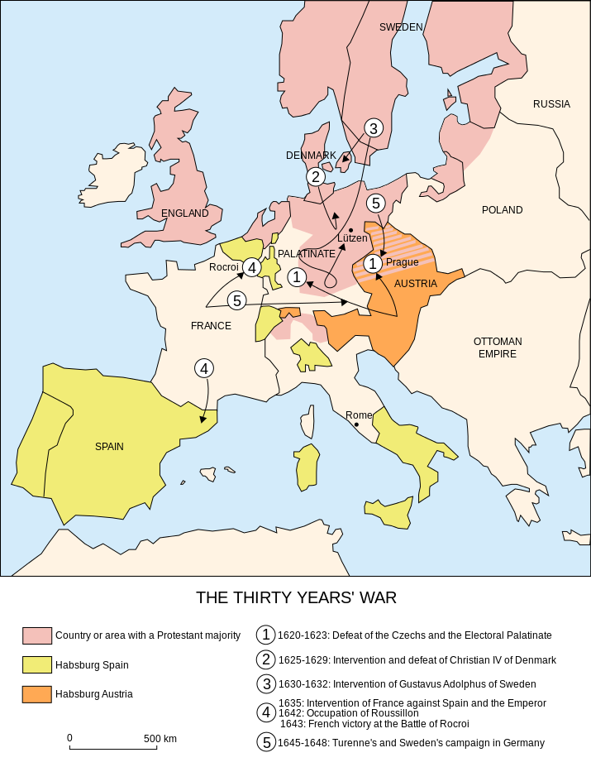

Slide 54
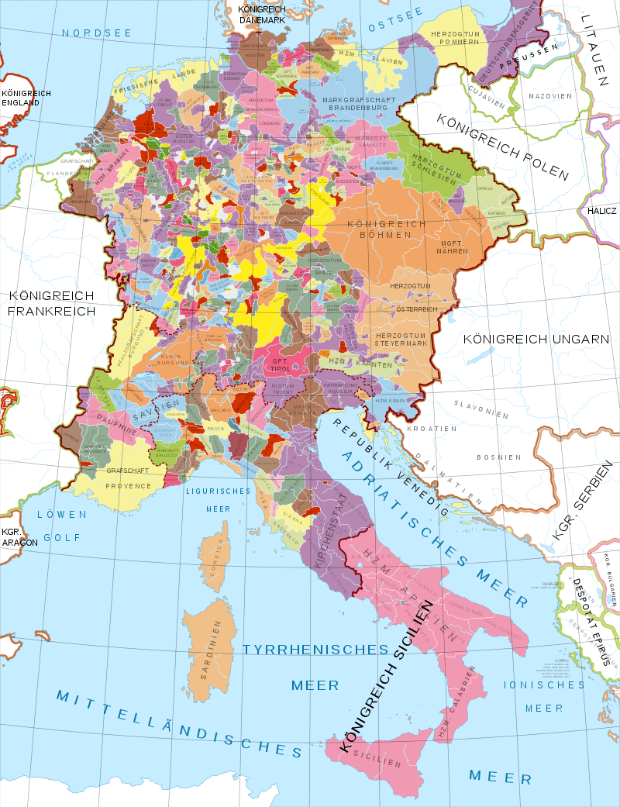

Slide 55
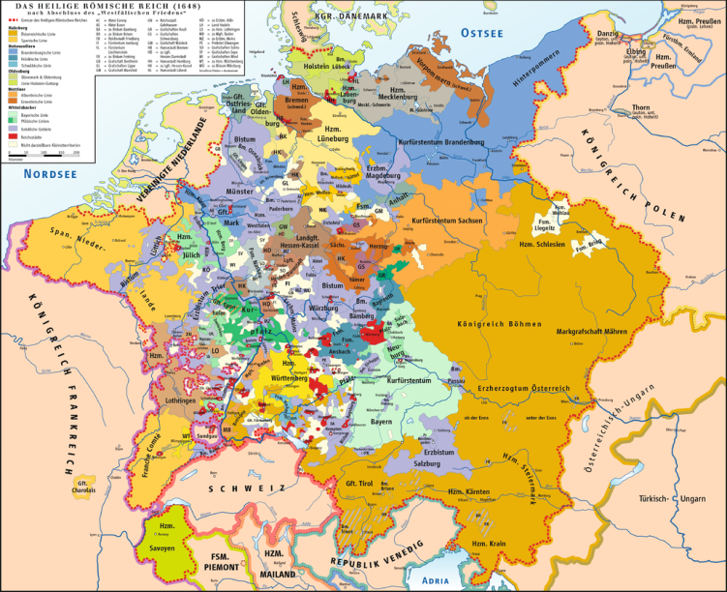

Slide 56
Internal Hindrances to German Irridentism
If you are one of the minor German states do you want to you want to bel completely subservient to the Holy Roman Empire?
Especially is Catholic and you are Protestant or vice versa
You will do enough homage
But you will play the major powers against each other
Catholic Bavaria will usually side against Catholic Austria.
Later Protestant Saxony will ally with Catholic Austria or France against Protestant Prussia

Slide 57
By the 1700’s
The UK has a national policy of maintaining the preeminent navy, plus allying against the strongest power in the continental Europe-usually France.
The rise of Prussia.
France plus others, usually Spain and sometimes Prussia and Russia against the UK, Austria, and sometimes Russia
France allies with Austria (Marie Antoinette), causing the UK to support Prussia.
Russian power grows.

Slide 58
Prussia
Starts as tributary to Austria King in Prussia instead of King of Prussia
Will change with Frederick the Great
Prussia comes to challenge Austria for supremacy among German states.

Slide 59
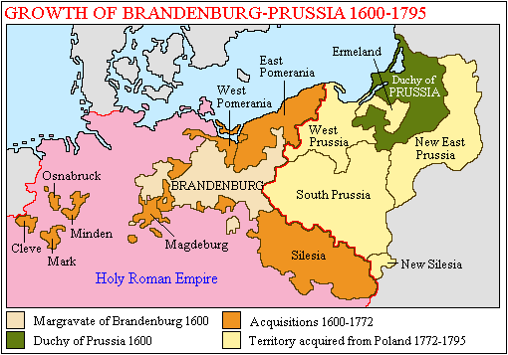

Slide 60
British National Policy Tudor to 1815
Tudor through 1791
Semi-Autarky through mercantilism
Naval parity to protect trade to 1700
Colonial competition- Colonies benefiting mother country.
Maintain naval supremacy from 1700 1815 to protect sea lanes in terms favorable to Britain.
Ally against strongest European power because they posed a threat to British national policy. From France to Spain, Holy Roman Empire, France, briefly the Dutch, back to France
When France was the enemy they usually allied with Austria and/or Prussia.
Saw France as primary threat for most of the period, because of France’s threat to British trade and French ambitions in Europe as leading power.
Concerned with Russian expansion from mid-1650’s in the Baltic, and Balkans.’
Naval Supremacy and ally against the strongest European power.

Slide 61
1756 The Great Shift

Slide 62
Russia and Austria-Hungary
From Peter the Great’s time Russia expands against Swedish, Turkish territory
AH starts nibbling at Ottoman Empire territory in the Balkans.

Slide 63
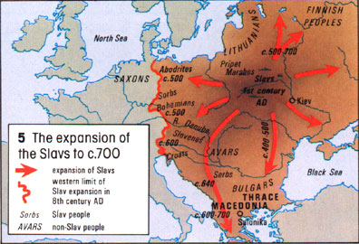

Slide 64
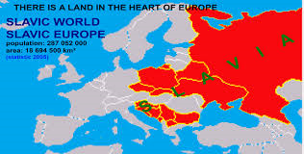

Slide 65
Russia’s Expansion

Slide 66
The Age of Metternich or Concert of Europe
Semi-officially over by 1823.
Maintains the balance of power
Count Metternich
Suppressed nationalist and revolutionary fervor
Killed by national rational self-interest

Slide 67
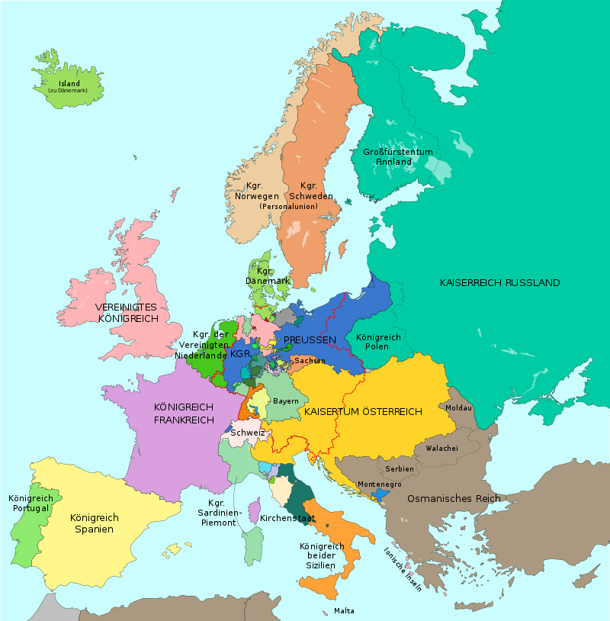

Slide 68
France
Germany
Russia
Austria-Hungary
UK
Italy
Serbia
Greece
Ottoman Empire
Bulgaria
Rumania

Slide 69
Franco-Prussian War 1870-1871
Leads to the formation of the German Empire under Prussian (House of Hohenzollern).
German Empire is a Federation dominated by Prussia.
Bavaria, Wurttemberg, and Saxony maintain their own separate armies subordinated to the German High Command. Practically indistinguishable from each other.
Rise of the socialists. German domestic policy is to split the progressives and maintain the Center and conservatives.

Slide 70
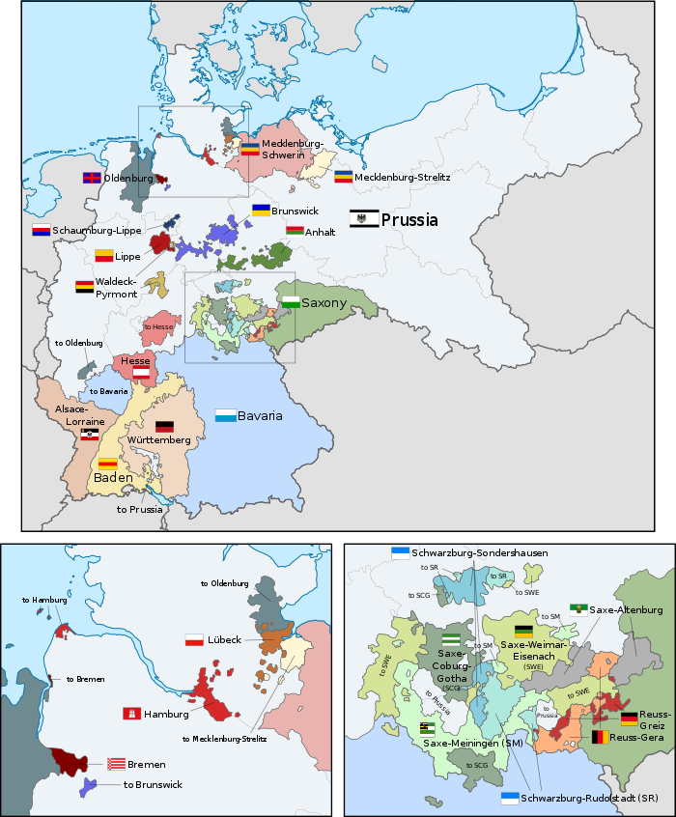

Slide 71
Realpolitik-Bismarck, Roon, Moltke

Slide 72
Bismarck’s goals
KEEP FRANCE POLITICALLY ISOLATED
German belief that an alliance with 2 of the 3 essential. Italy, Russia, Austria-Hungary to its survival.
Austrian isolation after failure to help Russia during Crimean War and Austro-Prussian loss.
Dual Alliance from 1879
League of the Three Emperors- 1873-1878, 1881-1887 fails because Russian and Austrian disputes in the Balkans.
Reinsurance Treaty 1887-1890- Secret treaty between Russia and Germany

Slide 73
Triple Alliance 1882-1914

Slide 74
Russia
Find a country to help finance industrialization.
Balkans
Pan-Slavic
Protector of all eastern Orthodoxy
Move from UK and Japan as rivals towards Austria-Hungary as the main rival.
Will sign a defensive alliance with France 1894

Slide 75
Russia’s Expansion

Slide 76
France
Franco-Russian Alliance 1894
Competition with Great Britain in Africa
Entente Cordiale 1904 with Great Britain
Loose naval treaty that delineated UK and French spheres in the Mediterranean.
Will not become a formal alliance until World War 1
Triple Entente

Slide 77
France Long term
Britain the main enemy until 1870.
UK kicks France, mostly out of the Americas.
Formation of Germany, and to a lesser extent Italy, seen as problem by France.

Slide 78
United Kingdom
Splendid Isolation 1860-1902
British isolation, and minor German meddling, during the Boer Wars.
France, Russia and German seen as a threat to colonial empire.
1870 UK leading industrial power, by 1914 overtaken by US and Germany.
German naval arms program
Treaty with Japan 1902
Cordiale with France 1904
Navy to maintain Free Trade

Slide 79
Why have colonies?
Natural resources
Ready market for manufactured goods.
Native populations to exploit/ improve
Autarky
National Prestige
Late bloomers Germany, Italy and Japan.

Slide 80
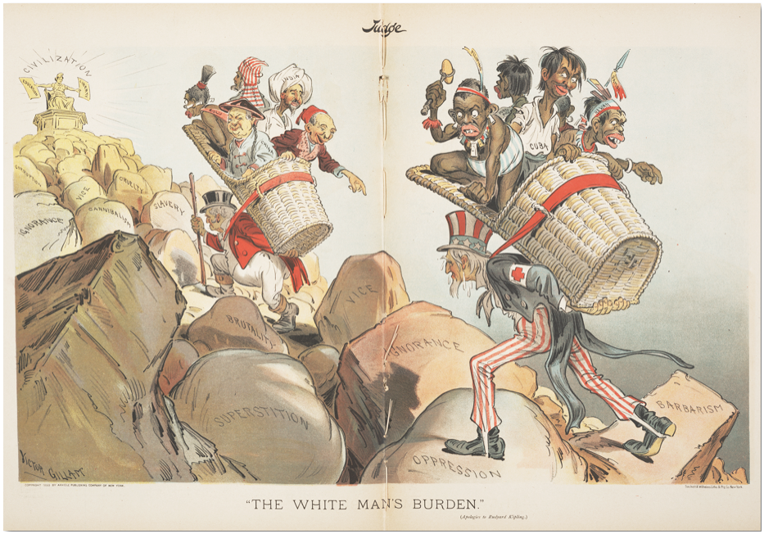

Slide 81
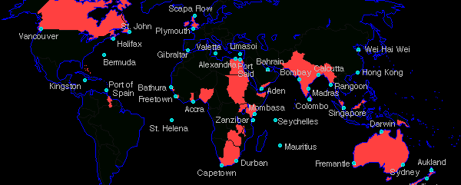
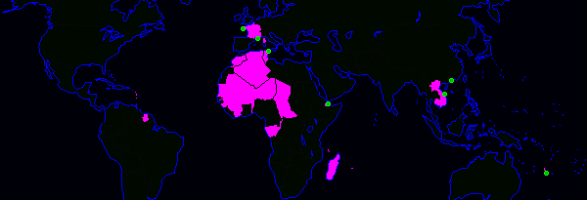
Empires
British Empire
French Empire

Slide 82
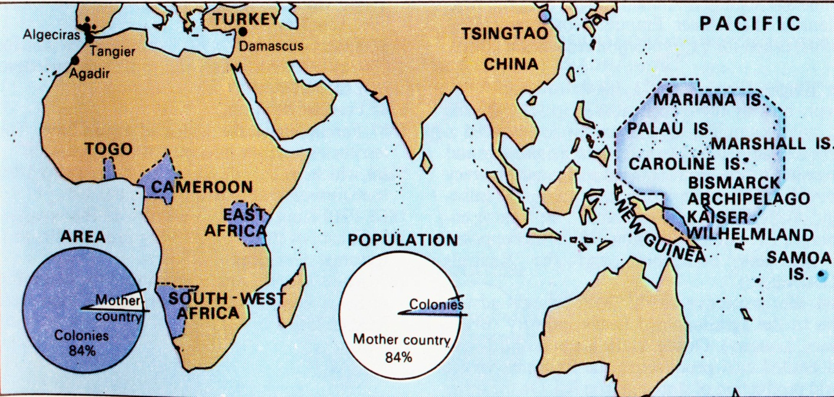
German Overseas Empire

Slide 85
Austria-Hungary/Italy
Expansion in the Balkans
No one else but Germany
Tied to Germany and Austria, but have territorial and historical disputes with Austria-Hungary

Slide 86
Germans vs Slavs
1000+ years of conflict
Germans usually winning
Slavs: Russia
Poles split up
Serbs, Czechs etc
Germany & Austria

Slide 87
East Europe Ethnic Mix

Slide 88
France
Germany
Russia
Austria-Hungary
UK
Italy
Serbia
Greece
Ottoman Empire
Bulgaria
Rumania

Slide 89
France
Germany
Russia
Austria-Hungary
UK
Italy
Serbia
Greece
Ottoman Empire
Bulgaria
Rumania

Slide 90
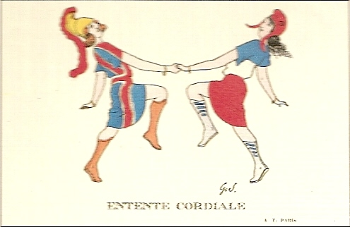
1904 Entente Cordiale
Delineated colonial empires.
Staff talks
Loose sort of alliance, but Britain will start to see this as a check to Germany

Slide 91
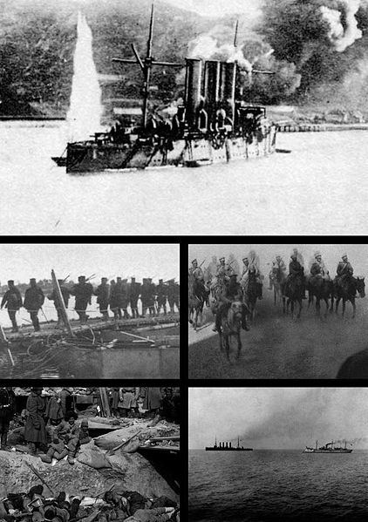
Russo-Japanese War 10 Feb 1904 to 5 Sep 1905

Slide 92
First Moroccan Crisis 1905-1906
German protest over French de facto control over Morocco because France violated Berlin Congress provision.
Italy, US, UK, Russia support France
Only Austria-Hungary supports Germany
The Algeciras Conference –Germany forced to accept compromise. France retains de facto control but gives up direct control over Moroccan police.
UK and France become closer
Germany isolated.

Slide 93
German-Russian trade treaty 1905
Germany takes advantage of Russian weakness from Russo Japanese War and uprising.

Slide 94
Anglo-Russian Convention
Ended the Great Game
Delineates Russian and British spheres of influence in South Asia.
Looked at suspiciously in the Ottoman Empire

Slide 95
Bosnian Crisis 1908
Austria-Hungary formally annexes Bosnia, which had administered since 1878 Congress of Berlin.
Russia comes close to threatening war, but is forced to back down.
Serbia
France starts to look at allowing Russian expansion in Balkans as part of Entente Treaty

Slide 96
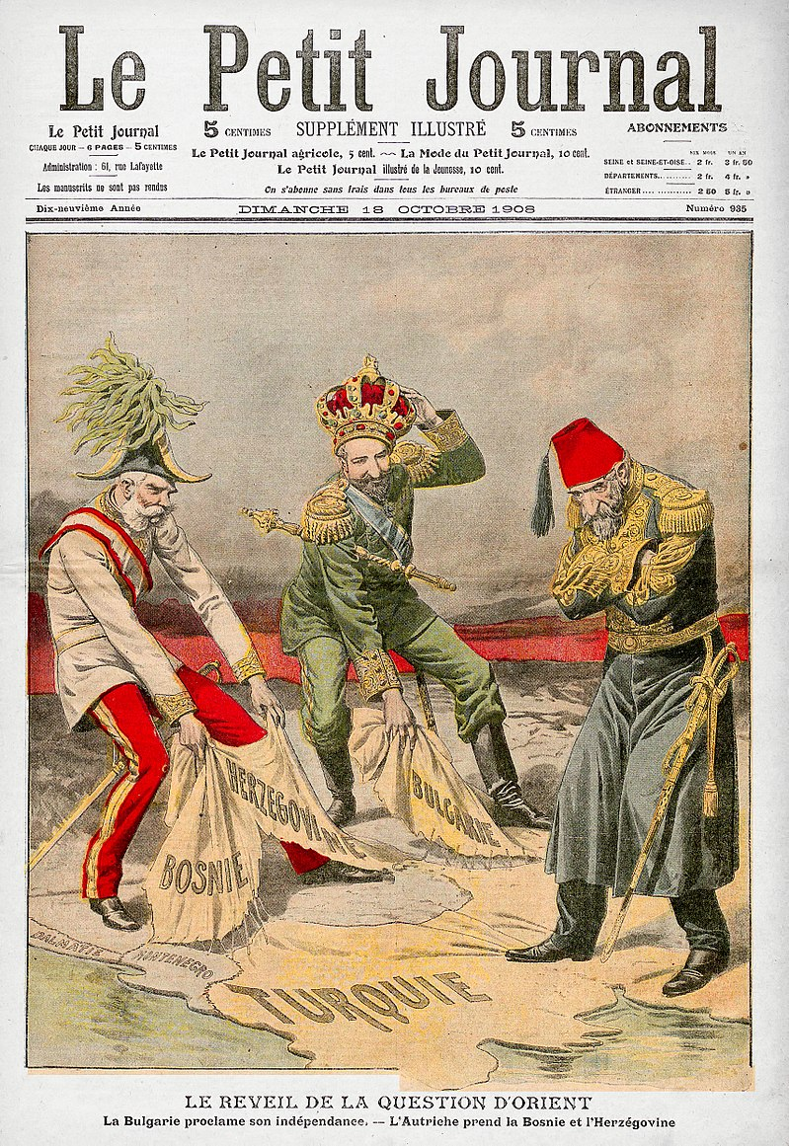

Slide 97
Agadir Crisis 1911
France moves troops into Moroccan interior.
Germany sends gunboat.
UK and France agree on secret naval treaty allowing France to concentrate fleet in the Med.
Germany backs down, but London-Berlin relations are at a low.

Slide 98
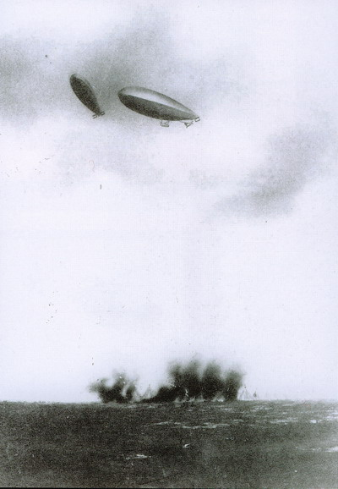
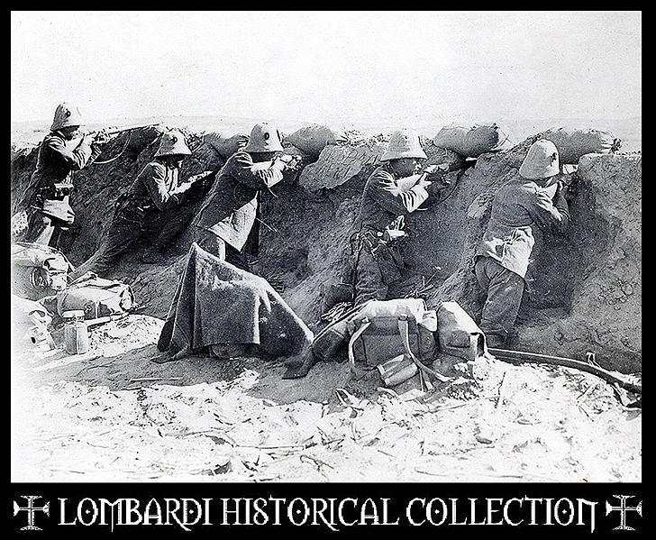
Italo-Turkish War 29 Sep 1911 to 12 Oct 1912

Slide 99
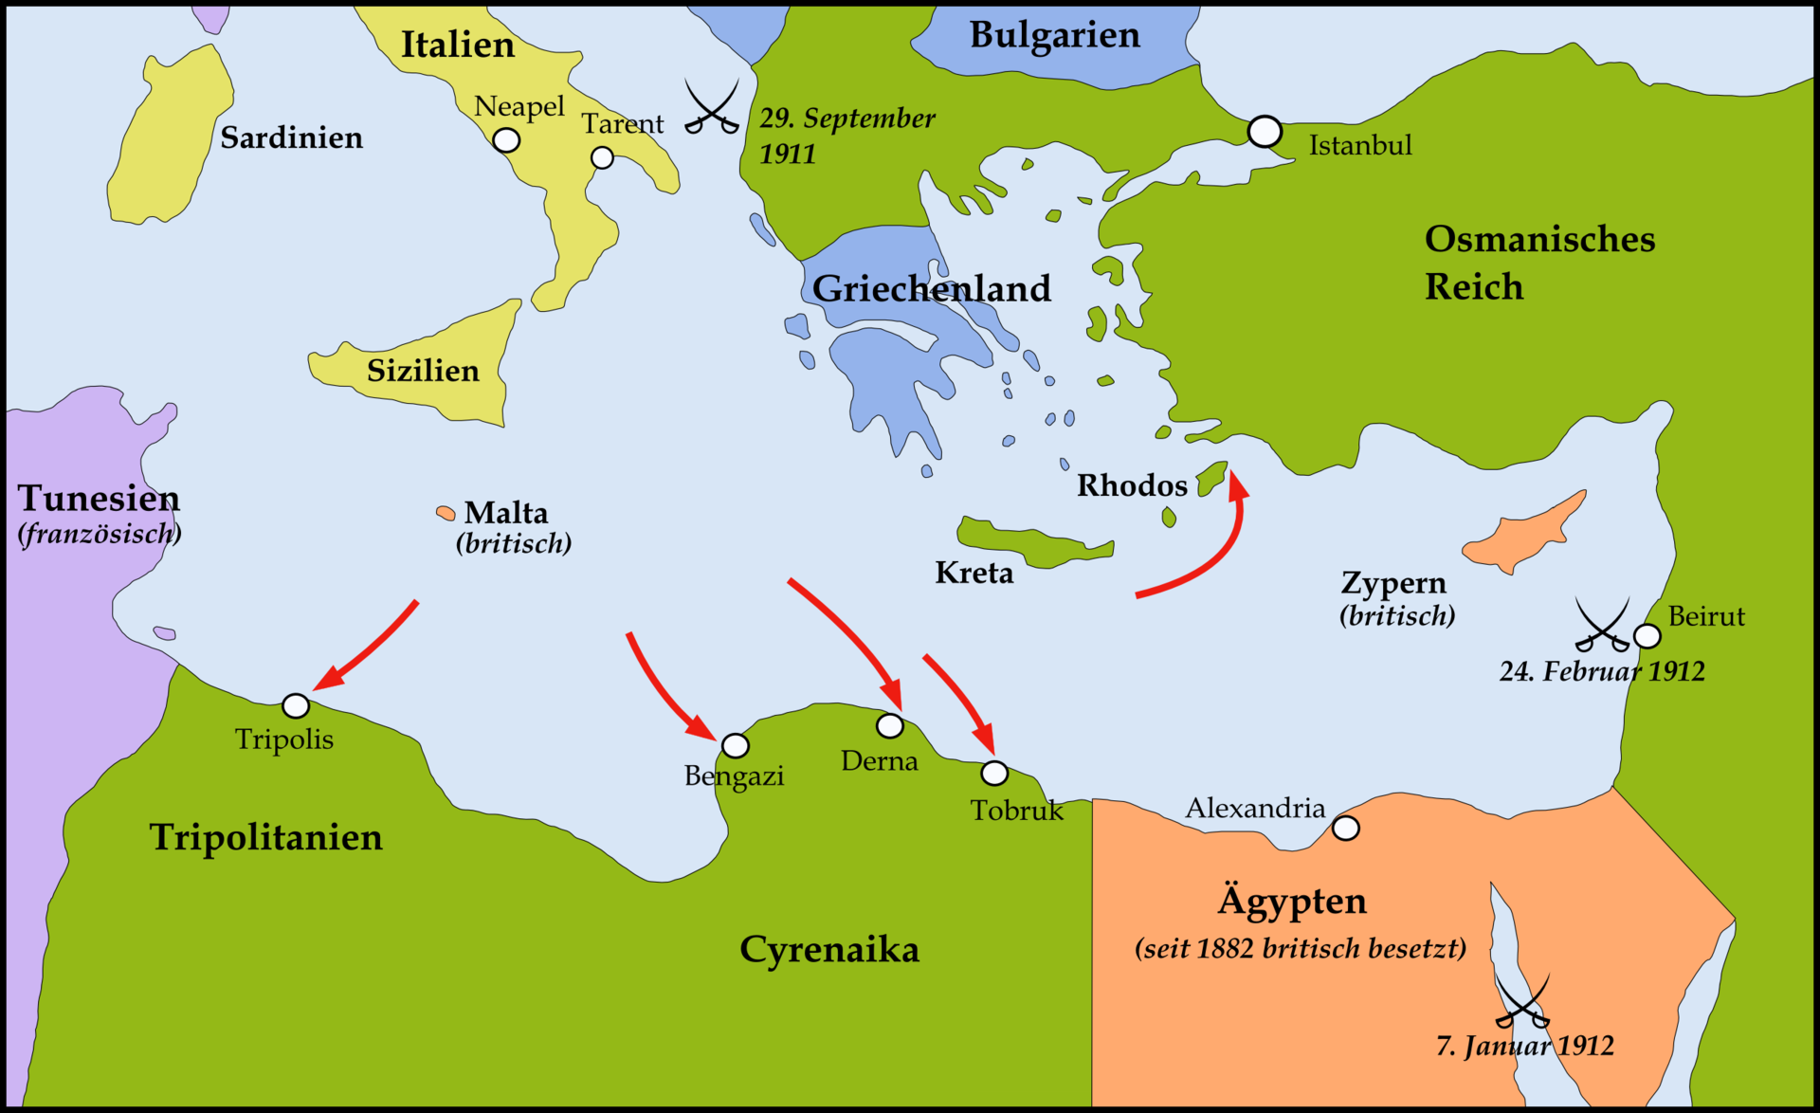

Slide 100
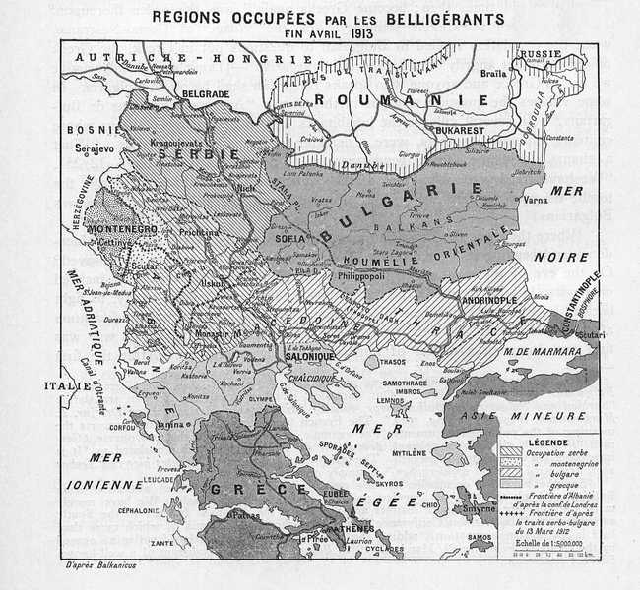
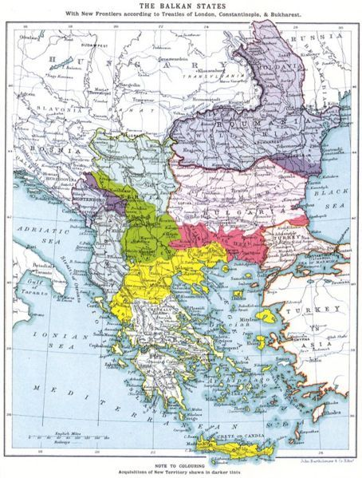
Balkan Wars 8 Oct 1912 to 18 Jul 1913

Slide 101
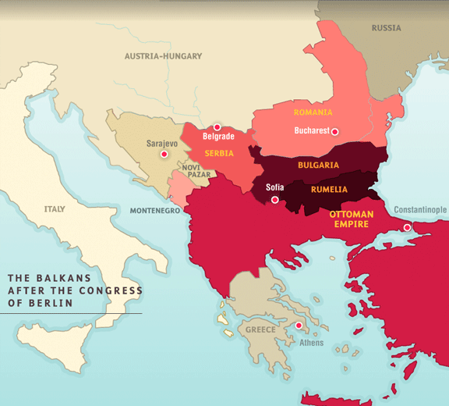

Slide 102
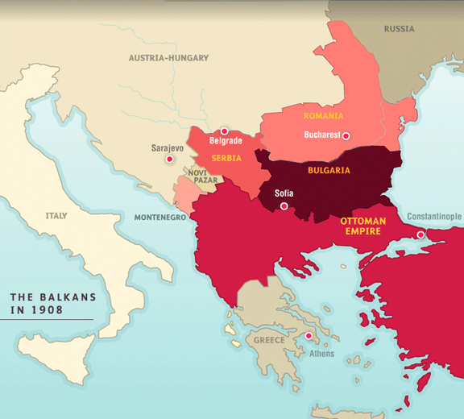

Slide 103
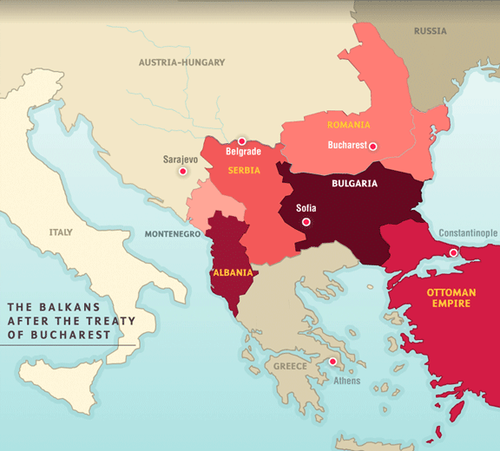

Slide 104
Franco-Russian secret changes 1908-1914
France accepts Russian offensive war to secure Balkan ambitions.
Russia accepts concept of offensive war in favor of France in North Africa
Entente goes from defensive to offensive alliance.
Specifically stated in pact if war breaks out between Serbia and Austria. France will stand by Russia, allowing the latter to give unconditional support to Serbia.

Slide 105
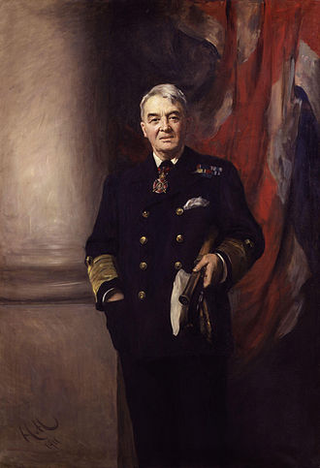
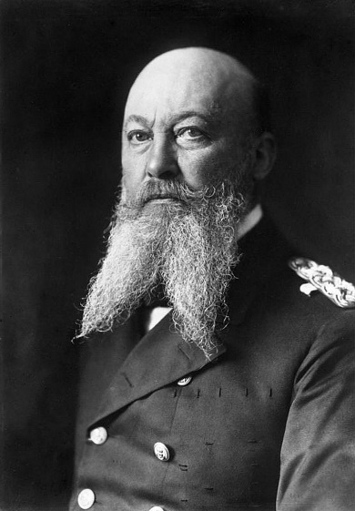
Of Dreadnaughts and Battlecruisers
Dreadnaughts BB’s vs Pre-Dreadnaughts BB’s
Battlecruisers
Armored Cruisers
Protected Cruisers
John Arbuthnot “Jackie” Fisher

Slide 106
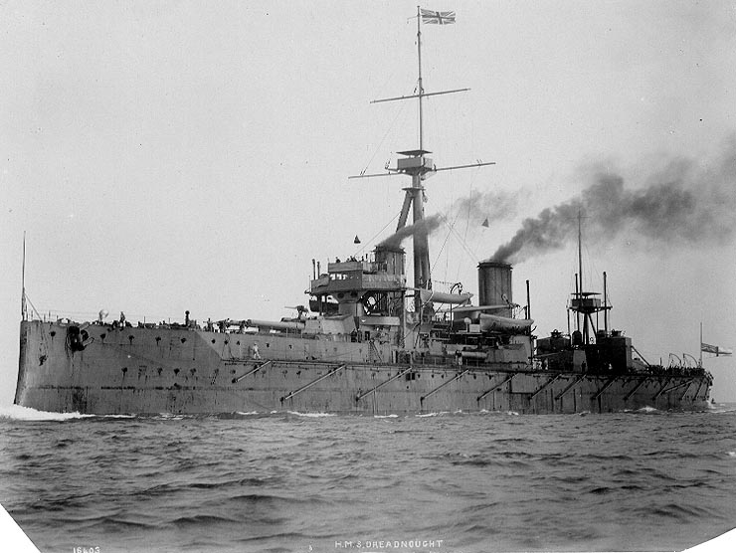
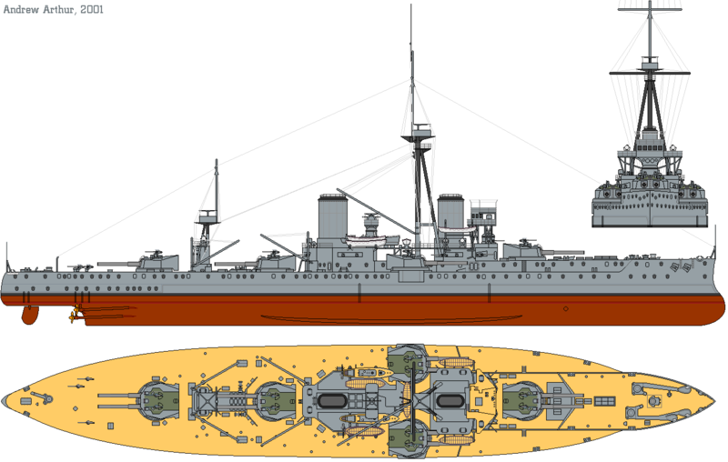
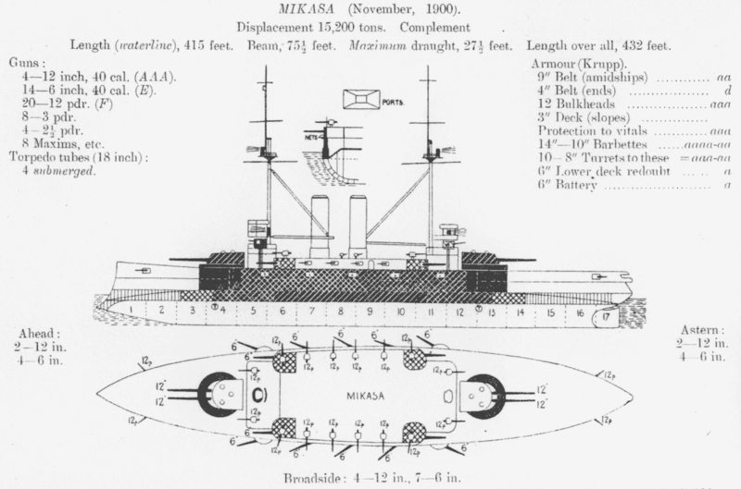
HMS Dreadnought

Slide 107
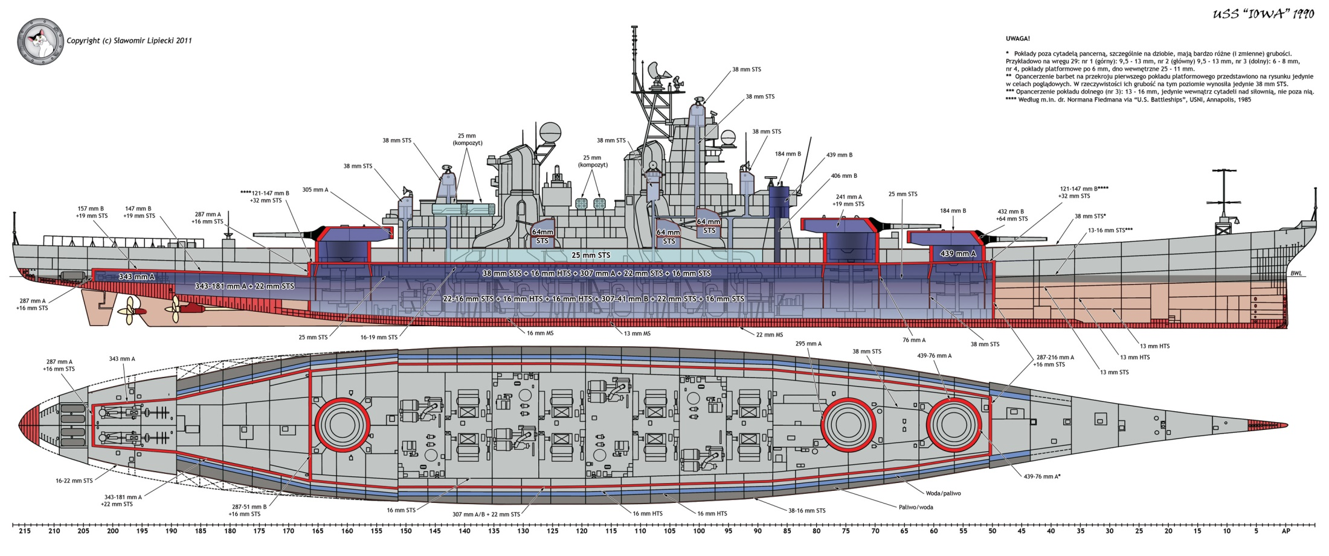

Slide 108
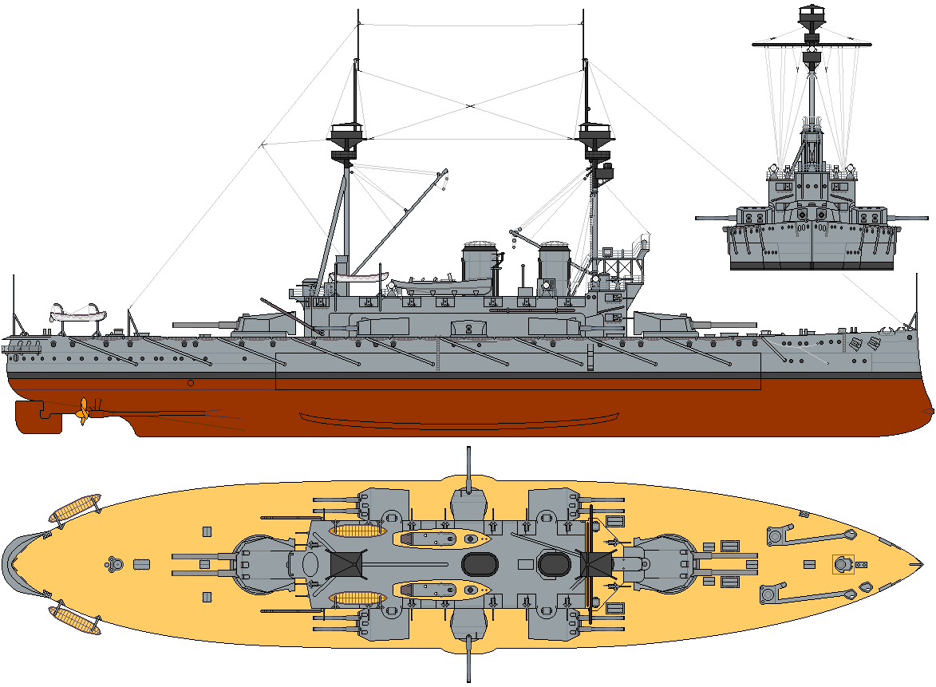

Slide 109
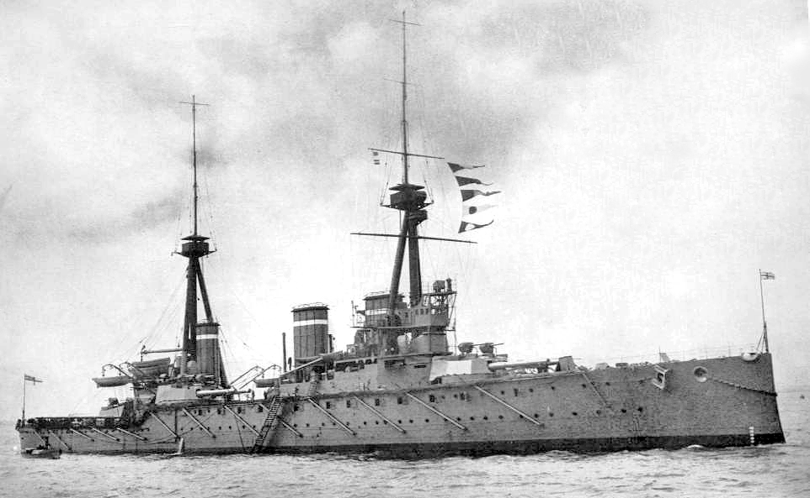
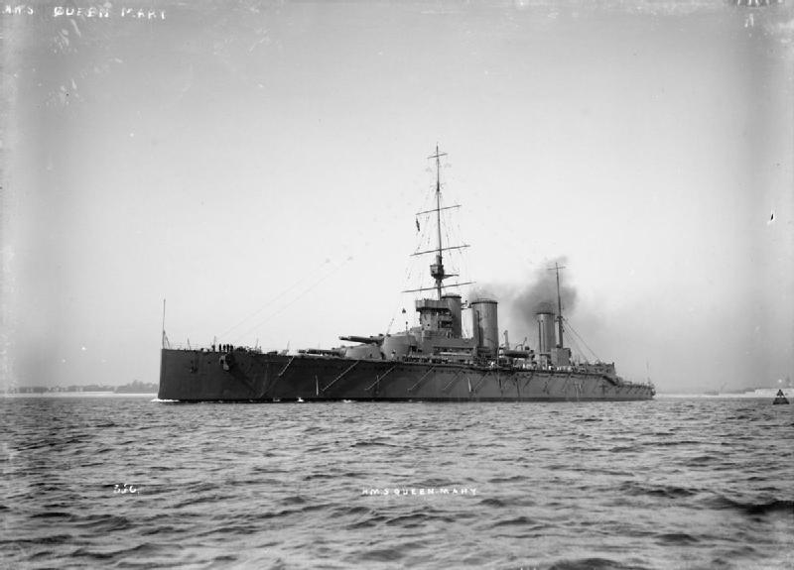

Slide 110
Naval Balance of Power 1914 number of Dreadnoughts & Battlecruisers
Allies
Great Britain 23 (15) 4 being built for others
United States 6 (4)
France 4 (3)
Japan 4 (4)
Italy 2 (2)
Russia 2 (1)
Central Powers
Germany 17 (7)
Austria-Hungary 2 (2)
Ottoman Empire 1-ex SMS Goeben

Slide 111
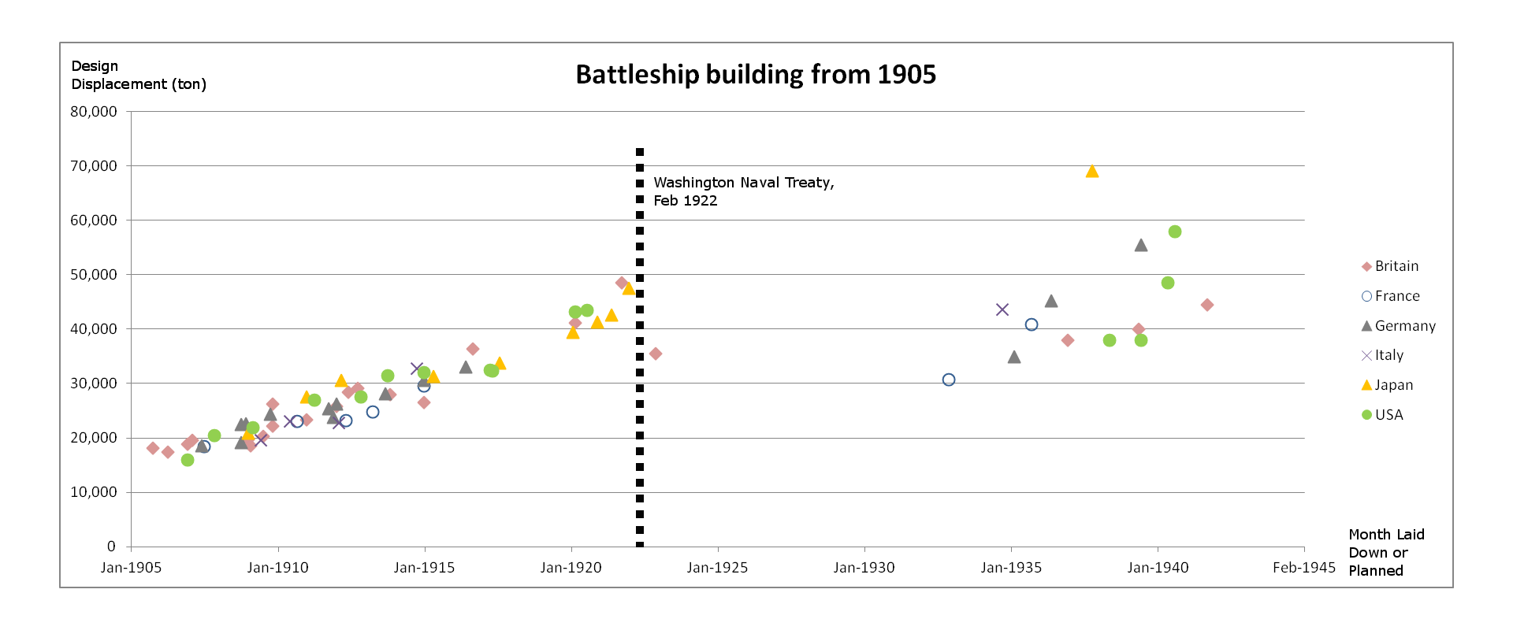

Slide 112
Anglo-German Détente 1912-1914
Secret treaty to divide overseas Portuguese colonies in case of Portugal Empire collapse.
Germany ends naval arms race 1912.
British and German public opinion was still firmly set in arms race.

Slide 113
Liman von Sanders Affair 1913
German Jewish officer given command of prestigious Turkish 1st Corps.
Berlin to Baghdad railway
German influence in Turkey
Inspector General, but soured German-Russian relations.

Slide 114
Before Sarajevo was war inevitable?
There was a thaw in Russian-British relations.
German and British relations had improved.
Secret negotiations between France and Russia, France was ready to guarantee Russian territorial goals in the Balkans.
Russia was backing an increasingly aggressive Serbia.
Serbian military was supporting terrorists in Bosnia.
Austria annexes Bosnia.
Germany was looking to woo Rumania, but the Hungarians of the Austrian government refused Rumanian demands.
Germany looks towards Bulgaria
Ottoman Empire goes searching for allies and finds for Germany.

Slide 115
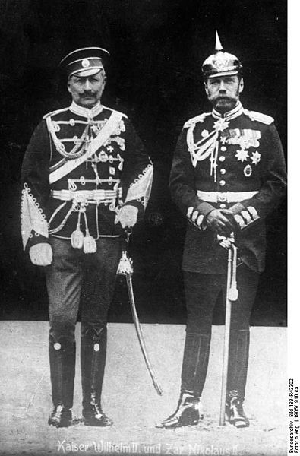
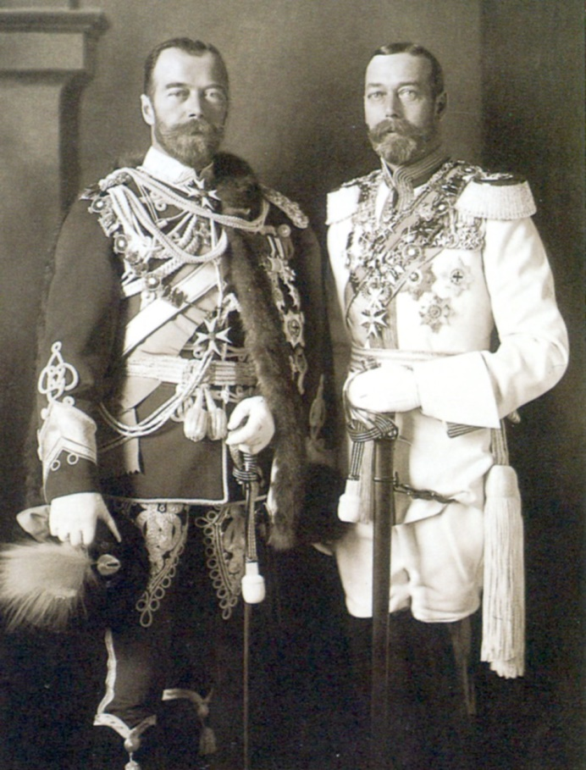
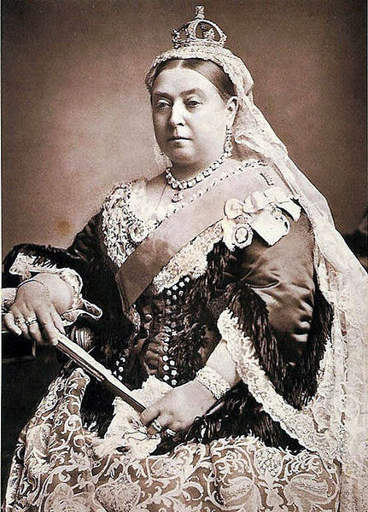
The Victoria Connection

Slide 116
Cousins War
Willy and Nicky 2nd Cousins
Willy and George 1st Cousins as are George and Nicky
All are also 5th Cousins as descendants of King George II.

Slide 117
July Crisis
Initial opinion is against Serbia. Lord Grey wished to see Serbian trounced.
Austrian heavy handedness causes opinions to look at Serbia with sympathy.

Slide 118
German-Austrian
Conrad von Hötzendorf, Leopold vob Berchtold, Franz Josef, Theobald von Bethmann-Hollweg

Slide 119
Entente

Slide 120
July Crisis
June 28, 1914: Serbian irredentists assassinate Archduke Franz Ferdinand of the Austro-Hungarian Empire.
June 30: Austrian Foreign Minister Count Leopold Berchtold and Emperor Franz Josef agree that the "policy of patience" with Serbia was at an end and a firm line must be taken.
July 5: Austrian Diplomat Alexander, Count of Hoyos visits Berlin to ascertain German attitudes.
July 6: Germany provides unconditional support to Austria-Hungary – the so-called "blank check".
July 20–23: French President Raymond Poincaré, on state visit to the Tsar at St Petersburg, urges intransigent opposition to any Austrian measure against Serbia.
July 23: Austria-Hungary, following their own secret enquiry, sends an ultimatum to Serbia, containing their demands, and gives only forty-eight hours to comply.
July 24: Sir Edward Grey, speaking for the British government, asks that Germany, France, Italy and Great Britain, "who had no direct interests in Serbia, should act together for the sake of peace simultaneously."[21]

Slide 121
The Ultimatum
The Austro-Hungarian ultimatum] demanded from the Serbian state to formally and publicly condemn the "dangerous propaganda" against Austria-Hungary, the ultimate aim of which, it claimed, is to "detach from the Monarchy territories belonging to it". Moreover, Belgrade should "suppress by every means this criminal and terrorist propaganda".
In addition, the Serbian government should
Suppress all publications which "incite hatred and contempt of the Austro-Hungarian Monarchy" and are "directed against its territorial integrity".
Dissolve the Serbian nationalist organization Narodna Odbrana ("The People's Defense") and all other such societies in Serbia.
Eliminate without delay from schoolbooks and public documents all "propaganda against Austria-Hungary".
Remove from the Serbian military and civil administration all officers and functionaries whose names the Austro-Hungarian Government will provide.
Accept in Serbia "representatives of the Austro-Hungarian Government" for the "suppression of subversive movements".
Bring to trial all accessories to the Archduke's assassination and allow "Austro-Hungarian delegates" (law enforcement officers) to take part in the investigations.
Arrest Major Vojislav Tankosić and civil servant Milan Ciganović who were named as participants in the assassination plot.
Cease the cooperation of the Serbian authorities in the "traffic in arms and explosives across the frontier"; dismiss and punish the officials of Šabac and Loznica frontier service, "guilty of having assisted the perpetrators of the Sarajevo crime".
Provide "explanations" to the Austro-Hungarian Government regarding "Serbian officials" who have expressed themselves in interviews "in terms of hostility to the Austro-Hungarian Government".
Notify the Austro-Hungarian Government "without delay" of the execution of the measures comprised in the ultimatum.
SERBIA ACCEPTS ALL CONDITIONALLY BUT POINT 6

Slide 122
July Crisis
July 24: Serbia seeks support from Russia and Russia advises Serbia not to accept the ultimatum.[22] Germany officially declares support for Austria's position.
July 24 Russian Council of Ministers agrees secret partial mobilisation of the Russian Army and Navy.
July 25: Tsar approves Council of Ministers decision and Russia begins partial mobilization of 1.1 million men against the Austrian-Hungarian Empire.[23]
July 25: Serbia responds to Austro-Hungarian démarche with less than full acceptance and asks that the Hague Tribunal arbitrate. Austria-Hungary breaks diplomatic relations with Serbia. Serbia mobilizes its army.
July 26: Serbian reservists accidentally violate Austro-Hungarian border at Temes-Kubin.[24]
July 26: A meeting is organized to take place between ambassadors from Great Britain, Germany, Italy and France to discuss the crisis. Germany declines the invitation.
July 28: Austria-Hungary, having failed to accept Serbia's response of the 25th, declares war on Serbia. Austro-Hungarian mobilization against Serbia begins.
July 29: Sir Edward Grey appeals to Germany to intervene to maintain peace.
July 29: The British Ambassador in Berlin, Sir Edward Goschen, is informed by the German Chancellor that Germany is contemplating war with France, and furthermore, wishes to send its army through Belgium. He tries to secure Britain's neutrality in such an action.
July 29: In the morning Russian general mobilization against Austria and Germany is ordered; in the evening[25] the Tsar chooses for partial mobilization after a flurry of telegrams with Kaiser Wilhelm.[26]
July 30: Russian general mobilization is reordered by the Tsar on instigation by Sergei Sazonov.

Slide 123
July Crisis
July 31: Austrian general mobilization is ordered.
July 31: Germany enters a period preparatory to war.
July 31: Germany sends an ultimatum to Russia, demanding that they halt general mobilization within twelve hours, but Russia refuses.
July 31: Both France and Germany are asked by Britain to declare their support for the ongoing neutrality of Belgium. France agrees to this. Germany does not respond.
July 31: Germany asks France whether it would stay neutral in case of a war Germany vs. Russia.
August 1: German general mobilization is ordered, deployment plan 'Aufmarsch II West' chosen.
August 1: French general mobilization is ordered, deployment Plan XVII chosen.
August 1: Germany declares war against Russia.
August 1: The Tsar responds to the king's telegram, stating, "I would gladly have accepted your proposals had not the German ambassador this afternoon presented a note to my Government declaring war."
August 2: Germany and the Ottoman Empire sign a secret treaty[27] entrenching the Ottoman–German Alliance.
August 3: Germany, after France declines (See Note) its demand to remain neutral,[28] declares war on France. Germany states to Belgium that she would "treat her as an enemy" if she did not allow free passage of German troops across her lands.
August 4: Germany implements offensive operation inspired by Schlieffen Plan.
August 4 (midnight): Having failed to receive notice from Germany assuring the neutrality of Belgium, Britain declares war on Germany.
August 6: Austria-Hungary declares war on Russia.
August 23: Japan, honoring the Anglo-Japanese Alliance, declares war on Germany.
August 25: Japan declares war on Austria-Hungary.

Slide 124
The culminating point
The culminating point in military strategy is the point at which a military force no longer is able to perform its operations.
On the offensive, the culminating point marks the time when the attacking force can no longer continue its advance, because of supply problems, the opposing force, or the need for rest. The task of the attacker is to complete its objectives before the culminating point is reached. The task of the defender on the other hand, is to bring the attacking force to its culminating point before its objectives are completed.
The concept of a culminating point was formulated by the Prussian military theorist Carl von Clausewitz in his book On War published in 1832

Slide 125
Clausewitzian Trinity
1) primordial violence, hatred, and enmity, which are to be regarded as a blind natural force-the people
2) of the play of chance and probability within which the creative spirit is free to roam-the commander of an army
3) and of its element of subordination, as an instrument of policy, which makes it subject to reason....”-the government
WAR IS CHAOS and the side which best manages that chaos will win
DETERMINISTIC CHAOS

Slide 126
Austria-Hungary
Least prepared for a general war of all the major powers.
Army Separated into 3
KuK Kingdom and Imperial -Main regular army-smallest amount of trained reserves of all powers.
Landwehr- Austrian militia- well trained lacking heavy guns
Honved-Hungarian militia- enthusiastic, but lacking in guns

Slide 128
German Army
Probably the best army in the world in 1914.
Best prepared and equipped for the coming fight.
Many more machineguns, and better heavy artillery.
A few million trained reservists and professionals.
Exerzier-Regiment für die Infanterie
Emphasized combined arms and fire superiority
Major Training Areas (MTA)

Slide 129
German Mobile Theory
German “doctrine” stressed the concept of annihilation (Vernichtungsgedänke)
Mobile operations or “war of movement”(Bewegungskrieg) in order to create the battle of encirclement (Kesselschlacht)
Concentric assaults by separated forces
They wished to avoid positional warfare (Stellungskrieg)

Slide 130
German Practice
Loose command arrangement
Commander’s intent (Absicht)
Nature of the task (Aufträge)
Subordinate would use initiative to create a resolution (Entschluss)
German subordinate’s were given authority to abandon the task, but could never abandon his commander’s intent. Higher HQ would be informed immediately by necessity.
If done the subordinate accepted full responsibility
System was designed to foster initiative and creativity

Slide 131
German Army
No set doctrine, system or dogma existed, outside what is already mentioned
Officer school system accepted the dialectic approach
Improvisation
German Army prior to 1945 never adopted set principles of war

Slide 132
Kreigspiel

Slide 134
Russian Army
Still recovering from defeat in Russo-Japanese War 1905
By far largest manpower reserves.
15 million total soldiers mobilized (24% of total)
Often lacked supplies for troops

Slide 136
French Army
Mixed record on training and leadership
Stressed the offensive. Eager for revenge
Understood that they had less of a population than Germany and a lower birthrate.
Had been conscripting large numbers since 1912.

Slide 137
French Army
Mixed training- some good, some bad
Belief that the French were natural soldiers
Battalion caree
Advance guard to draw enemy attention while reserves would maneuver and attack
Breakthrough over encirclement
Ardant Du Picq Battle Studies
Grandmaison theory of offenisive
Stressed movement over fire superiority
Movement “was a decisive and irresistible force”
Divided battle into preparatory, decisive attack and completion
In practice the offensive was done in driblets
Battle between “security” and movement
Bayonet

Slide 138
Napoleonic Strategy
Battalion Caree

Slide 140
Great Britain
Unprepared for a large land war.
Small professional constabulary army. Well trained individually, but lacking experience in fighting in large formations.
Individual marksmanship- Hythe School- mad minute
200,000
About 1.2 million will volunteer by the end of 1914.
BEF cadre’s largely destroyed by the time 1st volunteers arrived.
Will only enact conscription in 1916

Slide 142
French Plans Plan XVII

Slide 143
French Army
Were aware that the Germans may go through Belgium
That they could either pull back to check or
That the attack would force the Germans to react.
Wanted fight off of French soil
Seize key objectives and consolidate.

Slide 145
Schlieffen Plan
It did not exist as is commonly used in history or by officers postwar with an axed to grind.
It was a theoretical construct and not to be taken as a dogmatic plan to be used to the letter.
Von Schlieffen already knew thorough wargaming that the German Army had too few divisions to make it work needed 93 divisions, but only a maximum of 86 were available.
There were other Schlieffen plans. Aufmarsch West and Ost
The plan was a means to an end, NOT and end itself.
The plan was predicated on a situation when there would be no enemy in the east [...] there was no six-week deadline for completing the western offensive: the speed of the Russian advance was irrelevant to a plan devised for a war scenario excluding Russia.

Slide 146
Difference between history and military science
Military historians, as opposed to historians that write about military history, judged that the physical constraints of German, Belgian and French railways and the Belgian and northern French road networks made it impossible to move enough troops far enough and fast enough for them to fight a decisive battle if the French retreated from the frontier.
A military historian knows what a military force can and can’t do realistically.

Slide 147
In reality
To be used as a basis for further planning.
Von Moltke, in his wartime papers, did not expect the plan to knock France out of the war, but did believe that they could seize territory to be used in peace negotiations.
Aufmarsch II West selected

Slide 158
Battle of Gumbinnen Aug 20, 1914

Slide 164
Lord Kitchener and the New Army
Accrington Pals
700 men enlisted 585 casualties 230 kia 350 wia

