Slide 1
Warsaw Ghetto Uprising
35372
Dr Nicholas “Nick” Noppinger

Slide 2
Common Misconceptions
The Warsaw Ghetto Uprising of April 1943 is not the same as the Warsaw Uprising of 1944.
The Jews in Warsaw were not heavily armed and the fighting was sporadic low intensity conflict- guerilla war.
There were multiple groups that were loosely coordinated in the resistance.

Slide 3
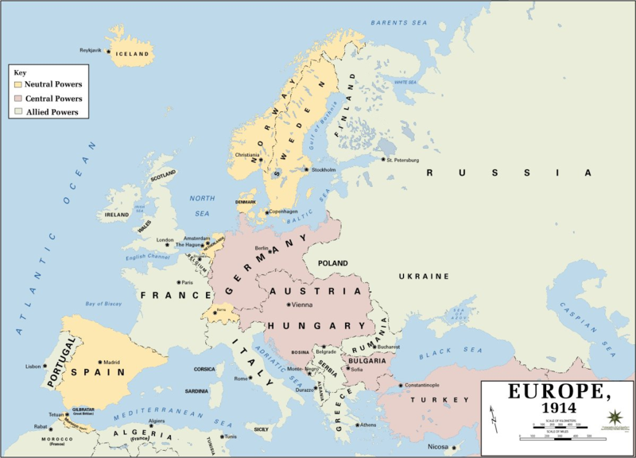

Slide 4
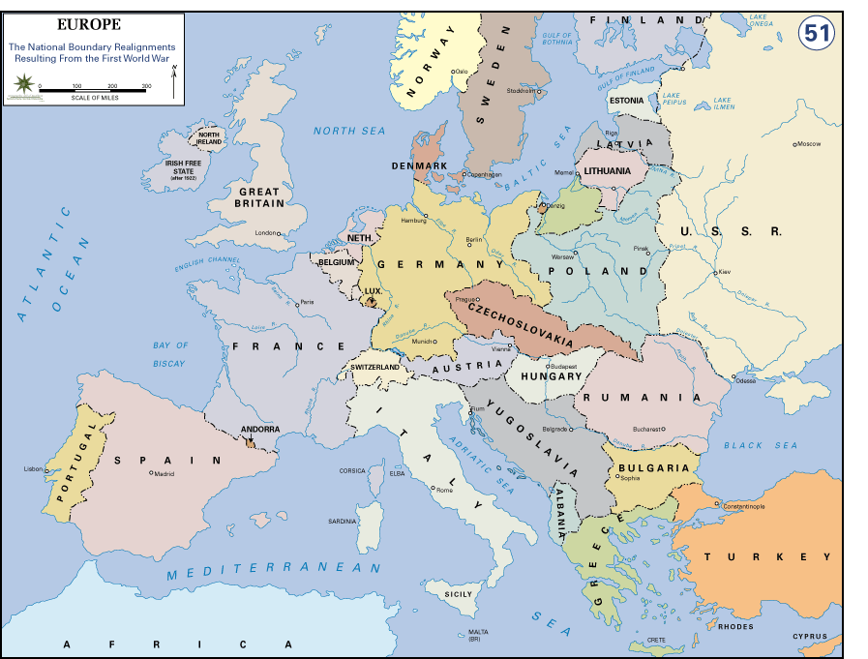

Slide 5
Treaty of Versailles
Legal restrictions on Germany
Article 231 (the "War Guilt Clause") lays sole responsibility for the war on Germany, which would be accountable for all the damage done to civilian population of the allies.
Article 227 charges former German Emperor, Wilhelm II with supreme offence against international morality. He is to be tried as a war criminal.
Articles 228-230 tried many other Germans as war criminals.
Military restrictions on Germany
Part V of the treaty begins with the preamble, "In order to render possible the initiation of a general limitation of the armaments of all nations, Germany undertakes strictly to observe the military, naval and air clauses which follow.
The Rhineland will become a demilitarized zone.
German armed forces will number no more than 100,000 troops, and conscription will be abolished.
Enlisted men will be retained for at least 12 years; officers to be retained for at least 25 years.
German naval forces will be limited to 15,000 men, 6 battleships (no more than 10,000 tons displacement each), 6 cruisers (no more than 6,000 tons displacement each), 12 destroyers (no more than 800 tons displacement each) and 12 torpedo boats (no more than 200 tons displacement each).
The manufacture, import, and export of weapons and poison gas is prohibited.
Tanks, submarines, military aircraft, and artillery are prohibited.
Blockades on ports are prohibited.

Slide 6
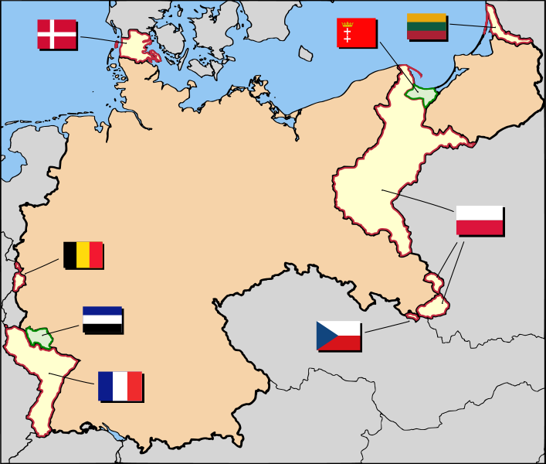
German Territorial Losses

Slide 7
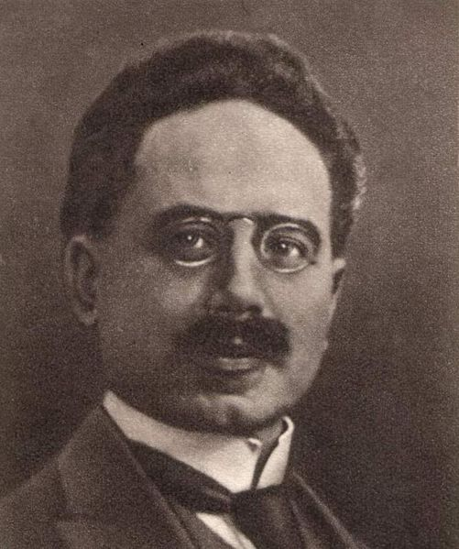
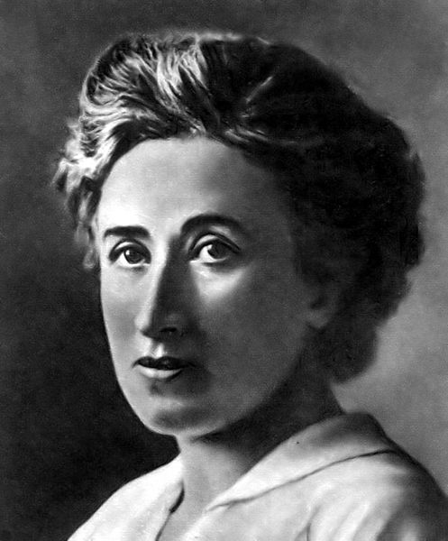
Civil war in Germany the Threat from the Left
Anarchy and Violence Nov to Dec 1918 Pres. Ebert almost loses power by violent means
Spartacist Uprising 5 Jan19 to 12 Jan19
Bavarian Socialist Republic (Soviet) Style State 6 Apr 19 to 3 May19

Slide 8
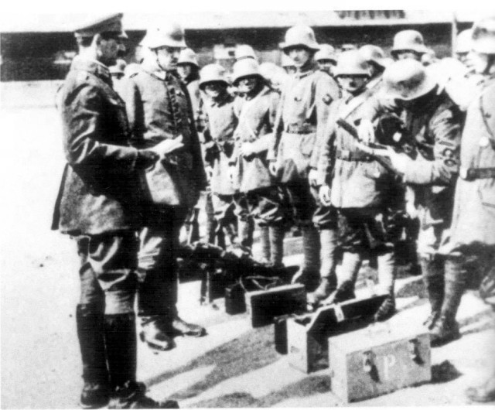
Freikorps
Ex Military
Government did not always have control
“Quasi”-government military units used to put down Communist/socialist revolts with approval of Allies
Many later joined SA

Slide 9
Civil War in Germany, The Right
Kapp Putsch 13 Mar 20 to 17 Mar20 Gov moves from Berlin to Stuttgart, fizzles for lack of support from most rightwing factions
Has support of part of military
Reichswehr does not fire on Reichswehr".
Beer Hall Putsch 9 Nov 23.
Led by Erich Ludendorff and Adolf Hitler
Coup fails Hitler sent to Landsberg Prison after treason trial.

Slide 10
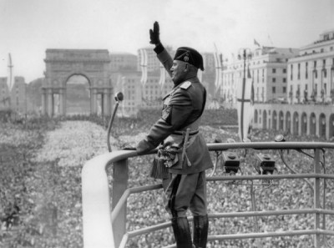
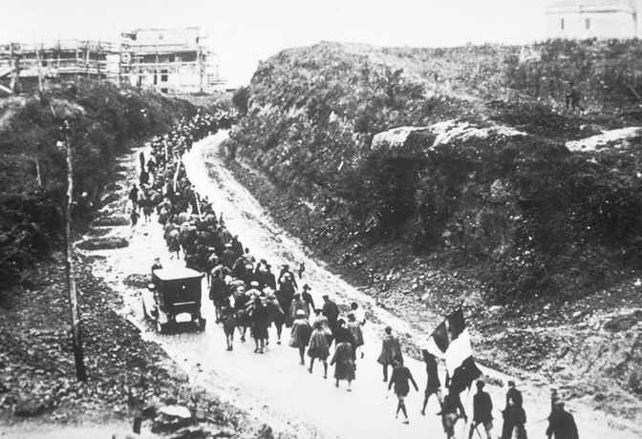
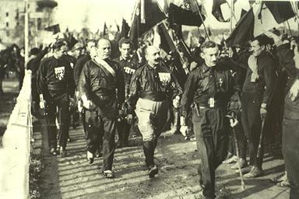
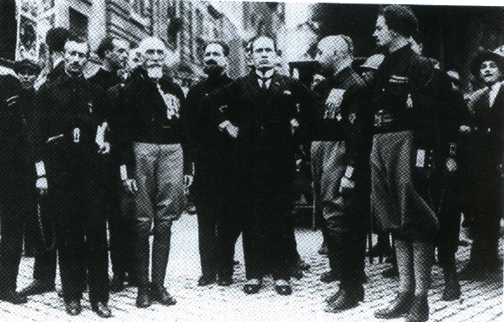
Italy
Despite victory in WW 1, Italy is left with huge war debts and political turmoil
The March on Rome 27Oct22 to 29 Oct22
Mussolini in power

Slide 11
The Early Nazi Party
Jan 19 Anton Drexler forms German Workers Party
Sep 19 Hitler, working for the Army, joins Nazi Party under orders from Army Capt. Ernst Roehm
By end of 1919, Party at less than 200 members
20 Feb20 Changes name to National Socialist German Workers Party
31 Mar20 Hitler discharged from Army, Allies disband 2/3 of Freikorps
Mar20 Kapp Putsch, Nazi’s do not participate
Hitler creates Ordnungstruppen, precursor of SA
End of 1920 Nazis at 2000 members
Sept21 SA and Hitler break up meeting of Socialists.
1922-23 rampant inflation in Germany, at its peak 10mil RM = $1USD, French occupy Ruhr stay until 1925
Nov 23 Beer Hall Putsch
Feb24 to Dec 24 Hitler in Landsberg Prison writes Mein Kampf, Nazi Party outlawed
Dec 24 Hitler released from prison
Jan 25 Nazi reestablished
Nov25 Strasser wing of Party rebels against Hitler Beefsteak Nazi’s
1930 Nazi’s become Germany’s strongest party

Slide 12
Germany 1924-1933
Political Parties form paramilitary wings
Communists form Der Rote Frontkämpferbund, Red Front Fighters Brigade
Socialists form Reichsbanner Schwarz-Rot-Gold – Country Flag Black-Red-Gold, aka Schufo
Nazi’s Form Sturmabteilung

Slide 13
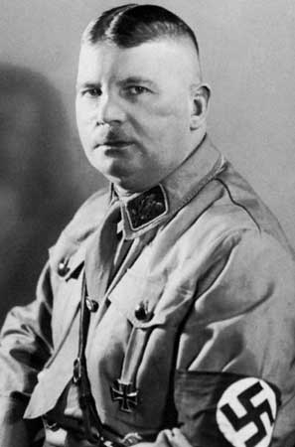
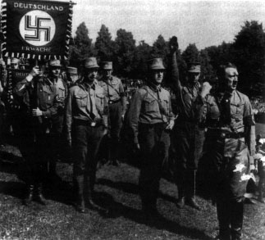
Sturmabteiling, The SA
Originally supported clandestinely by the Army
Later became rivals
Suppressed during Night of the Long Knives
Under the command of Ernst Roehm for much of period

Slide 14
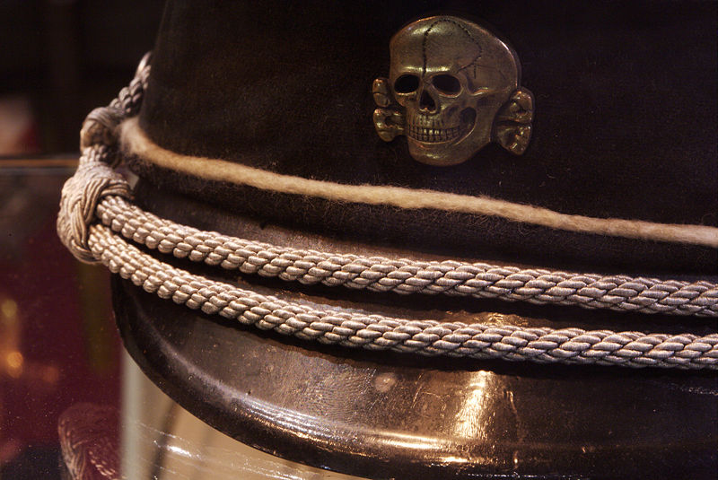
Schutzstaffel- SS
Formed in 1925, as part of the SA.
Personal Bodyguard to Hitler
Will eventually control police, intelligence services
All aspects of German life
Will form own Military and run concentration camps
Directly responsible for Final Solution

Slide 15
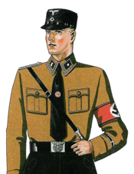
Early SS
Unit Origins of the SS created from SA cadre as Stabswache, soon to be named Stosstruppen Hitler
SS bodyguard unit for Hitler
Part of SA
Select Recruitment
Paid

Slide 16
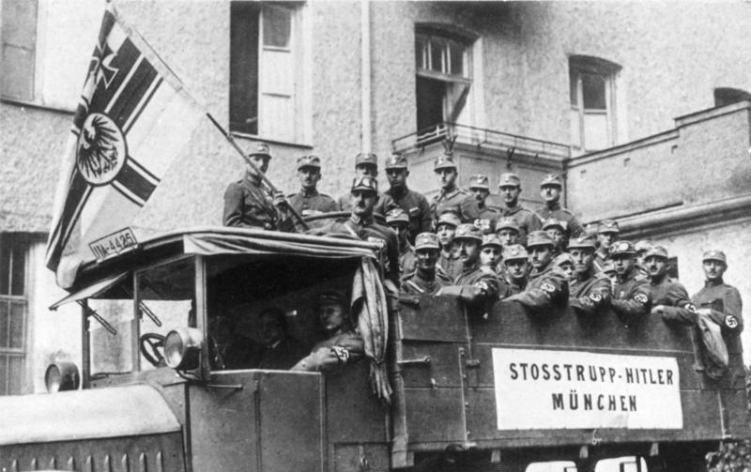

Slide 17
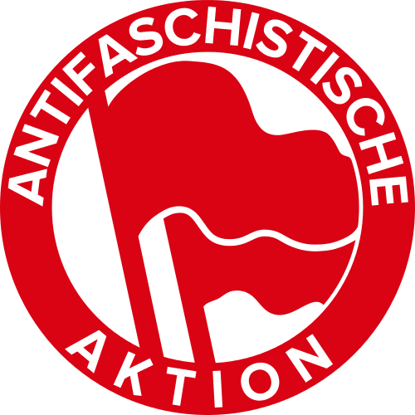
Paramilitary 1925-1933
Leftwing Groups
Roter Frontkämpferbund- KPD- Communist Party
Reichsbanner Schwarz-Rot-Gold- SPD- Socialists
Eiserne Front- Iron Front- Socialists

Slide 18
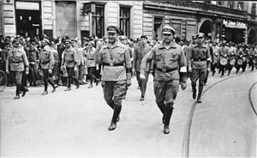
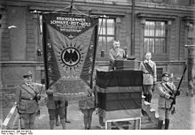
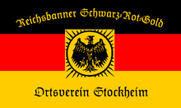

Slide 20
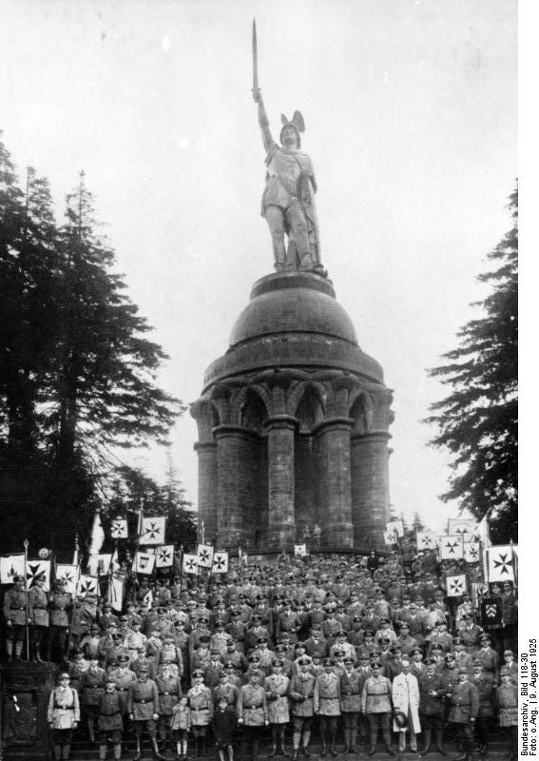
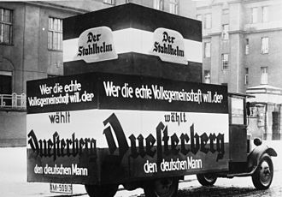
Paramilitary 1925-1933
Stahlhelm- Steel Helmet- German National Peoples Party- merged with SA 1933
Young German Order
Sturmabteilung

Slide 21
Political Party Violence in the US
In the 1800’s it was common for gangs to be associated with the political parties.
Violent voter intimidation
Continues to the day to some degree
Trade Unions/ violent pro-life groups

Slide 22
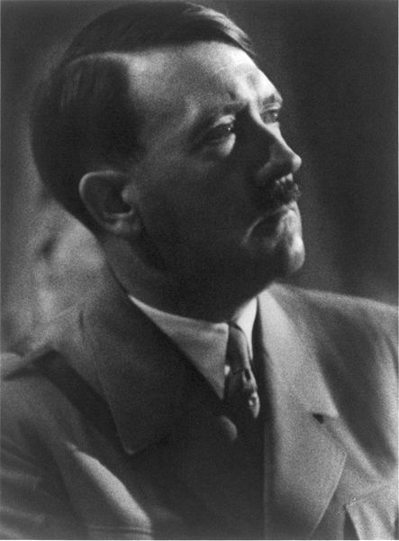
Hitler becomes Chancellor
July 1932 Hitler offered position as Vice Chancellor, he refuses.
As the Nazi Party becomes the most powerful Pres. Hindenburg to form a government after several other governments fail.
30 Jan33 Hitler appointed Chancellor of a Center-Right Coalition government

Slide 23
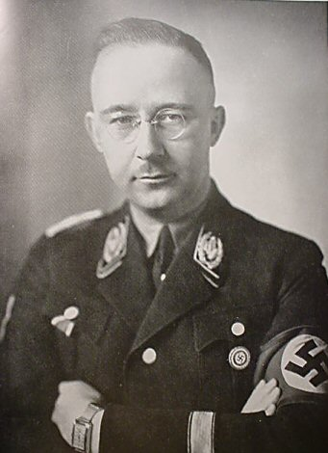
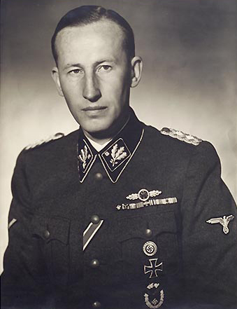
Night of the Long Knives
30 June34 to 2 July 34
SA top leadership purged
All party opponents purged
Sundry political opponents eliminated
Army cooperation
Hindenburg gives blessing
Military makes Faustian Deal

Slide 24
Germany 31-39
1934 German Military rearms and expands in violation of Treaty of Versailles
2 August 34 Hindenburg dies, Hitler combines off Pres and Chan. Becomes sole leader of Germany
Anglo-German Naval Treaty 18 Jun35
7 Mar 36 German Army reenters Rhineland

Slide 25
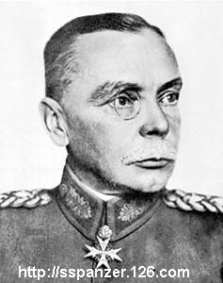
Reichswehr
Defeat in World War One
Rebirth under Hans von Seekt
Rapallo Treaty 1922
Germany allowed to train in the Soviet Union
Soviets given technical aid
Army supports glider, athletic, rifle clubs etc
Former Air Force pilots working for Lufthansa

Slide 26
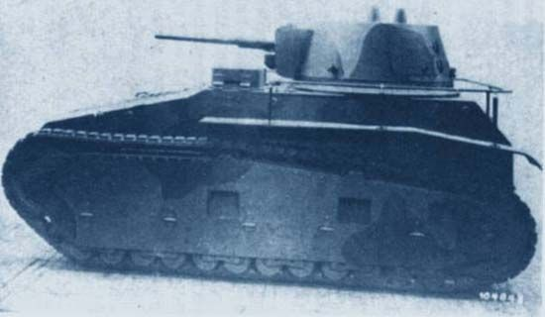
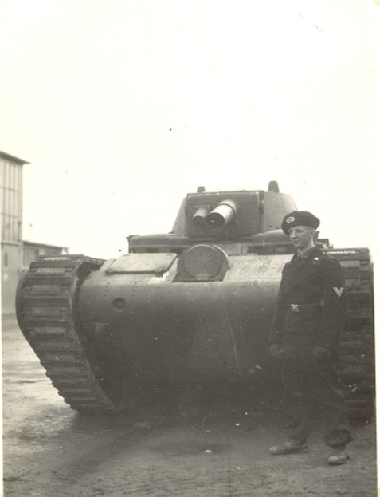
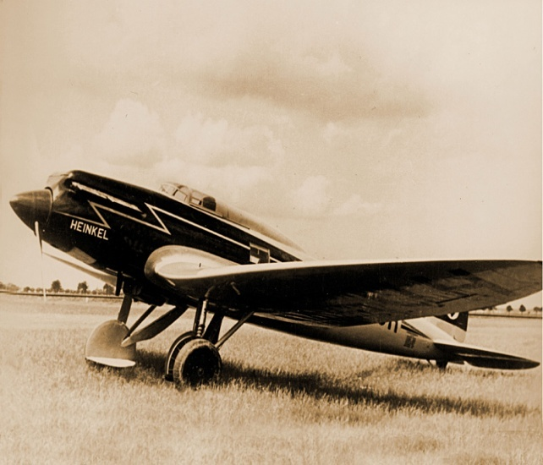
German Rearmament
German military ready to expand, Hitler repudiates Versailles treaty, secretly at first

Slide 27
Historical Anti-Semitism
Greece
Rome-Diaspora
Early Christianity- desecration of the Host- blood libel, killers of Christ
Persecution, England, Germany, Russia, France, Spain Medieval Period
Jews expelled from England 1276-1655
Social Darwinism
Dreyfus Affair
Protocols of the Elders of Zion

Slide 32
Who issued this order?
The Jews, as a class violating every regulation of trade established by the Treasury Department and also department orders, are hereby expelled …within twenty-four hours from the receipt of this order
that no Jews are to be permitted to travel on the road southward
"all cotton speculators, Jews, and all vagabonds with no honest means of support", to leave the district.

Slide 33
Nazi Racial policies
Germans from Germany (Reichsdeutsche) - Nordic Germans are said most favorable, but all German citizens are in the top category.
Germans from outside, active ethnic Germans (Volksdeutsche), honorary "Aryans" from Axis powers, European countries in Volksliste category 1 and 2 (see Volksdeutsche and Deutschstämmige).
Germans from outside, passive Germans and members of families (Deutschstämmige), handicapped, political dissidents, common criminals in Volksliste category 3 and 4.
Other Germanic peoples closely related to Germans (Norwegians, Danes, Swedes, Finland-Swedes ^{[13]}, Estonian Swedes, Faroese, Flemings, Icelanders, English and the Dutch) but treated as categories 1 and 2 in most privileges, especially pro-Nazi sympathizers. Until 1942, the Greeks were included in this category by virtue of their being descendants of the Ancient Greeks.
Italians (particularly from regions north of Rome, e.g. Tuscany, Lombardy, etc.), Spaniards (particularly Basques) and Portuguese were treated as category 1 and 2, especially pro-Nazi sympathizers (e.g. Fascist Italy, Francoist Spain, and Salazarist Portugal diplomats). Some Southern Italians were treated as least (Suspicion of miscegenation with African and Semitic peoples), but within the same category. The Greeks are included in this category after 1943, due to their strong anti-Nazi resistance movement.
Celtic/Gaelic peoples: Irish, Scottish and Welsh.
French people in France (except German speaking Alsatians, and pro-Nazi French supporters in categories 1 and 2).
Highlander Polish (Goralenvolk): an attempt to split the Polish nation by using local collaborators.
Hungarians, Estonians, and Finns (despite their non Indo-European languages), Baltic peoples (Lithuanians and Latvians) and Romanians, Bulgarians and Croats.
Ukrainians: Many were part of Waffen SS divisions (SS-Galizien), while others were exterminated as partisans suspected in supporting the Red Army.
Russians, Belarusians (from East Slavic group), Serbs (from South Slavic group) were considered to be Untermensch ("under men") in the standard Nazi ideological texts.^{[14]}
Poles were considered to be Untermensch ("under men") in Nazi ideology.^{[15]}
Enemy nationals who happened to fall under the white "Aryan" racial category (i.e. United States of America and Canada), but were living in Germany at the time, were treated with suspicion by legal restrictions.
The categories of "races" deemed unworthy and subject to discrimination.
Jews-divided into various degrees of religious denomination, Mischlinge or of half/part-Jewish ancestries (esp. of one Jewish parent, highly illegal under the race laws) and Rassenschande or "Aryan" Germans found as converts into Judaism.
"Lebensunwertes Leben" ("Life unworthy of life"). As well as Jews, it included the Gypsies/Roma, also subject to extermination during Porrajmos. Includes minuscule numbers of darker-skinned German nationals: non-whites from colonial Africa, as well as Arabs and Berbers in North Africa. Homosexuals and disabled people (based on physical and mental illnesses) were also considered to be part of this category, and subject to eugenics policies, including compulsory sterilization, internment and deportation.

Slide 34
Nazi views on Race
The lowest Jews, Negroes, and Gypsies.
Other people of Color, Arabs, Indian’s. American Indians, Chinese, all other Asians etc. Japanese honorary Aryans
Next level Slav’s-though there were some “Germanic elements” that might be salvaged.
Other Non-Aryans –Celts, French, Italians (Romans considered Aryan depending on the Nazi writer), Spanish, Greeks (though Ancient Greeks considered Aryan) etc
Non-German Aryan’s -Dutch, British, Norwegians, Swedes, Danes, Finns - German Aryan’s

Slide 35
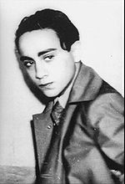
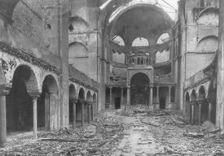
Kristallnacht
October 1938 expulsion of Polish Jew from Germany
7 Nov 38 assassination of Ernst vom Rath by Herschel Grynszpsan
9-10 Nov 38 Kristallnacht

Slide 36
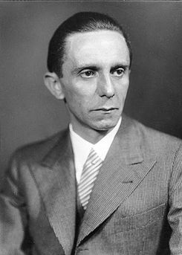
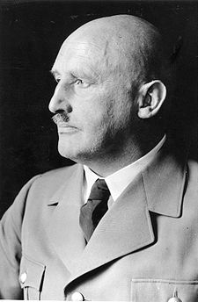
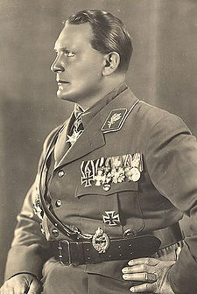
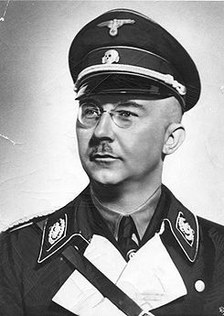
Fights over control of Jewish “Problem”

Slide 37
Emigration Plans
Palestine stopped by Royal Navy after Arab violence in 1937-1938
Madagascar Plan
Nisko Plan

Slide 38
Concentration Camps
Labor Camps
Transit and Collection Camps
Re-education Camps
Hostage Camps
Extermination Camps

Slide 40
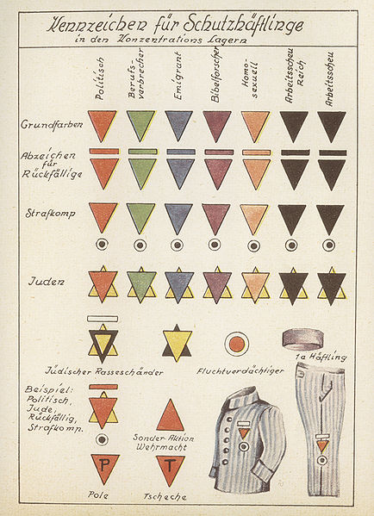

Slide 41
Einsatzgruppen
Einsatzgruppe A Stahlecker (Jost) Sonderkommando 1a Sandberger Sonderkommando 1b Ehrlinger (Strauch) Einsatzkommando 2 R. Batz (Strauch, Lange) Einsatzkommando 3 Jäger Einsatzgruppe B Nebe (Naumann) Sonderkommando 7a Blume (Steimle, Rapp) Sonderkommando 7b Rausch (Ott Rabe) Sonderkommando 7c Bock Einsatzkommando 8 Bradfisch (Richter, Isselhorst, Schindhelm) Einsatzkommando 9 Filbert (Schäfer, Wiebens) Vorkommando Moskau Six (Klingelhöfer)
Einsatzgruppe C Rasch (Thomas) Einsatzkommando 4a Blobel (Weinmann, Steimle, Schmidt) Einsatzkommando 4b Hermann (Fendler, F. Braune, Haensch Einsatzkommando 5 E. Schultz (Meier) Einsatzkommando 6 Kröger (Mohr, Biberstein) Einsatzgruppe D Ohlendorf (Bierkamp) Einsatzkommando 10a Seetzen (Christmann) Einsatzkommando 10b Persterer Einsatzkommando 11a Zapp Einsatzkommando 11b B. Müller (W. Braune, P. Schultz) Einsatzkommando 12 Nosske (Ministerialrat E. Müller)

Slide 42
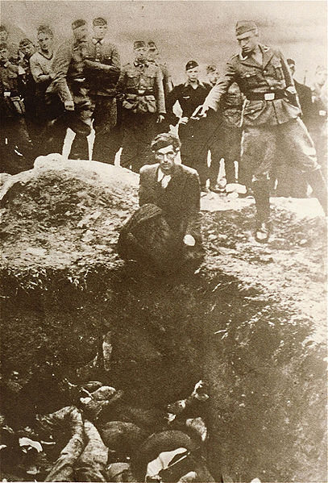
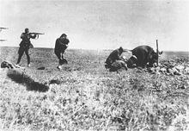
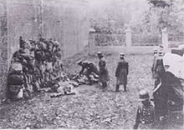
Einsatzgruppen

Slide 43
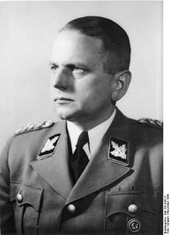
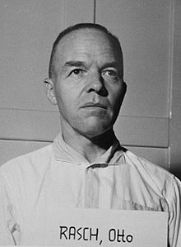
Commanders 1.3 million
Franz Walter Stahlecker, Artur Nebe, Otto Rasch, Otto Ohelendorf

Slide 44
Early methods of killing and the change
In conquered urban areas of eastern Europe, many Jews would be killed in nearby locations such as woods or inside buildings. The remaining Jews would be confined to ghettos. Death rates from disease and malnourishment were high; groups from the ghetto were periodically taken away and shot or deported to extermination camps. An example of this is the Lithuanian city of Kaunas; the Jews of Kaunas were concentrated in a ghetto and sent, thousands at a time, to be slaughtered in the 7th and 9th forts (watch towers) of Kaunas.
In small rural areas, or in battle zones, the Jews were quickly led to their deaths in nearby woods and mass graves, which were often dug by the victims. An example of such a case is the town of Dovno in Ukraine.
In big cities, mainly in the battle zones, the Nazis would create a small local committee of 8 to 12 important Jews, known as the Judenrat, who would be required to summon the local Jews for "relocation". The Jews (including the Judenrat delegates) would then be marched to previously prepared trenches or natural pits and shot. Examples are the massacre at Babi Yar and the Ponary massacre.
Alternatives to execution by firearms existed. The gas vans used by Einsatzgruppe D and Einsatzkommando Kulmhof in the death camp Chelmno are an example. Another, occasionally used in smaller towns, was to lock the Jews in abandoned buildings, which were then set alight or blown up, though this was rather rare.
Wannsee Conference 20 Jan 1942
Prior to the Wanssee Conference only Jews of Polish origin were deported from Germany to Poland

Slide 45
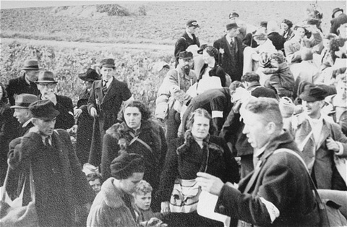
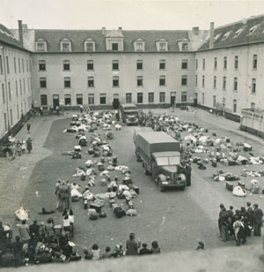
1st Step Collection in Transit Camps

Slide 46
Living Conditions
Life in the Dossinkazerne could, to some extent, be compared to living in an army barracks. The conditions of hygiene were acceptable. The dormitories were kited out with iron bedsteads and mattresses, however as from October 1942 Prisoners were obliged to sleep on sacks filled with straw placed on the ground. They were allowed to receive packets and food supplies which were essential in supplementing the meagre rations. They were distributed daily. They were kept in the dormitories 22 hours a day.
When Frank became commander of the camp the tempo of the turnover of prisoners was greatly reduced. The convoys became less frequent an, this, the second phase in the history of the camp, was marked with one serious problem, namely, overcrowding. Certain members of prison society began to suffer from hunger, especially the poor and those without friends or family who were unable to obtain supplementary supplies from outside. Various endemic diseases typical of such conditions began to appear e.g. scabies, impetigo etc. Children were often the first to succumb to these illnesses.
An extended stay in the holding camp of Mechelen brought with it a atmosphere of weariness and boredom. To counteract these feelings conferences, lessons and classes for children were organized. Artists began to draw and paint The religious aspects of life took on an even more important function. Marriages were secretly consecrated.

Slide 47
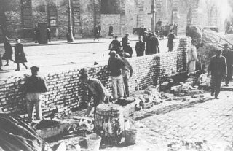
Shipment to Ghettos in the East

Slide 48
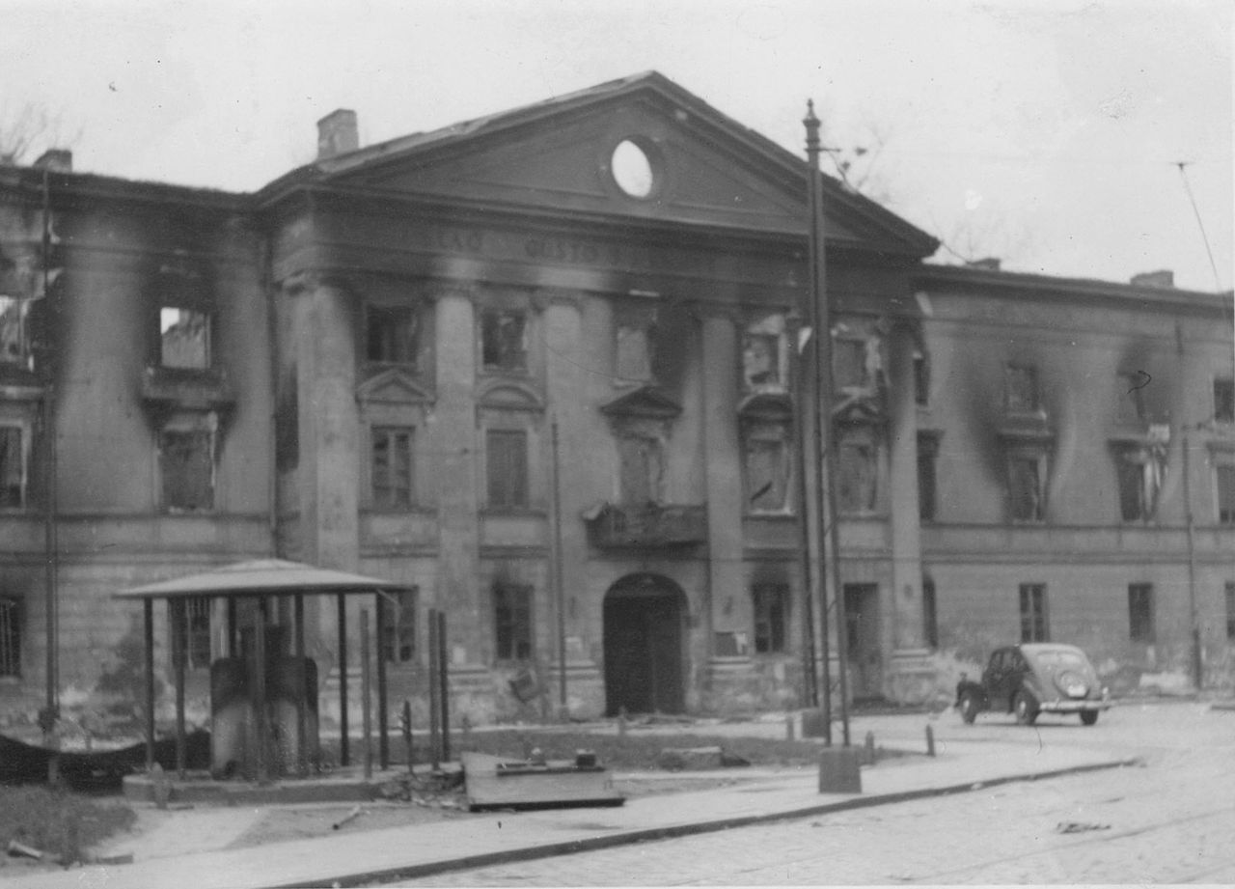
Judenrat
12 to 24 depending upon the size of the Ghetto in Warsaw some 500 to 600k
Helped the Nazi’s keep control over the Ghetto
Run the Jewish Ghetto Police under Nazi control.

Slide 49
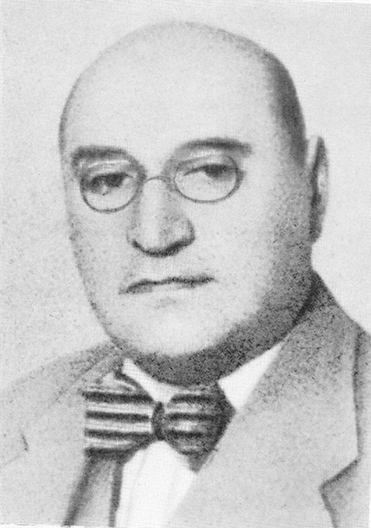
Adam Czerniaków

Slide 50
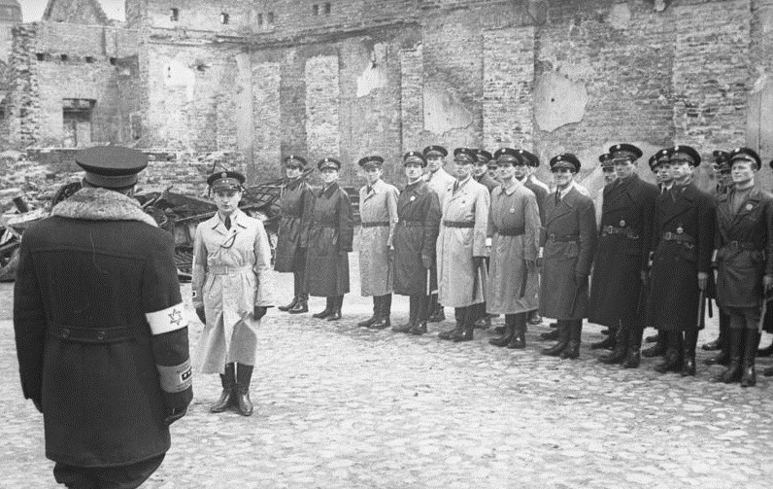
Ghetto Police

Slide 51
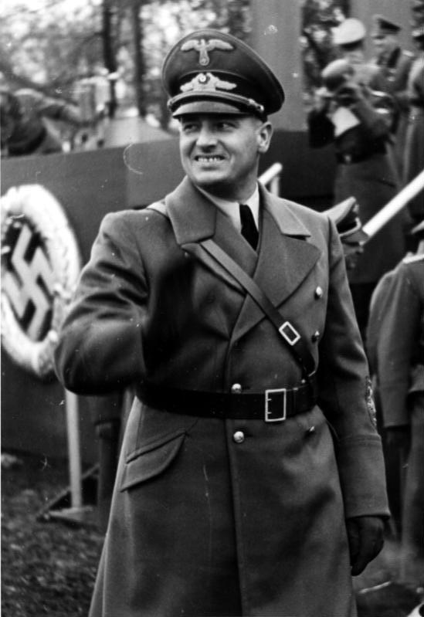
General Government of Poland

Slide 52
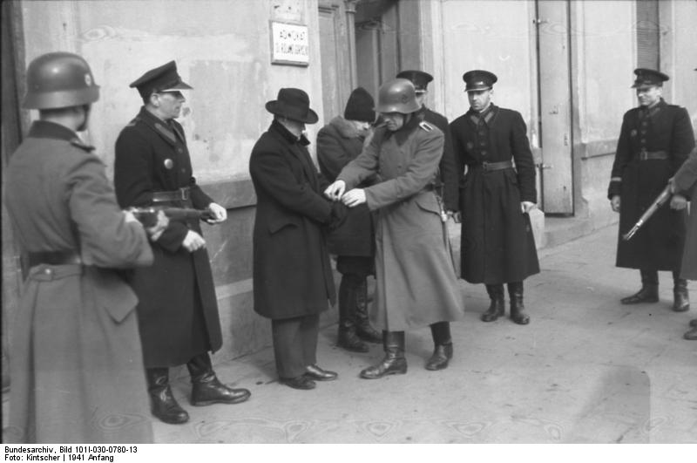
Polish Police “Blue”

Slide 53
Polish life before World War 2
Distinctly split off from Catholic Poles.
On again off again persecutions from government.
Many belonged to outlawed Communist and Socialists Parties.
Hasidic Jews persecution
Strong Zionist element.

Slide 54
3 Distinct Social Classes
All numbers approximate
Less than 20,000- the rich
Next 200,000 the inbetweeners
Bottom 200,000 plus the starving poor.

Slide 55
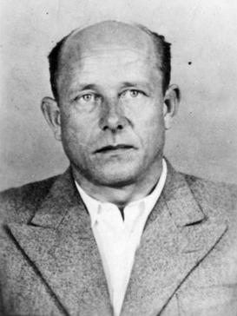
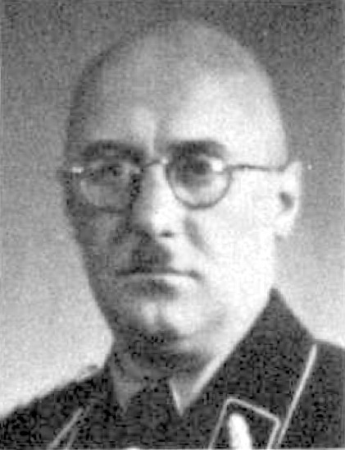
Aktion Reinhard-Grossaktion Warsaw
22 July 1942 to Sep 42 up to 15,000 per day, usually 5000 to 6000 were deported to Treblinka for “resettlement” further East.
By Jan 43 about 50k Jews remain
Hermann Hofle, Ferdinand von Sammern-Frankenegg, Odilo Globocnik

Slide 56
Deportation to the Death Camps

Slide 58
The Death Camps
6 Major Camps
Auschwitz II (Auschwitz-Birkenau)- 1.2 million
Chełmno- 152,000-340,000
Bełżec-434,500
Majdanek-78,000
Sobibór-167,000
Treblinka-750,000
Minor death camps
Maly-Trostenets Built on foundation of Soviet Gulag, Exterminate Jews of Minsk- 65,000
Jasenovac- The only non-Nazi death camp founded by Croatian Government to house Serbs, included some Jews, Gypsies- up to 500,000
At least three other minor temporary camps

Slide 59
Methods of Killing by camp
Auschwitz II (Auschwitz-Birkenau) –Zyklon B
Chełmno- CO
Bełżec-CO, small use of Zyklon B
Majdanek-CO, then Zyklon B
Sobibór-CO
Treblinka-CO
Maly-Trostenets- Mobile CO vans, bullet in the back of the head
Jasenovac- CO- Bullets, sulfer-dioxide.
Concentration Camps with small gas chambers- Dachau, Mauthausen, Buchenwald, Ravensbruck, Stutthof,

Slide 62
Death Camps Operation Period
Auschwitz II (Auschwitz-Birkenau)
Chełmno December 8, 1941 to March 1943, reopens briefly June-July 1944.
Bełżec- March 1942-December 1942
Majdanek October 1, 1941 to July 22, 1944
Sobibór April 1942- Mar 1944.
Treblinka July 23, 1942- August 19, 1943
Maly-Trostenets- May 10, 1942- June 28, 1944
Jasonovac-Aug41-Apr45

Slide 63
Extermination or Labor Camp
Pure Death Camps
Sobibor- Oper. Reinhard
Treblinka II-OR
Belzec-OR
Auschwitz-Birkenau
Maly-Trostenets
Other
Chelmno
Jasenovac
Auchswitz 1 and III
Maidenek
Treblinka I

Slide 64
Formation of fighting Groups
Both groups formed during 1st Deportations
Jews in Warsaw knew by January about the extermination camps, but it was unclear if it meant all Jews.
Knew about Treblinka in late July from Polish underground Home Army- AK
ZOB-Jewish Combat Organization- largely socialist, mixed Zionist Anti-Zionists
ZZW-Jewish Military Union- the larger and best equipped of the 2. Rightwing, included several former Polish Army veterans, but least known because Postwar Communist government suppressed group. This group had extensive ties to the Home Army.

Slide 65
Why did the Germans Stop?
The Wehrmacht made complaints about losing Jewish labor to Hitler. Hitler allowed for the workers to remain.
About 50 to 65k Jews remained, abut 25k were official workers the rest were “illegals” that had escaped the deportations and were hiding.
Disease and food conditions slightly improve.
Most, but not all, of the remainers were healthier young male and females.
The SS planned to move the workers to Lublin along with the equipment, but they had other priorities in the meantime.
The Jewish fighting groups slowly armed themselves.

Slide 66
Żydowska Gwardia Wolności-Żagiew
Jewish Freedom Guard
Jewish colloborators with the Nazi’s
Gestapo set up organization set up to infiltrate Jewish and Polish resistance.
Members targeted by ZZW and ZOB after 1st Deportations.
Abraham Gancwajch

Slide 67
January 18,1943- 2nd Deportation
German plans to liquidate ghetto, and remove the “legal” workers to Lublin.
Encounter sporadic resistance to action.
Over the next 4 days about 6000 deported, but they are attacked by ZZW and ZOB.
Unknown number of casualties, less than 20.
Judenrat and Jewish Police no longer have effective control over ghetto.

Slide 68
Assassinations by fighting groups
A number of Jewish Police are eliminated in targeted killings.
Alfred Nossig-Judenrat suspected of providing info to Gestapo killed. Feb 22, 1943
Ghetto Police commander was targeted, and forced to commit suicide. Józef Szeryński 24 Jan 43

Slide 69
Warsaw Ghetto Uprising April 19, 1943 to May 16, 1943

Slide 70
Feb and Mar 1943
Germans try carrot and stick approach.
Wehrmacht and SS battle over workers.
Under flags of truce they try to get the workers to come out to be deported to Lublin.
Sent in additional rations, medicine, etc.

Slide 71
Többens and Schultz
Manufactured socks and uniforms for the German Army
This firm alone employed 15,000 Jews.

Slide 72
2nd Deportation Apr 19, 1943
Germans plan final liquidation of Ghetto and have assembled about 2200 soldiers and police of various groups.
ZOB- according to Yitzhak Zuckerman- each ZOB member at least had a pistol w/15 to 20 rounds, and 4 homemade handgrenades. The group had about 20 rifles and 2 SMG’s
ZOB- between 220 and 500 members.
ZZW about 500, relatively unknown in arms, but ZOB said they all had rifles and some SMG’s as well as at least 1 heavy machine gun and 2 light machine guns.

Slide 73
ZOB
Tosia Altman, Mordechai Anielewicz, Yitzhak "Antek" Zuckerman, Zivia Lubetkin, Simcha "Kazik" Rotem, Marek Edelman

Slide 74
Jürgen Stroop

Slide 75
Warsaw Ghetto Uprising April 19, 1943 to May 16, 1943

Slide 76
Trawniki Men- Hiwis-Hilfswilliger
Ukrainians, Latvians, Lithuanians, helping the Germans in uniform.
Overall the Germans recruit between 2.5 3 million Hiwis.

Slide 78
Uprising
Apr 22, 45 German officers Hans Demke killed
Stoop decides to burn the Ghetto to the ground
Small scale house to house fighting as the ZZW and ZOB had fortified their positions and built bunkers
ZOB expected to die in place, ZZW built in escape routes.
By Apr 29, the Germans had focused mostly on ZZW areas and had killed their leadership. ZZW survivors fled through the Muranowski tunnel and relocated to the Michalin forest. Heavy fighting ends.
Polish AK launches limited supporting attacks.

Slide 79
ZOB
May 8 ZOB hq (Mila 18)attacked with most of the ZOB officers committing suicide either by cyanide or pistol.
Some survivors flee through sewers.
May 16 uprising ends with destruction of Great Synagogue.

